Slide 1
HTLL(High Throughput & Low Latency) Systems[mainly in .NET] - Refresher
A Note Before Starting Anything
The concepts, techniques etc mentioned in this deck can be applicable or related to concepts, techniques etc mentioned in other decks but whatever mentioned in this deck are more critical from HTLL(High Throughput and Low Latency) Systems perspective and so keeping them in this deck.Also, if someone has not worked in the concepts etc mentioned in upcoming slides in this deck, it might seem that HTLL Systems are the most complex systems but that’s not the case. Every system and project has it’s own challenges and complexities and so don’t have a prejudice about complexity and challenges of various types of systems.

Slide 2
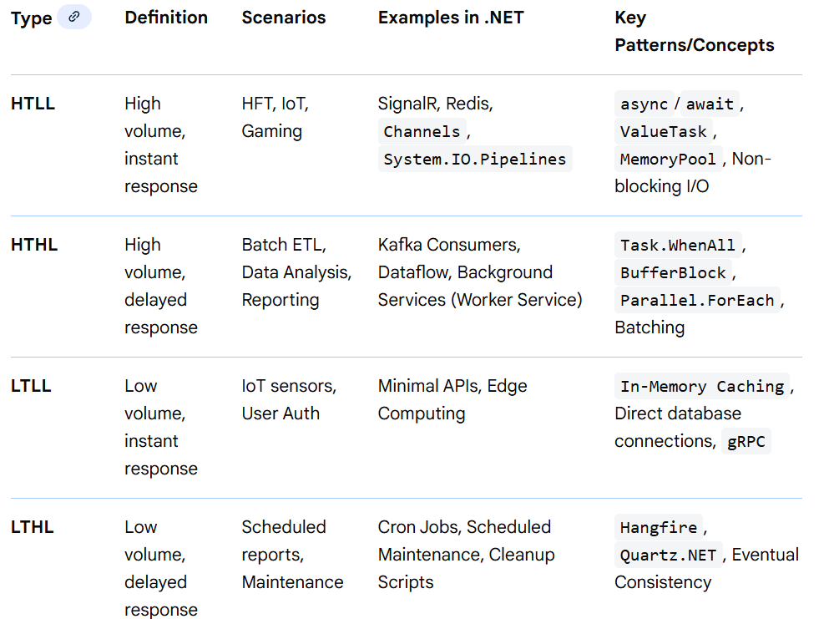
HTLL, HTHL, LTLL & LTHL
Overview
System performance is defined by the balance between throughput (volume) and latency (speed). High-Throughput, Low-Latency (HTLL) is the gold standard for real-time systems (e.g., trading), often achieved in .NET via in-memory computing and asynchronous non-blocking patterns. High-Throughput, High-Latency (HTHL) suits batch processing, utilizing massive parallelism. Low-Throughput, Low-Latency (LTLL) fits specialized, sporadic requests.

Slide 3
HTLL, HTHL, LTLL & LTHL
HTLL, HTHL, LTLL & LTHL Techniques, Patterns, Gotchas etc
High Throughput, Low Latency (HTLL)
Definitions & Goals: Handle massive request rates (10K–1M+ rps), deliver responses in ms to tens of ms, very little queuing, predictable tail-latency (P95/P99 tight) etc.
Typical Use Cases: Real-time bidding /ad exchange, High-frequency trading, Game servers, Online critical services (e.g., session auth), Telemetry ingestion with near-real-time processing, Communication Services like VOIP etc.
Concepts: Minimize garbage collection (GC), zero-copy networking, asynchronous pipelines etc.
Core Techniques & Patterns
1. Event-Driven & Non-Blocking IO
Reactor / proactor model (Netty, libuv)
Avoid 1:1 blocking threads
Backpressure at network stack
2. Lock-Free / Wait-Free Algorithms
Ring buffers (e.g., Disruptor pattern)
Atomic primitives
Sharded data structures → avoid global locks
3. Batching Without Queuing
Batch just enough to amortize cost (e.g., 10–100 msgs)
Flush on timeout + size thresholds
Avoid large internal buffers

Slide 4
HTLL, HTHL, LTLL & LTHL
HTLL, HTHL, LTLL & LTHL Techniques, Patterns, Gotchas etc
1. High Throughput, Low Latency (HTLL)
Core Techniques & Patterns
4. In-Memory Processing
Keep working set in RAM
Data structures optimized for cache locality
5. Avoid GC Stops
Off-heap data structures
GC-tuned runtimes (e.g., ZGC, Shenandoah)
Languages with real-time GC or manual memory
6. Kernel Bypass
DPDK, eBPF, RDMA for network
Zero-copy I/O
7. Load Shedding
Reject or degrade gracefully under overload
Early discard rather than queuing
Tradeoffs
Design Effect on Latency Effect on Throughput
Bigger batches Higher latency Higher efficiency
Lock-free structures Low latency High throughput
Kernel bypass Very low latency High throughput

Slide 5
HTLL, HTHL, LTLL & LTHL
HTLL, HTHL, LTLL & LTHL Techniques, Patterns, Gotchas etc
1. High Throughput, Low Latency (HTLL)
Common Gotchas
GC pauses dominating tail latencies
Synchronized metrics causing contention
Misconfigured TCP timeouts (e.g., Nagle, delayed ACKs)
Over-batching → latency spikes
Monitoring & Scaling
P99/P999 latency focus (not just average)
Backpressure metrics
Queue lengths (should be shallow)
Hot shards
Example Technologies
Languages: C/C++, Rust, Erlang, optimized Java
Frameworks: Netty, DPDK, akka-typed
Stores: Redis in-mem, Aerospike

Slide 6
HTLL, HTHL, LTLL & LTHL
HTLL, HTHL, LTLL & LTHL Techniques, Patterns, Gotchas etc
2. High Throughput, High Latency (HTHL)
Definition & Goals: Massive volume, but individual request can take seconds to minutes, Often asynchronous batch systems, Latency isn’t user-critical etc.
Typical Use Cases: ETL / Data lake ingestion, Log analytics (e.g., ELK), Bulk video transcoding, Data science pipelines, Large file transfers / backups etc.
Concepts: Parallelism, batch processing, queue-based load leveling etc.
Core Techniques & Patterns
1. Asynchronous Processing
Decouple producers and consumers
Message queues (Kafka, Pulsar)
Store results for later retrieval
2. Sharding & Partitioning
Horizontal distribution to scale
Avoid per-partition hotspots
3. Bulk & Micro-Batch
Kafka consumer groups
Batching to minimize overhead
4. Distributed Compute
MapReduce, Spark, Flink
Task trackers with dynamic slots

Slide 7
HTLL, HTHL, LTLL & LTHL
HTLL, HTHL, LTLL & LTHL Techniques, Patterns, Gotchas etc
2. High Throughput, High Latency (HTHL)
Core Techniques & Patterns
5. Data Locality
Move compute to data
HDFS, distributed file systems
Tradeoffs
Design Throughput Latency
Larger batch size ↑ throughput ↑ latency
Loose ordering ↑ throughput Not suitable for ordered workflows
Parallel partitions ↑ throughput Variable lag per partition
Common Gotchas
Long GC pauses with huge buffers
Rebalancing storms in distributed queues
State management across distributed workers
Backpressure to producers
Monitoring & Scaling
Lag metrics (consumer offsets vs end)
Task failures & retries
Data skew on partitions

Slide 8
HTLL, HTHL, LTLL & LTHL
HTLL, HTHL, LTLL & LTHL Techniques, Patterns, Gotchas etc
2. High Throughput, High Latency (HTHL)
Example Technologies
Kafka, Pulsar, Kinesis
Spark, Hadoop, Flink
S3/HDFS, Iceberg
3. Low Throughput, Low Latency (LTLL)
Definition & Goals: Few requests, but each can take long, Often compute-intensive or awaiting external slow systems etc.
Typical Use Cases: Scientific simulations, Batch billing, invoicing runs, Long external API calls, Human-in-the-loop processes etc.
Concepts: In-memory speed, minimized connection overhead.
Core Techniques & Patterns
1. Task Queues
Celery, Hangfire, RQ
Job state persistence, retries
2. Workflow Orchestration
Airflow, Temporal, Cadence
DAGs, retries, compensation logic

Slide 9
HTLL, HTHL, LTLL & LTHL
HTLL, HTHL, LTLL & LTHL Techniques, Patterns, Gotchas etc
3. Low Throughput, Low Latency (LTLL)
Core Techniques & Patterns
3. Checkpointing & Persistence
Persist intermediate state
Resume long jobs after failures
4. Circuit Breakers / Timeouts
Prevent cascading waits
Fail early with controlled fallback
Tradeoffs
Approach Complexity Benefit
Workflow engine High Robust long jobs
Simple cron Low Hard to manage failures
Common Gotchas
Orphaned jobs after crash
State consistency across restarts
Time drift in scheduler systems
Monitoring & Scaling
Job age histograms
Retry counts/failure patterns
Resource utilization (CPU/GPU)

Slide 10
HTLL, HTHL, LTLL & LTHL
HTLL, HTHL, LTLL & LTHL Techniques, Patterns, Gotchas etc
3. Low Throughput, Low Latency (LTLL)
Example Technologies
Temporal, Airflow, AWS Step Functions
Worker pools + durable queues
Databases for job state
4. Low Throughput, High Latency (LTHL)
Definition & Goals: Few requests, fast responses, Often interactive or control systems etc.
Concepts: Asynchronous background processing, idempotency.
Typical Use Cases: Admin APIs, Command/control Uis, Simple microservices, Local sensors,
Core Techniques & Patterns
1. Simple Synchronous Handling
Lightweight app servers
Minimal thread pools
2. In-Process Caches
LRU caches
Avoid remote calls
3. Optimized Routing
Direct calls, not queues

Slide 11
HTLL, HTHL, LTLL & LTHL
HTLL, HTHL, LTLL & LTHL Techniques, Patterns, Gotchas etc
4. Low Throughput, High Latency (LTHL)
Core Techniques & Patterns
4. Fine-Tuned I/O
Keep network stack simple
Avoid unnecessary middle proxies
Tradeoffs
Optimization Impact
Minimal threads Very low latency
Local in-proc state Low latency
Common Gotchas
Over-engineering for low load
Hidden blocking calls (DB over network)
Ignoring timeouts
Monitoring & Scaling
Simple request latencies
Log rare errors
Deployment health
Cross-Cutting Themes

Slide 12
HTLL, HTHL, LTLL & LTHL
HTLL, HTHL, LTLL & LTHL Techniques, Patterns, Gotchas etc
Latency vs Throughput Tradeoffs
⚖️ Batching
Batch Size Throughput Latency
Small/none ↓ throughput ↓ latency
Medium ↑ throughput moderate latency
Large highest throughput high latency
⚖️ Concurrency
More threads/tasks → ↑ throughput but risk contention → ↑ latency
Evented IO → more tasks with low latency
⚖️ Durability
Synchronous writes (fsync) → safer but slower
Async/Buffered → faster, risk partial durability
Pattern Catalogue
Pattern Best Regime Problem Solved
Event Loop / Non-Blocking IO HT-LL, LT-LL Efficient handling of many events
Partitioned Queues HT-HL Scale with demand
Circuit Breaker LT-HL, HT-LL Avoid cascading failures
Bulk-head Isolation HT-LL Contain component slowdowns
Backpressure HT-LL, HT-HL Prevent overload

Slide 13
HTLL, HTHL, LTLL & LTHL
HTLL, HTHL, LTLL & LTHL Techniques, Patterns, Gotchas etc
Pattern Catalogue
Pattern Best Regime Problem Solved
Caching LT-LL, HT-LL Reduce remote calls
Consistent Hashing HT-LL, HT-HL Even load distribution
Workflow Engines LT-HL Manage complex, long jobs
Monitoring & SLOs
Latency Metrics
Percentiles: P50, P95, P99, P99.9
Jitter: variability over time
Tail latency: critical for HT-LL
Throughput Metrics
Requests/sec
Megabytes/sec
Task completion rate
Health Signals
Queue lengths
Backpressure triggers
System saturation thresholds

Slide 14
HTLL, HTHL, LTLL & LTHL
HTLL, HTHL, LTLL & LTHL Techniques, Patterns, Gotchas etc
Technology Mapping
Regime Transport/Queue Compute Model Storage
HT-LL Aeron/DPDK, Kafka (small msgs) Event loop, async In-mem (Redis, Aerospike)
HT-HL Kafka/Pulsar Spark/Flink Distributed FS (S3/HDFS)
LT-HL RabbitMQ/SQS Temporal/Airflow Durable DB
LT-LL HTTP/gRPC Simple sync Local cache/DB
Pitfalls & Gotchas (Summary)
HT-LL
Hidden blocking calls
Unbounded queues
GC pauses dominate tail
HT-HL
Data skew kills throughput
Rebalance storms
Fault domain correlated failures
LT-HL
Job state loss
Scheduler drift
Quiet failures unnoticed

Slide 15
HTLL, HTHL, LTLL & LTHL
HTLL, HTHL, LTLL & LTHL Techniques, Patterns, Gotchas etc
LT-LL
Over-engineering
Ignoring dependency costs
Decision Guidance
📌 Need sub-10ms at 100K rps? → HT-LL: evented IO, lock-free, in-memory, backpressure
📌 Massive data processing where minutes are acceptable? → HT-HL: batching, distributed compute
📌 Critical long jobs? → LT-HL: durable task queues, workflow engine
📌 Low volume interactive APIs? → LT-LL: simple, fast sync, local caches

Slide 16
Building HTLL Systems in .NET(High Level Techniques)
Building ultra-low latency, high-throughput APIs in .NET requires a multi-faceted approach, combining optimized code, efficient infrastructure use, and system design best practices.
I. Code-Level Optimizations
Asynchronous Programming (Async/Await): Use async and await for all I/O-bound operations (database calls, external API calls, file I/O) to prevent blocking the main thread pool threads. This allows the server to handle thousands of concurrent requests with a small pool of threads, drastically improving throughput.
Minimize Object Allocations and GC Pressure: The .NET Garbage Collector (GC) pauses can introduce latency, especially with large objects (>= 85,000 bytes).Minimize allocations in "hot code paths" (frequently called code).Consider using Span<T>, Memory<T>, ArrayPool<T>, MemoryPool<T> for efficient memory management and buffer pooling. Use structs without managed references where possible for performance-critical sections (e.g., data processing).
Efficient Data Serialization: Use the built-in System.Text.Json over third-party libraries like Newtonsoft.Json, as it's optimized for performance with UTF-8 and supports asynchronous reading/writing. Configure it for performance (e.g., JsonSerializerOptions with PropertyNameCaseInsensitive = false). Consider Protocol Buffers (Protobuf) for even smaller payloads.
Minimize Exceptions: Avoid using exceptions for normal program flow, as throwing and catching exceptions is slow. Use a Result object pattern or conditional checks instead.
Use lock-free pipelines: use System.Threading.Channels
Use Minimal APIs: Consider using Minimal APIs in ASP.NET Core, as they remove some of the default middleware overhead of traditional MVC controllers, potentially processing more requests per second with less memory.

Slide 17
Building HTLL Systems in .NET(High Level Techniques)
I. Code-Level Optimizations
Minimize Middleware: Only include necessary middleware in your ASP.NET Core pipeline.
Use the Latest .NET Version: Each release of .NET Core/later versions includes significant performance improvements in the runtime and libraries.
Native AOT (Ahead-Of-Time Compilation): Compile to native code for significant startup time reduction and smaller footprints, using <PublishAot>true</PublishAot> in your .csproj.
II. Data Access Optimization
Aggressive Caching: Store frequently accessed data in a fast, in cache (MemoryCache or distributed cache like Redis) to avoid repeated database round trips.
Optimize Database Queries:
Use asynchronous data access methods (e.g., ToListAsync()).
Use AsNoTracking() for read-only queries in Entity Framework Core to avoid the overhead of tracking entities for changes.
Retrieve only the necessary data using projections (LINQ's .Select()) and pagination for large datasets.
Ensure proper indexing on frequently queried columns to speed up lookups.
Connection Pooling: Leverage built-in database connection pooling to minimize the expensive overhead of establishing new connections for every request.
Offload Heavy Tasks: For long-running or non-critical tasks (e.g., email sending, report generation), offload them to background services using message queues like RabbitMQ or Azure Service Bus.

Slide 18
Building HTLL Systems in .NET(High Level Techniques)
III. Infrastructure and System Design
Minimize Round Trips: Combine related requests (e.g., batching, GraphQL).
Optimize Kestrel and Protocols:
Use the high-performance Kestrel web server, the default in ASP.NET Core.
Enable HTTP/2 and HTTP/3 protocols for features like multiplexing, which reduces connection overhead.
Load Balancing and Horizontal Scaling: Distribute incoming traffic across multiple API instances using a load balancer (e.g., NGINX, AWS ALB) to ensure consistent latency under high load.
Response Compression: Enable compression (Gzip or Brotli) to reduce payload size, leading to faster data transfer times.
Reduce Dependencies: Fewer external calls mean lower latency.
Content Delivery Networks (CDNs): Use a CDN to serve static assets from locations geographically closer to users, reducing network latency.
Monitoring and Profiling: Continuously monitor performance using Application Performance Management (APM) tools (e.g., Application Insights, Datadog) and profile bottlenecks with tools like BenchmarkDotNet or dotTrace. This data-driven approach is essential for identifying and addressing specific latency issues.

Slide 19
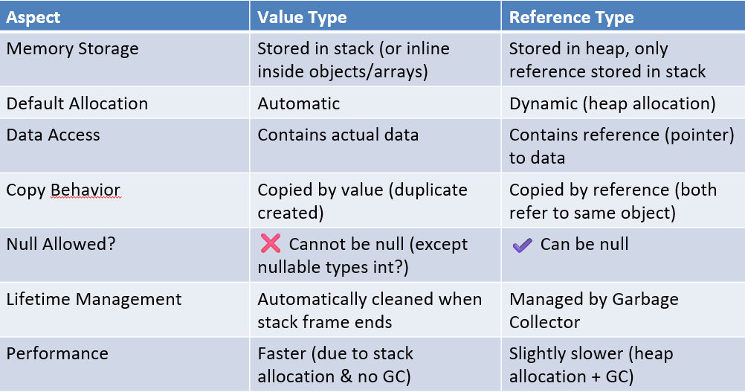
Some Basic (.NET) Concepts(but very important w.r.t HTLL Systems)
Value & Reference Types

Slide 20
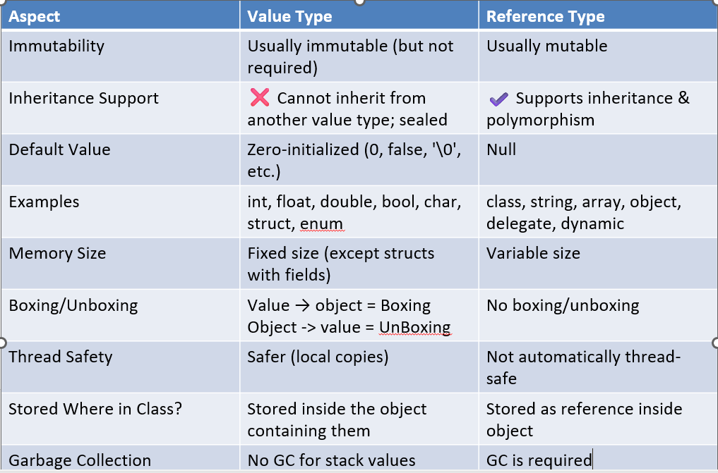
Some Basic (.NET) Concepts(but very important w.r.t HTLL Systems)
Value & Reference Types

Slide 21
Some Basic (.NET) Concepts(but very important w.r.t HTLL Systems)
Value & Reference Types
⭐ Quick Summary
Value Types
Hold data directly
Copied by value
Fast
No inheritance
Stored in stack
Reference Types
Hold address of data
Copied by reference
Garbage collected
Support inheritance
Stored in heap.

Slide 22
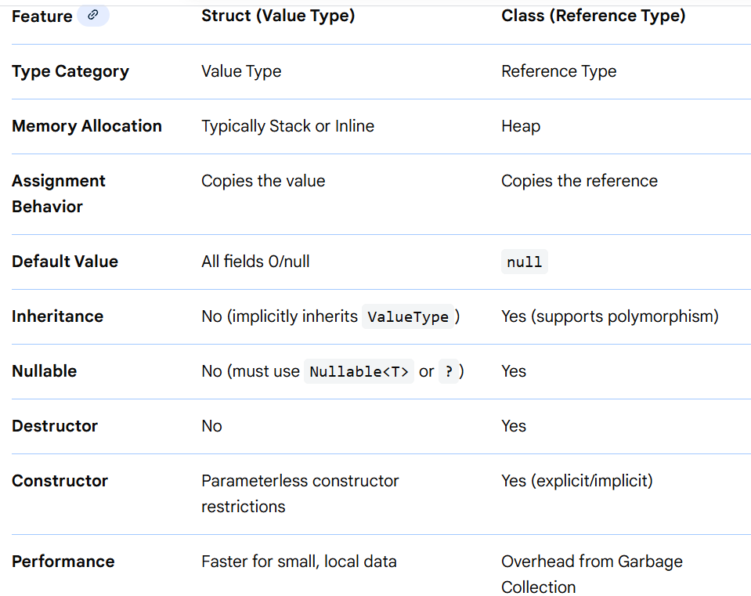
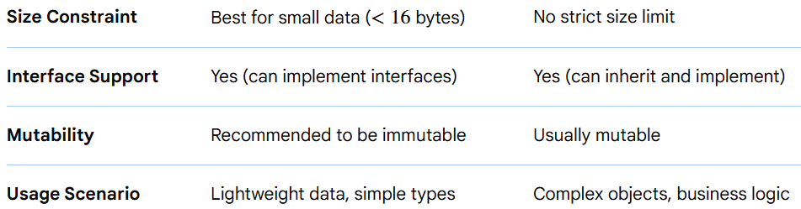
Some Basic (.NET) Concepts(but very important w.r.t HTLL Systems)
Struct & Class

Slide 23
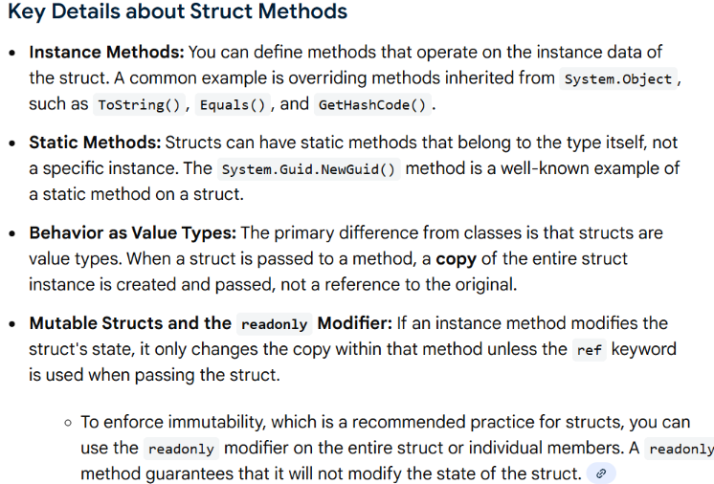
Some Basic (.NET) Concepts(but very important w.r.t HTLL Systems)
Struct & Class
Key Differences Breakdown
Memory Management: Structs are stored on the stack and immediately freed when they go out of scope, avoiding GC overhead. Classes are allocated on the heap, requiring garbage collection.
Assignment/Passing: When a struct is passed to a method, a full copy is made, which is fast for small structures but inefficient for large ones. When a class is passed, only the reference (pointer) is copied.
Inheritance: Structs cannot inherit from other structs or classes, nor can they be used as a base class. Classes are fully supported by Object-Oriented Programming principles, allowing inheritance.
Nullability: Structs cannot be null unless explicitly defined as Nullable<T>.
Best Practices: Use structs for simple data structures like points, colors, or pairs of values that are lightweight. Use classes for complex, entity-based objects in a domain model. For HTLL systems wherever possible use structs rather than classes.

Slide 24
Some Basic (.NET) Concepts(but very important w.r.t HTLL Systems)
Multidimensional & Jagged Array
1️⃣ Multidimensional Array (Rectangular Array)
✅ Best suited when
Data is strictly rectangular
Every row has exactly the same number of columns
Memory layout should be contiguous
Indexing logic is fixed and predictable
❌ Avoid when
Row sizes vary
Frequent resizing is needed
📌 Example 1: Image Pixel Matrix
Used in CNN preprocessing, medical imaging, satellite imagery, etc.
public sealed class GrayscaleImage
{
private readonly byte[,] _pixels;
public int Width { get; }
public int Height { get; }
public GrayscaleImage(int width, int height)
{
if (width <= 0 || height <= 0)

Slide 25
Some Basic (.NET) Concepts(but very important w.r.t HTLL Systems)
Multidimensional & Jagged Array
1️⃣ Multidimensional Array (Rectangular Array)
📌 Example 1: Image Pixel Matrix
public sealed class GrayscaleImage
{
// earlier code in earlier slide
throw new ArgumentException("Invalid image dimensions.");
Width = width;
Height = height;
_pixels = new byte[height, width]; // row-major
}
public byte GetPixel(int row, int col)
{
ValidateIndices(row, col);
return _pixels[row, col];
}
public void SetPixel(int row, int col, byte value)
{
ValidateIndices(row, col);
_pixels[row, col] = value; }

Slide 26
Some Basic (.NET) Concepts(but very important w.r.t HTLL Systems)
Multidimensional & Jagged Array
1️⃣ Multidimensional Array (Rectangular Array)
📌 Example 1: Image Pixel Matrix
public sealed class GrayscaleImage
{
// earlier code in earlier slide
public double ComputeAverageIntensity()
{
long sum = 0;
for (int i = 0; i < Height; i++)
{
for (int j = 0; j < Width; j++)
{
sum += _pixels[i, j];
}
}
return sum / (double)(Width * Height);
}

Slide 27
Some Basic (.NET) Concepts(but very important w.r.t HTLL Systems)
Multidimensional & Jagged Array
1️⃣ Multidimensional Array (Rectangular Array)
📌 Example 1: Image Pixel Matrix (Computer Vision / ML Preprocessing)
public sealed class GrayscaleImage
{
// earlier code in earlier slides
private void ValidateIndices(int row, int col)
{
if (row < 0 || row >= Height || col < 0 || col >= Width)
throw new IndexOutOfRangeException();
}
}
✔ Why multidimensional here?
Image is always rectangular
Memory locality → faster CNN preprocessing
Cleaner indexing: [row, col]

Slide 28
Some Basic (.NET) Concepts(but very important w.r.t HTLL Systems)
Multidimensional & Jagged Array
1️⃣ Multidimensional Array (Rectangular Array)
📌 Example 2: Seat Allocation System (Airline / Theater)
public class SeatingLayout
{
private readonly bool[,] _seats;
public SeatingLayout(int rows, int seatsPerRow)
{
_seats = new bool[rows, seatsPerRow];
}
public bool BookSeat(int row, int seat)
{
if (_seats[row, seat])
return false;
_seats[row, seat] = true;
return true;
}

Slide 29
Some Basic (.NET) Concepts(but very important w.r.t HTLL Systems)
Multidimensional & Jagged Array
1️⃣ Multidimensional Array (Rectangular Array)
📌 Example 2: Seat Allocation System (Airline / Theater)
public class SeatingLayout
{
// earlier code in earlier slide
public int CountAvailableSeats()
{
int count = 0;
foreach (bool seat in _seats)
{
if (!seat) count++;
}
return count;
}
}
2️⃣ Jagged Array (Array of Arrays)
✅ Best suited when
Rows have different lengths
Data is hierarchical

Slide 30
Some Basic (.NET) Concepts(but very important w.r.t HTLL Systems)
Multidimensional & Jagged Array
2️⃣ Jagged Array (Array of Arrays)
✅ Best suited when
Performance matters (jagged arrays are faster in .NET than multidimensional arrays)
You need flexible memory allocation
❌ Avoid when
Data is strictly rectangular
Simple mathematical matrix operations
📌 Example 1: Student Marks (Real-World Academic System)
Each student has different number of subjects.
public class StudentMarks
{
private readonly int[][] _marks;
public StudentMarks(int studentCount)
{
if (studentCount <= 0)
throw new ArgumentException("Invalid student count.");
_marks = new int[studentCount][];
}

Slide 31
Some Basic (.NET) Concepts(but very important w.r.t HTLL Systems)
Multidimensional & Jagged Array
2️⃣ Jagged Array (Array of Arrays)
📌 Example 1: Student Marks (Real-World Academic System)
public class StudentMarks
{
// earlier code in earlier slide
public void AddMarks(int studentIndex, int[] marks)
{
if (marks == null || marks.Length == 0)
throw new ArgumentException("Marks cannot be empty.");
_marks[studentIndex] = marks;
}
public class StudentMarks
{
// Earlier code in earlier slide
public double GetAverage(int studentIndex)
{
int[] marks = _marks[studentIndex]
?? throw new InvalidOperationException("Marks not assigned.");
return marks.Average(); }}

Slide 32
Some Basic (.NET) Concepts(but very important w.r.t HTLL Systems)
Multidimensional & Jagged Array
✔ Why jagged here?
Students may take different numbers of subjects
Memory efficient
Faster iteration than [,]
📌 Example 2: Monthly Sales by Region (Business Analytics)
Different regions → different number of stores.
public sealed class SalesData
{
private readonly decimal[][] _monthlySales;
public SalesData(int regionCount)
{
_monthlySales = new decimal[regionCount][];
}
public void SetRegionSales(int regionIndex, decimal[] sales)
{
if (sales == null)
throw new ArgumentNullException(nameof(sales));
_monthlySales[regionIndex] = sales;
}

Slide 33
Some Basic (.NET) Concepts(but very important w.r.t HTLL Systems)
Multidimensional & Jagged Array
📌 Example 2: Monthly Sales by Region (Business Analytics)
public sealed class SalesData
{
// earlier code in earlier slide
public decimal GetTotalSales()
{
decimal total = 0;
foreach (var region in _monthlySales)
{
if (region == null) continue;
foreach (var sale in region)
{
total += sale;
}
}
return total;
}
}

Slide 34
Some Basic (.NET) Concepts(but very important w.r.t HTLL Systems)
Multidimensional & Jagged Array
3️⃣ Comparison (Very Important)
Feature Multidimensional [,] Jagged [][]
Memory layout Contiguous Fragmented
Access speed Slower Faster
Flexibility Fixed High
.NET optimization Poor Excellent
Real-world usage Images, matrices Business data, logs
📌 Microsoft Recommendation:
Prefer jagged arrays over multidimensional arrays in performance-critical code.
4️⃣ Summary (One-liner)
Use multidimensional arrays for true mathematical matrices or images,
Use jagged arrays for real-world irregular data and performance-critical systems.

Slide 35
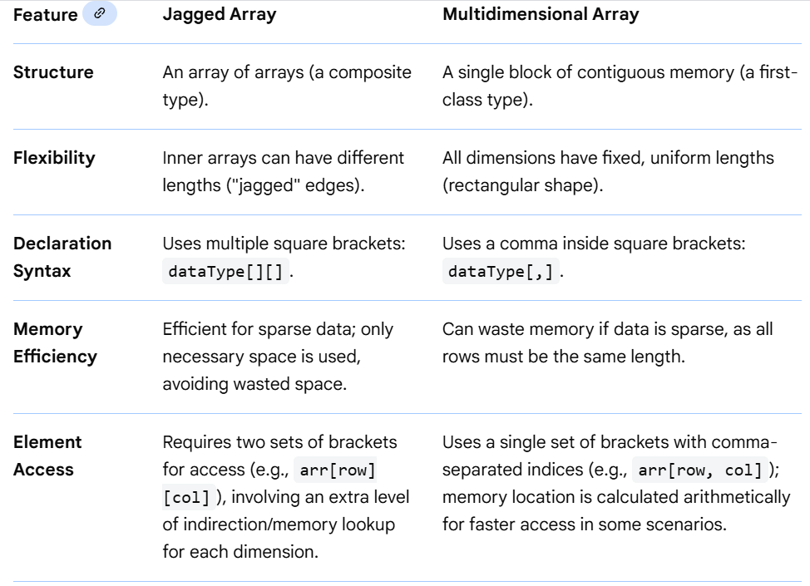
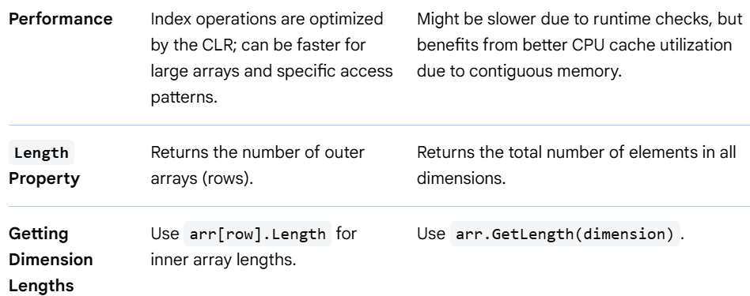
Some Basic (.NET) Concepts(but very important w.r.t HTLL Systems)
Multidimensional & Jagged Array(Detailed Comparison Summary)

Slide 36
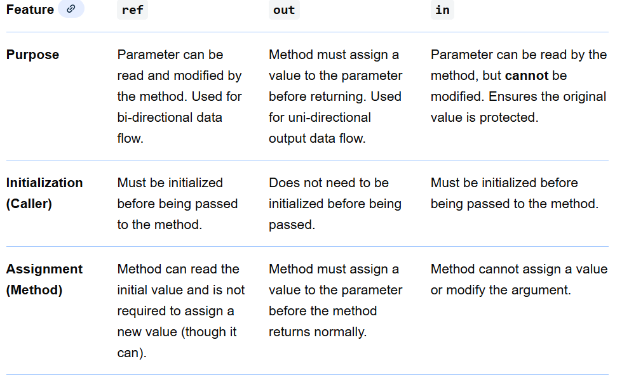
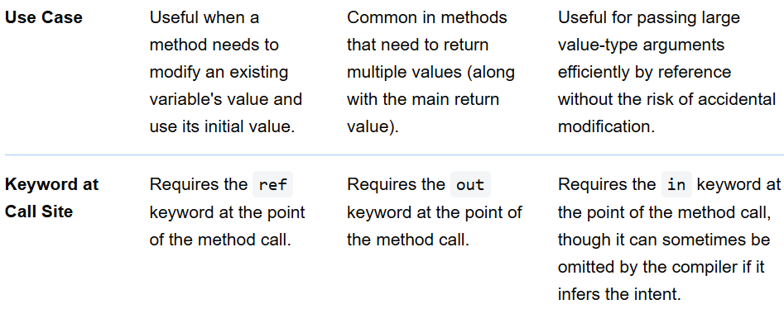
Some Basic (.NET) Concepts(but very important w.r.t HTLL Systems)
ref, in & out

Slide 37
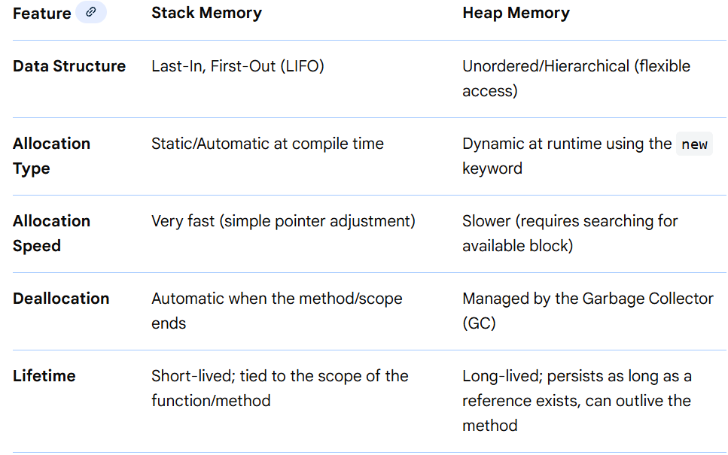
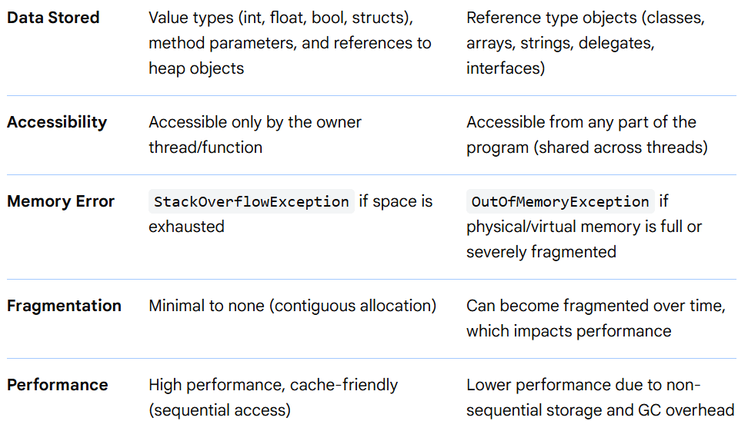
Some Basic (.NET) Concepts(but very important w.r.t HTLL Systems)
Stack Memory & Heap Memory

Slide 38
Some Basic (.NET) Concepts(but very important w.r.t HTLL Systems)
Stack Memory & Heap Memory
Key Concepts
Value Types in C# (like int, char, bool, struct) generally store their value directly on the stack, providing fast access.
Reference Types (like class, object, string, array) are always allocated on the heap. A reference (pointer) to the heap object is stored on the stack, allowing the object to be accessed.
The Garbage Collector (GC) is the .NET runtime component responsible for automatically reclaiming memory from unused objects on the heap, preventing memory leaks (in most cases).
Memory allocated with the stackalloc expression is placed on the stack, and it is automatically discarded when the method returns, offering a way to improve performance for short-lived buffers.

Slide 39
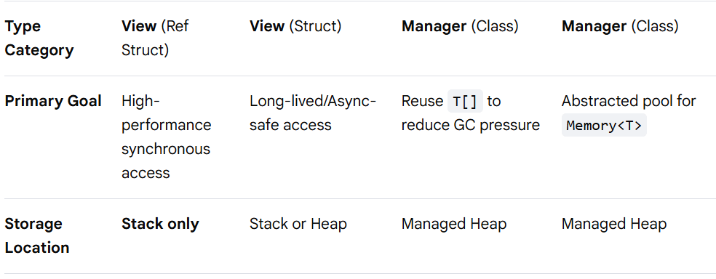
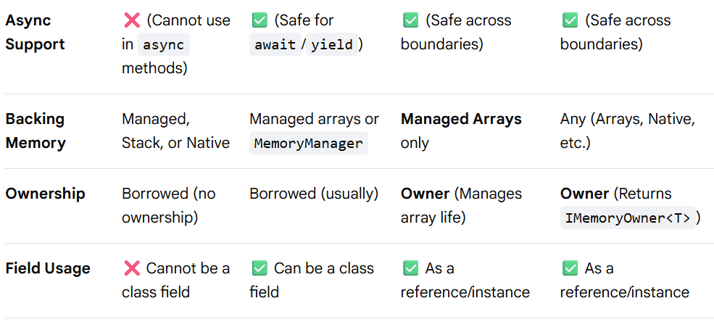
Some Basic (.NET) Concepts(but very important w.r.t HTLL Systems)
Span<T>, Memory<T>, ArrayPool<T> & MemoryPool<T>

Slide 40
Some Basic (.NET) Concepts(but very important w.r.t HTLL Systems)
Span<T>, Memory<T>, ArrayPool<T> & MemoryPool<T>
Key Contextual Differences
View vs. Pool: Span<T> and Memory<T> are views—they don't "own" the data, they just point to it. ArrayPool<T> and MemoryPool<T> are factories that provide the actual memory to those views.
The "Ref Struct" Constraint: Because Span<T> is a ref struct, it is physically tied to the current execution stack. This makes it impossible to use in async methods where the state machine might "pause" and move to a different thread/stack.
For Further Exploration
Memory<T> and Span<T> usage guidelines - .NET | Microsoft Learn
Introduction to the High Performance package - Community Toolkits for .NET | Microsoft Learn

Slide 41
Some Basic (.NET) Concepts(but very important w.r.t HTLL Systems)
Hot Path
In performance engineering, the “hot path” is the small slice of code that runs most frequently and dominates runtime/latency.
Think of it as: where the CPU actually spends its life 🔥
What “hot” really means
A path is hot when it is:
Executed very often (loops, message handlers, request pipelines)
Responsible for most CPU cycles or latency
On the critical latency path (especially in HFT, real-time systems, low-latency services)
80–90% of execution time usually lives in 10–20% of the code.
Examples
.NET / Backend
Order matching loop in an exchange
Kafka / Service Bus message processing handler
Serialization / deserialization in request pipeline
Allocation-heavy LINQ in a tight loop
Systems / Infra
Packet parsing in network stack
Lock acquisition in a high-contention section
Polling loop / event dispatch loop

Slide 42
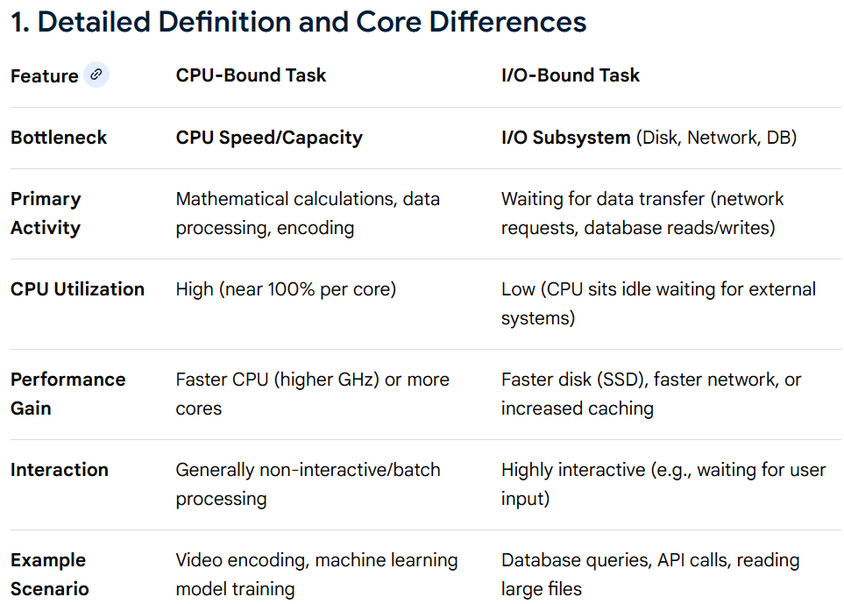
Some Basic (.NET) Concepts(but very important w.r.t HTLL Systems)
CPU Bound vs IO Bound

Slide 43
Some Basic (.NET) Concepts(but very important w.r.t HTLL Systems)
CPU Bound vs IO Bound
Techniques to Handle and Optimize
The goal for both is to maximize utilization, but they require opposite strategies: parallelism for CPU-bound, concurrency for I/O-bound.
A. Handling CPU-Bound Tasks
The strategy is to divide the work and use more compute power.
Multiprocessing: Launch multiple processes, each running on a separate CPU core (ideal for Python/Node.js to bypass the Global Interpreter Lock (GIL) or single-thread constraint).
Parallel Algorithms/Multithreading: Structure code to divide a task into smaller, independent chunks that run in parallel.
GPU/Specialized Hardware Acceleration: Offload heavy computations (like matrix multiplication) to GPUs or FPGAs.
Algorithm Optimization: Refactor algorithms to reduce computational complexity (e.g., using
instead of ).
Worker Pools/Clusters: In Node.js, use worker_threads or cluster module to distribute tasks across cores.
B. Handling I/O-Bound Tasks
The strategy is to keep the CPU busy with other tasks while waiting for I/O to complete.
Asynchronous I/O (Async/Await): Initiate I/O tasks (like network requests) and allow the program to continue executing other code while waiting.

Slide 44
Some Basic (.NET) Concepts(but very important w.r.t HTLL Systems)
CPU Bound vs IO Bound
B. Handling I/O-Bound Tasks
Multithreading: Use many threads; when one thread blocks waiting for I/O, the operating system context-switches to another active thread.
Caching: Store frequently accessed data in memory (RAM) or fast key-value stores (e.g., Redis) to avoid repeated disk or network I/O.
Batching/Buffering: Read/write data in large chunks rather than many small requests to reduce I/O overhead.
Non-Blocking Event Loops: Use frameworks like Node.js or Vert.x that handle thousands of connections on a single thread.
Real-World Scenarios and Mixed Workloads
Rarely is a system 100% one or the other.
Web Server: Receives a request (I/O), parses JSON (CPU), queries database (I/O), serializes data (CPU).
Handling Mixed: Use asynchronous I/O for database/network calls, but immediately hand off heavy computation (e.g., image resizing) to a worker thread/process pool to avoid blocking the main server loop.

Slide 45
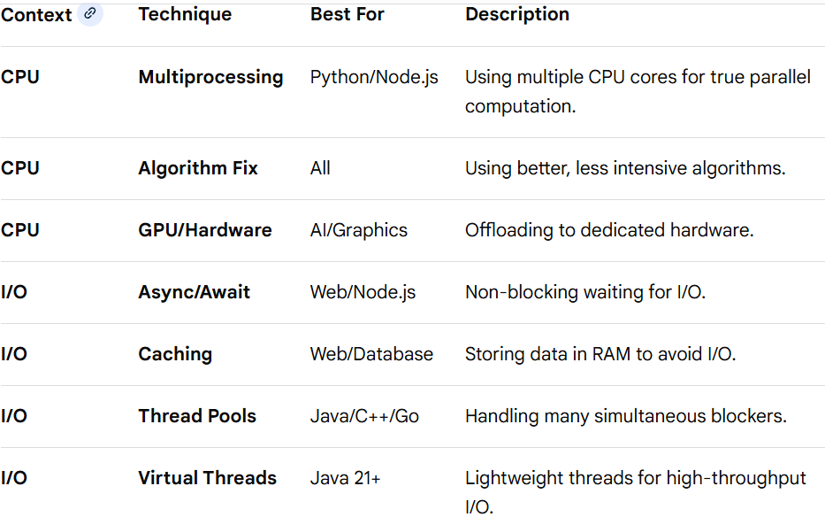
Some Basic (.NET) Concepts(but very important w.r.t HTLL Systems)
CPU Bound vs IO Bound
Optimization Strategies

Slide 46
Garbage Collection
1. Core Mental Model (First Principles)
What GC really solves
GC solves memory safety + lifetime management, not performance.
In .NET:
You allocate freely.The runtime decides when memory is reclaimed.You trade deterministic destruction for safety + productivity.GC answers “Is this object still reachable?”, not “Is it still needed?”
2. Reachability & Object Lifetime
Roots (Where GC starts)
An object is alive if it is reachable from GC roots:
GC Roots
Local variables on stacks (method frames)
Static fields
CPU registers
Thread-local storage
Finalization queue
Handles (GCHandle, P/Invoke)
If no root → object is eligible for collection
💡 Insight
Lifetime ≠ scope
An object can outlive its creating method if referenced elsewhere.

Slide 47
Garbage Collection
3. Generational GC (The Big Optimization)
The Hypothesis: Most objects die young
The .NET GC divides the managed heap into logical generations and physical regions.
A. Logical generations
Gen 0
Gen 1
Gen 2
Physical regions
SOH (Small Object Heap) – objects < ~85 KB
LOH (Large Object Heap) – objects ≥ ~85 KB
POH (Pinned Object Heap) – pinned objects (newer runtimes)
B. Mapping: Generations → Heap Regions → Algorithms
Small Object Heap (SOH)
Generation Typical Lifetime GC Type Algorithm Used
Gen 0 Very short-lived Minor GC Mark → Compact
Gen 1 Short-to-medium Minor GC Mark → Compact
Gen 2 Long-lived Full GC Mark → Sweep → Compact

Slide 48
Garbage Collection
4 . Why These Algorithms Are Chosen
Why SOH uses Mark–Compact
Small objects are numerous
Fragmentation would be disastrous
Moving objects is cheap relative to size
Enables fast linear allocation
SOH allocation:
[Free][Free][Free] → allocate → bump pointer
Why LOH uses Mark–Sweep
Objects are large
Moving them is expensive (CPU + memory bandwidth)
Pinning large objects is common (buffers, arrays)
Fragmentation is tolerated to avoid movement cost
LOH allocation:
[Obj][Free][Obj][Free][Obj]

Slide 49
Garbage Collection
5. Visual Mapping Summary
├── SOH
│ ├── Gen 0 → Mark + Compact
│ ├── Gen 1 → Mark + Compact
│ └── Gen 2 → Mark + Sweep + Compact
├── LOH
│ └── Gen 2 → Mark + Sweep (Compact optional)
└── POH
└── Gen 2 → Mark + Sweep (No compaction)
6. GC Collection Scope
GC Trigger Collected Areas
Gen 0 GC Gen 0 only
Gen 1 GC Gen 0 + Gen 1
Gen 2 GC Gen 0 + Gen 1 + Gen 2 + LOH + POH
7. One-Liners
“All LOH objects belong to Gen 2 logically.”
“SOH is compacted; LOH is swept.”
“Mark–compact favors allocation speed; mark–sweep favors movement avoidance.”
“LOH compaction is explicit, not automatic.”

Slide 50
Garbage Collection
8. Practical Implications (Very Important)
Performance Gotchas
Frequent large allocations → LOH fragmentation
Long-lived large arrays → Gen 2 pressure
Pinning → worsens fragmentation
Best Practices
Reuse large buffers (ArrayPool)
Avoid frequent large allocations
Trigger LOH compaction only when necessary
9. Allocation Mechanics (Why new Is Cheap)
Bump Pointer Allocation
Allocation = pointer increment
No free-list lookup
Almost as fast as stack allocation
var obj = new MyClass(); // extremely cheap
💡 GC is optimized for allocation, not retention

Slide 51
Garbage Collection
10. Small Object Heap (SOH) vs Large Object Heap (LOH)
Threshold
< 85 KB → SOH
≥ 85 KB → LOH
Differences
Aspect SOH LOH
Compaction Yes No (by default)
Allocation Fast Slower
Fragmentation Low High
💡 Classic Gotcha
byte[] buffer = new byte[100_000]; // LOH allocation
LOH Compaction
Available since .NET 4.5+
Opt-in:
GCSettings.LargeObjectHeapCompactionMode =
GCLargeObjectHeapCompactionMode.CompactOnce;
11. Workstation GC vs Server GC
Workstation GC
Optimized for UI responsiveness
Single heap
Used by desktop apps

Slide 52
Garbage Collection
11. Workstation GC vs Server GC
Server GC
Optimized for throughput
One heap per core
Used by ASP.NET, microservices
{
"runtimeOptions": {
"gcServer": true
}
}
💡Insight
Server GC scales linearly with cores but uses more memory.
12. Background GC
Problem
Gen 2 collections cause long pauses
Solution
Background GC
Gen 2 runs concurrently
Gen 0/1 collections continue
💡 Enabled by default in Server GC

Slide 53
Garbage Collection
13 . Finalization (The Most Misunderstood Part)
What is a Finalizer?
~MyClass()
{
// cleanup
}
What really happens
Object becomes unreachable
Moved to finalization queue
Finalizer thread runs later
Object becomes collectible next GC
💥 Gotchas
Finalizers delay reclamation
Finalizable objects survive at least 2 GCs
Finalizer thread is single-threaded
14.. IDisposable & Deterministic Cleanup
Correct Pattern
Using( var stream = new FileStream(...))

Slide 54
Garbage Collection
14. IDisposable & Deterministic Cleanup
Why Dispose exists
GC handles memory
Dispose handles resources
File handles
Sockets
DB connections
Full Dispose Pattern (Advanced)
protected virtual void Dispose(bool disposing)
{
if (disposing)
{
// managed cleanup
}
// unmanaged cleanup
}
💡 Rule
GC ≠ resource management

Slide 55
Garbage Collection
15. Suppressing Finalization
GC.SuppressFinalize(this);
Use when:
You cleaned up manually
Finalizer is unnecessary now
16. GC Handles (Advanced Interop)
Handle Type Purpose
Normal Prevent collection
Pinned Prevent movement
Weak Weak reference
💥 Pinned handles cause fragmentation
17. Pinned Objects & Fragmentation
Why pinning is bad
Prevents compaction
Creates holes in memory
Hurts Gen 2

Slide 56
Garbage Collection
17. Pinned Objects & Fragmentation
Common Causes
fixed
P/Invoke
Large pinned buffers
Solution
Pin short-lived
Use ArrayPool<T>
Use Span<T>
19. Allocation Pressure Patterns
Bad Patterns
Creating objects in tight loops
Boxing (int → object)
LINQ in hot paths
Large temporary buffers
Good Patterns
Object pooling
Structs (when appropriate)
Reuse buffers

Slide 57
Garbage Collection
19.. Structs vs Classes (GC Impact)
Aspect Struct Class
Allocation Stack/inline Heap
GC None Yes
Copy cost Higher Reference
💡 Gotcha
Large structs can be worse than classes
20. Escape Analysis (Limited)
JIT can stack-allocate some objects
Very conservative
Do not rely on it
21. GC Pauses & Latency
What causes pauses
Gen 2 collections
LOH fragmentation
Finalizers
Excessive allocation

Slide 58
Garbage Collection
21. GC Pauses & Latency
Measuring
PerfView
dotnet-counters
EventPipe
22. Explicit GC Calls (Almost Always Wrong)
GC.Collect(); // 🚫
Only valid when:
App shutdown
Controlled benchmarking
After massive one-time allocation
23 . GC Tuning Knobs (Advanced)
Setting Effect
GCHeapHardLimit Memory cap
GCLatencyMode Pause vs throughput
SustainedLowLatency Real-time-ish workloads

Slide 59
Garbage Collection
24. GC & Async/Await
State machines allocate objects
Captured variables extend lifetime
async void can leak
25. GC in ASP.NET / Microservices
Common Issues
Singleton holding scoped services
HttpClient misuse
Large JSON allocations
Best Practices
Reuse HttpClient
Pool buffers
Avoid per-request large allocations
26. “Insights”
GC is optimized for allocation
Promotion is expensive
Finalizers are poison unless needed
LOH fragmentation kills performance
GC does not manage unmanaged resources
Most “memory leaks” are reference leaks

Slide 60
Garbage Collection
27. Mental Checklist
✔ Are objects short-lived?
✔ Are large objects reused?
✔ Are finalizers avoided?
✔ Is LOH fragmentation controlled?
✔ Is Server GC enabled where needed?

Slide 61
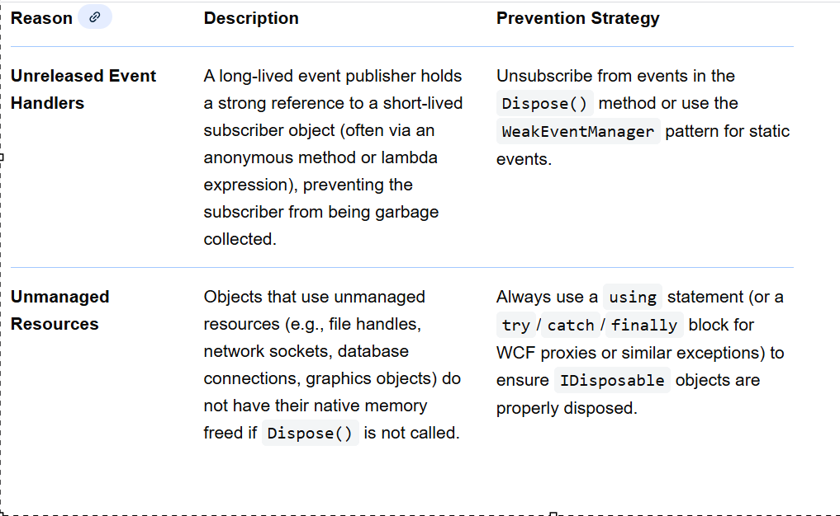
Garbage Collection
Common Reasons for Memory Leaks in .NET Managed Code

Slide 62
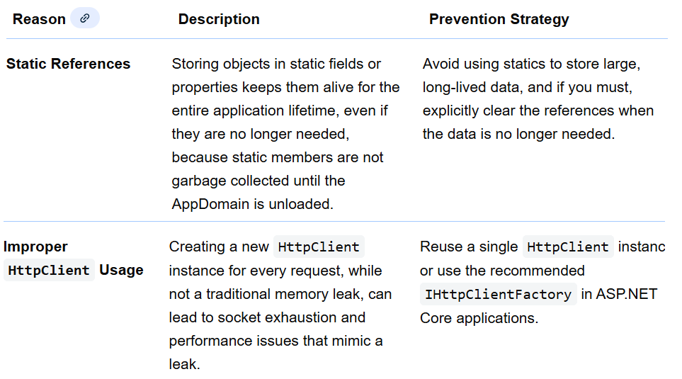
Garbage Collection
Common Reasons for Memory Leaks in .NET Managed Code

Slide 63
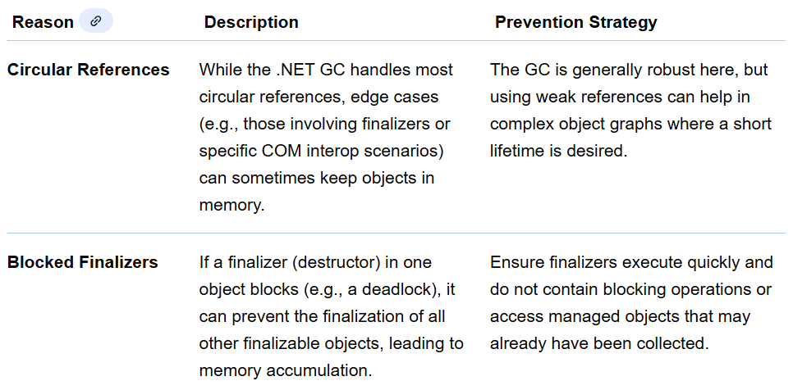
Garbage Collection
Common Reasons for Memory Leaks in .NET Managed Code

Slide 64
Garbage Collection
Weak References
1. Weak References — the core idea
A weak reference allows the GC to collect an object even if it’s still referenced—as long as all remaining references are weak.
In .NET:
WeakReference<T> wr = new(obj);
Key rule:
Weak refs are for observation, not ownership
2. Weak References and Events (⚠️ the biggest leak source)
The problem: Event subscriptions cause hidden memory leaks
publisher.SomeEvent += subscriber.Handle;
Why this leaks
publisher holds a strong reference to subscriber
If publisher lives long (static, global, singleton)
subscriber can never be GC’ed
The problem: Event subscriptions cause hidden memory leaks
publisher.SomeEvent += subscriber.Handle;
Why this leaks
publisher holds a strong reference to subscriber, If publisher lives long (static, global, singleton), subscriber can never be GC’ed.This is the classic .NET memory leak.

Slide 65
Garbage Collection
Weak References
2. Weak References and Events (⚠️ the biggest leak source)
❌ Bad pattern (strong event reference)
public class Publisher
{
public event EventHandler SomethingHappened;
}
If Publisher is long-lived → subscribers leak.
✅ Weak Event Pattern
Option 1: WeakReference manually
class WeakEventHandler
{
private readonly WeakReference<EventHandler> _handler;
public WeakEventHandler(EventHandler handler)
{
_handler = new WeakReference<EventHandler>(handler);
}
public void Invoke(object sender, EventArgs e)
{ if (_handler.TryGetTarget(out var h))
h(sender, e); }}

Slide 66
Garbage Collection
Weak References
2. Weak References and Events (⚠️ the biggest leak source)
✅ Weak Event Pattern
Option 1: WeakReference manually
Used internally by event manager.
Option 2: WeakEventManager (WPF)
WeakEventManager<Publisher, EventArgs>
.AddHandler(publisher, nameof(publisher.SomeEvent), subscriber.Handle);
✔ Preferred in UI frameworks
❌ Not available everywhere
When to use weak events
Scenario Use weak events?
UI components ✅ YES
Plugins / extensibility ✅ YES
Domain models ⚠️ Maybe
Short-lived publishers ❌ NO

Slide 67
Garbage Collection
Weak References
3. Weak References and Static Objects
The problem: static fields live forever
static Cache _cache = new Cache();
Anything referenced by _cache cannot be collected.
❌ Bad static cache
static Dictionary<string, LargeObject> _cache = new();
This grows forever.
✅ WeakReference-based cache
static Dictionary<string, WeakReference<LargeObject>> _cache = new();
Usage:
if (_cache.TryGetValue(key, out var wr) &&
wr.TryGetTarget(out var obj))
{
return obj;
}
✔ Object is GC-able
✔ Cache becomes self-cleaning

Slide 68
Garbage Collection
Weak References
3. Weak References and Static Objects
⚠️ Prefer ConditionalWeakTable
ConditionalWeakTable<Key, Value> table;
Key advantages:
Automatic cleanup
Thread-safe
Zero resurrection risk
Used internally by:
ASP.NET
WPF
Runtime services
When weak statics make sense
Use case Weak reference?
Metadata caching ✅
Object annotations ✅
Configuration ❌
Critical state ❌

Slide 69
Garbage Collection
Weak References
4. Weak References and Captured Variables (Closures)
The problem: closures extend object lifetime
void Register()
{
var bigObject = new BigObject();
timer.Elapsed += (s, e) =>
{
bigObject.DoWork();
};
}
Why this leaks
Lambda captures bigObject
Delegate is stored somewhere long-lived
bigObject can never be GC’ed
❌ Hidden closure leak pattern
Task.Run(() =>
{
_service.Process(_hugeData);
});

Slide 70
Garbage Collection
Weak References
4. Weak References and Captured Variables (Closures)
Even after task completes, references may persist in:
Queues
Schedulers
Thread pools
✅ Weak reference inside closure
var weak = new WeakReference<BigObject>(bigObject);
timer.Elapsed += (s, e) =>
{
if (weak.TryGetTarget(out var obj))
obj.DoWork();
};
✔ Closure survives
✔ Object doesn’t
Closure rule of thumb
Closures keep everything alive — unless weakened

Slide 71
Garbage Collection
Weak References
5. Weak References and Threads / Tasks
The problem: threads strongly root objects
new Thread(() => worker.Run()).Start();
Thread keeps delegate alive
Delegate keeps captured objects alive
Objects survive until thread exits
❌ Long-running thread leak
class Worker
{
public void Start()
{
new Thread(() =>
{
while (true)
DoWork();
}).Start();
}
}
Worker can never be collected.

Slide 72
Garbage Collection
Weak References
5. Weak References and Threads / Tasks
✅ Weak reference for background workers
var weakWorker = new WeakReference<Worker>(this);
new Thread(() =>
{
while (weakWorker.TryGetTarget(out var w))
{
w.DoWork();
Thread.Sleep(1000);
}
}).Start();
✔ Thread exits naturally
✔ Worker GC’ed safely
Tasks & async: same risk
Task.Delay(Timeout.Infinite).ContinueWith(_ =>
{
service.Run();
});
Use cancellation tokens or weak refs.

Slide 73
Garbage Collection
Weak References
6. When NOT to use WeakReference ❌
Scenario Why
Business invariants Object may disappear
Transactions Non-deterministic
Security context Unsafe
Core state Fragile
Weak references trade determinism for memory safety
7. WeakReference vs Alternatives
Tool Better for
WeakReference<T> Observers, plugins
ConditionalWeakTable Metadata
IDisposable Event cleanup
CancellationToken Async/thread lifetime
Scoped DI Ownership clarity

Slide 74
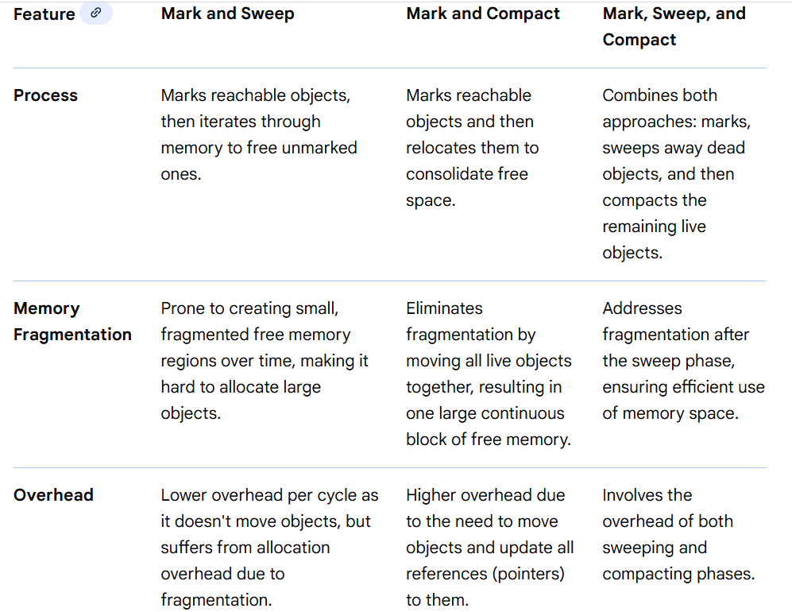
Garbage Collection
GC Algos

Slide 75
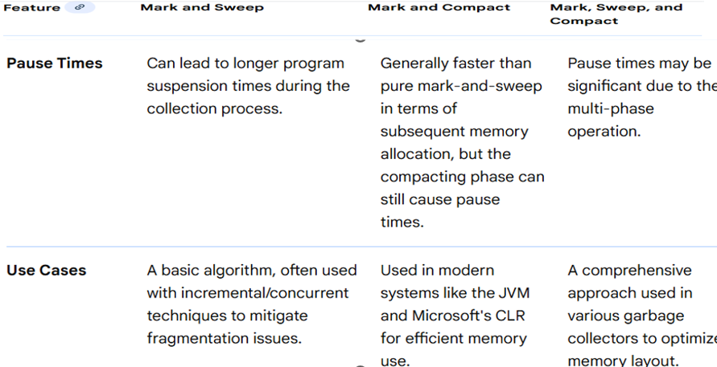
Garbage Collection
GC Algos

Slide 76
Garbage Collection
GC Allocation and Pauses Minimisation
Mental model first (important).
You don’t “optimize GC”.
You optimize object lifetime & allocation rate.
GC pain comes from:
Too many allocations.
Long-lived objects.
Large objects (LOH).
High allocation rate under load.
1️⃣ Reduce allocations (highest ROI).
🔹 Avoid per-request / per-message allocations.
Common culprits:
new objects in hot paths.
LINQ.
string concatenation.
closures / lambdas capturing variables.
❌ Bad:
messages.Select(m => Process(m)).ToList();

Slide 77
Garbage Collection
GC Allocation and Pauses Minimisation
✅ Better:
foreach (var m in messages).
{.
Process(m);
}.
🔹 Use struct carefully.
Good for:
Small, immutable, short-lived data.
No boxing.
Passed by ref.
❌ Bad struct:
Large (>16–32 bytes).
Mutable.
Stored in collections.
🔹 Prefer stack allocation.
Span<byte> buffer = stackalloc byte[256];
Use for:
Parsing.
Serialization.
Temporary buffers.

Slide 78
Garbage Collection
GC Allocation and Pauses Minimisation
2️⃣ Object pooling (huge in servers).
🔹 Pool expensive or frequent objects.
Examples:
Buffers.
Message envelopes.
DTOs.
Serialization objects.
Use:
ArrayPool<T>.
ObjectPool<T> (Microsoft.Extensions.ObjectPool)
var buffer = ArrayPool<byte>.Shared.Rent(4096);
try
{
// use buffer
}
finally
{
ArrayPool<byte>.Shared.Return(buffer);
}

Slide 79
Garbage Collection
GC Allocation and Pauses Minimisation
2️⃣ Object pooling (huge in servers).
⚠️ Rules:
Always clear sensitive data.
Never retain pooled objects.
3️⃣ Control large objects (LOH = GC killer).
🔹 Avoid allocations > 85 KB.
Anything ≥ ~85 KB goes to Large Object Heap.
Bad:
new byte[100_000].
Large strings.
Huge arrays per request.
Fixes:
Chunk data.
Reuse via pooling.
Stream instead of buffering.
4️⃣ Minimize string allocations.
🔹 Avoid string concatenation.
❌.
var s = a + ":" + b + ":" + c;

Slide 80
Garbage Collection
GC Allocation and Pauses Minimisation
4️⃣ Minimize string allocations.
✅
var sb = new StringBuilder();
sb.Append(a).Append(':').Append(b).Append(':').Append(c);
Or even better:
Span<char> buffer = stackalloc char[64];
🔹 Use ReadOnlySpan<char> / Span<char>.
Parsing without allocations:
ReadOnlySpan<char> span = input.AsSpan();
Used heavily in:
JSON.
Protocol parsing.
Headers.
Routing logic.
5️⃣ Kill hidden allocations (very common)
🔹 Watch for these silent allocators
Feature Hidden Allocation
LINQ Iterators, closures
async/await State machines
Exceptions Stack trace allocation

Slide 81
Garbage Collection
GC Allocation and Pauses Minimisation
5️⃣ Kill hidden allocations (very common)
Feature Hidden Allocation
Boxing object, interfaces
Logging Interpolated strings
🔹 Logging best practice
❌
_logger.LogInformation($"User {id} failed at {step}");
✅
_logger.LogInformation("User {UserId} failed at {Step}", id, step);
Structured logging avoids string allocations.
6️⃣ Tune async & concurrency
🔹 Avoid async in ultra-hot paths
Async allocates:
State machine
Continuations
Prefer:
Sync + batching
Channels
Dedicated worker loops

Slide 82
Garbage Collection
GC Allocation and Pauses Minimisation
6️⃣ Tune async & concurrency
Example (good pattern):
while (await channel.Reader.WaitToReadAsync())
{
while (channel.Reader.TryRead(out var item))
{
Process(item);
}
}
This is GC-friendly and cache-friendly.
7️⃣ Reduce Gen2 pressure (pause killer)
Gen2 collections cause long pauses.
Avoid:
Static caches growing forever
Event handlers never unsubscribed
Singleton holding per-request objects
Rules:
Clear references aggressively
Prefer weak references for caches
Bounded caches (LRU)

Slide 83
Garbage Collection
GC Allocation and Pauses Minimisation
8️⃣ GC configuration (last step, not first)
🔹 Server GC
For services:
<ServerGarbageCollection>true</ServerGarbageCollection>
🔹 GC Heap Hard Limit (containers!)
Critical in AKS / Kubernetes:
DOTNET_GCHeapHardLimit=1500m
Prevents GC death spiral under memory pressure.
9️⃣ Measure before & after (non-negotiable)
🔹 Tools
dotnet-counters
dotnet-trace
PerfView
BenchmarkDotNet
EventPipe
Key metrics:
Allocation rate (MB/sec)
Gen0/1/2 counts
Pause duration
LOH size

Slide 84
Garbage Collection
GC Allocation and Pauses Minimisation
10️⃣ Architectural patterns that help GC
Pattern Why
Event loop Predictable allocations
Batching Fewer objects
Channels Bounded memory
Backpressure Prevent allocation storms
Streaming Avoid buffers
Quick GC checklist
No LINQ in hot path
No large allocations per request
Pools for buffers & DTOs
Structured logging
Bounded queues
Measure allocation rate
Container GC limits set

Slide 85
Garbage Collection
For Further Exploration
Disposable Class Example
Garbage Collection and Performance - .NET | Microsoft Learn
How does Garbage Collection work?
C# Garbage Collection Tutorial – Stackify
What are the Generations in Garbage Collection? - Stack Overflow
Find, Fix, and Avoid Memory Leaks in C# .NET: 8 Best Practices
Understanding weak references in .NET- CodeProject
Understanding ConditionalWeakTable - Stack Overflow
WeakReference Event Handlers
In-memory caching in .Net. In-memory caching is a common technique
Usages of object resurrection - Stack Overflow
.NET Memory Management and Optimization Techniques for Large-Scale Applications
8 Techniques to Avoid GC Pressure and Improve Performance in C# .NET
Effective-.NET-Memory-Management
Advanced Garbage Collection Concepts
How the Mark-Sweep-Compact Algorithm Works
Why is .NET 9's Performance So Good? with Stephen Toub
.NET GC FAQ
Analyzing Memory Dumps of .NET Applications | Microsoft Learn
Analyze memory usage for .NET objects - Visual Studio (Windows) | Microsoft Learn
Mastering .NET Performance: How to Analyze and Optimize Memory (Heap Allocation)
CLR Profiler – Wikipedia
PerfView is a CPU and memory performance-analysis tool

Slide 86
Memory Hierarchy
A memory hierarchy organizes computer storage into levels, from tiny, super-fast CPU registers to massive, slow secondary storage (like SSDs/HDDs), balancing speed, cost, and capacity to give the illusion of large, fast memory, using principles like locality of reference to keep frequently used data closer to the processor. Levels generally include Registers, Cache (L1, L2, L3), Main Memory (RAM), and Secondary Storage (SSD, HDD), each with increasing capacity and access time as you move down.
Levels of the Memory Hierarchy
Registers: Fastest, smallest, on-chip CPU storage for immediate data.
Cache Memory (L1, L2, L3): Very fast, small buffers between CPU and RAM, stores frequently used data/instructions.
Main Memory (RAM): Larger, slower than cache, primary working memory for active programs.
Secondary Storage (SSD, HDD): Large, non-volatile, long-term storage, much slower than RAM.
Tertiary/Offline Storage (Tape Drives): Slowest, largest, used for backups and archiving.
Key Characteristics & Principles
Speed & Cost Trade-off: Faster memory is more expensive and smaller; slower memory is cheaper and larger.
Capacity: Increases as you move down the hierarchy (Registers < Cache < RAM < Disk).
Locality of Reference: Programs tend to reuse data and instructions recently accessed, justifying the hierarchy's structure.
Performance Optimization: By keeping popular data in faster tiers, the overall system performance improves dramatically.

Slide 87
Memory Hierarchy
C# constructs map to the memory hierarchy through CLR-managed structures like the stack (fast, local variable access) and heap (large object storage/Garbage Collected). CPU caches are utilized via contiguous memory structures like struct arrays and Span<T>, while MemoryMappedFile connects file storage directly to RAM.
Memory Hierarchy Mapping in C#
Registers (Fastest): Used by the JIT compiler for local variables and intermediate calculations.
CPU Cache (L1/L2/L3):
Arrays (T[]): Data stored contiguously in memory, enhancing cache locality.
struct (Value Types): Stored inline, reducing pointer dereferencing and cache misses.
Span<T> / Memory<T>: Provide safe, contiguous views over managed or unmanaged memory, optimizing cache usage.
RAM (Main Memory):
Stack: Stores value types and method references; automatically managed.
Heap: Stores reference types and large objects.
Large Object Heap (LOH): Dedicated area for objects > 85,000 bytes, avoiding frequent compaction.
Disk (Storage):
System.IO.MemoryMappedFiles: Directly maps file data to application virtual memory, allowing for fast I/O.
Virtual Memory: Managed by the OS; data not immediately in RAM is swapped to disk.

Slide 88
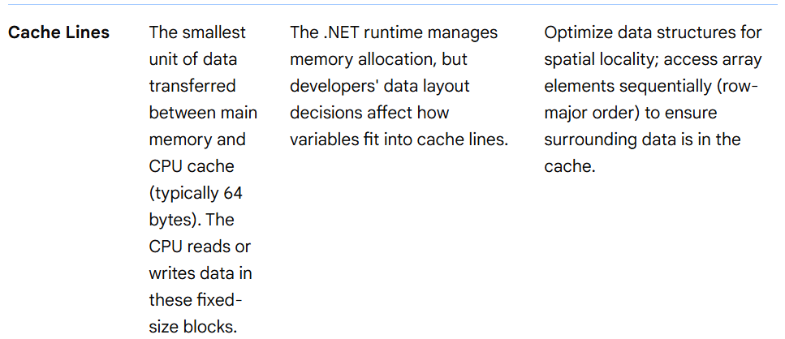
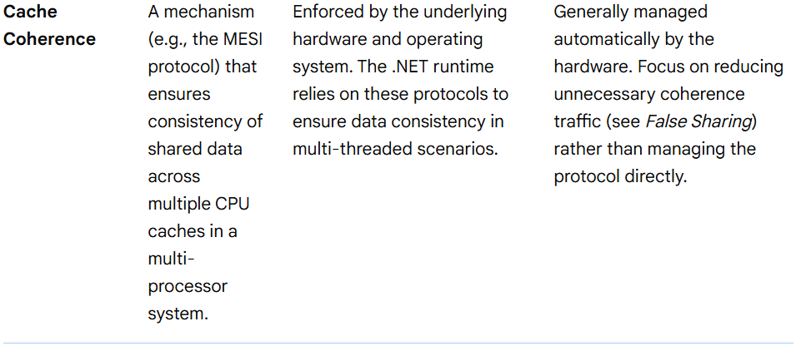
Memory Hierarchy
Key Performance Constructs
stackalloc: Allocates memory directly on the stack for high-performance, short-lived buffers.
UnmanagedMemoryStream: Accesses unmanaged memory directly.
struct vs class: Structs (value types) are stored on the stack or inline within heap objects, while classes are always heap-allocated, impacting garbage collection overhead.
Some Other Important Memory Hierarchy related Concepts

Slide 89
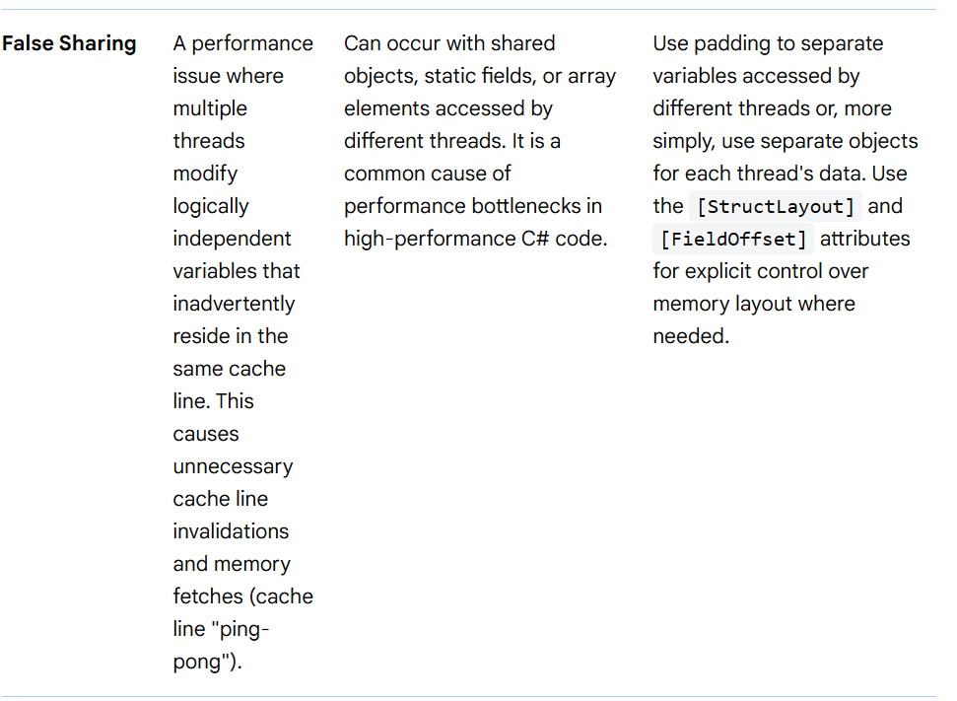
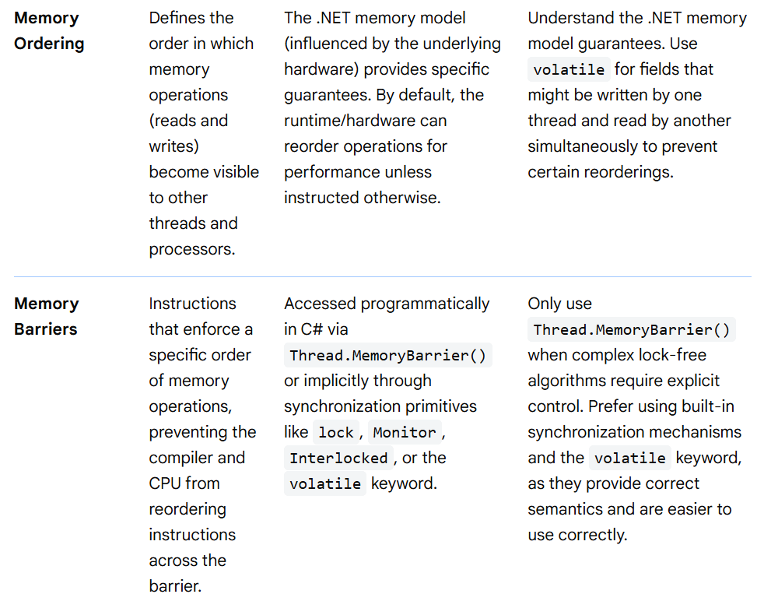
Memory Hierarchy
Some Other Important Memory Hierarchy related Concepts

Slide 90
Memory Hierarchy
NUMA
1. What is NUMA?
NUMA = Non-Uniform Memory Access
System has multiple CPU sockets (nodes)
Each node has local memory
Accessing:
Local memory → fast
Remote node memory → slower
CPU Node 0 <--> Memory 0 (fast)
CPU Node 1 <--> Memory 1 (fast)
CPU Node 0 ---> Memory 1 (slow)
NUMA matters for:
High-core servers
Large RAM machines
Latency-sensitive workloads

Slide 91
Memory Hierarchy
NUMA
3. .NET Garbage Collector and NUMA
or
<!-- app.config -->
<configuration>
<runtime>
<gcServer enabled="true" />
</runtime>
</configuration>
✔ Strongly recommended for NUMA systems.
4. Thread Scheduling & NUMA in .NET
Default behavior
.NET threads are scheduled by the OS
OS tries to keep:
Thread
Memory
CPU core on the same NUMA node
ThreadPool behavior
ThreadPool threads migrate

Slide 92
Memory Hierarchy
NUMA
4. Thread Scheduling & NUMA in .NET
Can cause:
Remote memory access
Cache misses
This is acceptable for:
Web APIs
Typical backend services
But problematic for:
Low-latency systems
High-frequency trading
Scientific computing
5. Manual NUMA Control in .NET (Advanced)
5.1 Pin threads to CPUs (Affinity)
using System.Diagnostics;
Process.GetCurrentProcess().ProcessorAffinity =
(IntPtr)(1 << 4); // Pin to CPU core 4
⚠ This is dangerous unless you know:
Core layout
NUMA topology

Slide 93
Memory Hierarchy
NUMA
5. Manual NUMA Control in .NET (Advanced)
5.2 NUMA APIs via P/Invoke (Windows)
You can query NUMA nodes using Win32:
[DllImport("kernel32.dll")]
static extern bool GetNumaHighestNodeNumber(out uint nodeNumber);
You can also:
Allocate memory on specific NUMA nodes
Bind threads to nodes
But this is very advanced and rarely worth it.
6. ASP.NET Core + NUMA Best Practices
Recommended configuration
Enable Server GC
Use Kestrel + async/await
Avoid excessive thread creation
Use multiple processes instead of massive threading

Slide 94
Memory Hierarchy
NUMA
6. ASP.NET Core + NUMA Best Practices
Example:
dotnet MyApp.dll --urls=http://localhost:5000
Run one process per NUMA node (advanced servers):
NUMA Node 0 → App Instance 1
NUMA Node 1 → App Instance 2
Handled via:
Windows Processor Groups
Linux numactl
7. Linux + .NET + NUMA
Run .NET app pinned to a NUMA node
numactl --cpunodebind=0 --membind=0 dotnet MyApp.dll
This ensures:
Threads run on Node 0
Memory allocated from Node 0
✔ Very effective for performance-critical services.

Slide 95
Memory Hierarchy
NUMA
8. When should YOU care about NUMA in .NET?
You should care if:
Scenario NUMA Tuning
Web API / MVC ❌ Not needed
Background services ❌
High-throughput batch jobs ⚠ Maybe
In-memory caches (Redis-like) ✔
ML / Scientific workloads ✔✔
Ultra-low latency systems ✔✔✔
9. Common Pitfalls
❌ Using Workstation GC on servers
❌ Excessive thread hopping
❌ One huge process on multi-socket machines
❌ Ignoring Linux NUMA settings
10. Practical Recommendation (TL;DR)
If you're unsure:
✔ Enable Server GC
✔ Let the OS handle NUMA
✔ Scale using multiple processes, not threads

Slide 96
Memory Hierarchy
NUMA
10. Practical Recommendation (TL;DR)
Only do manual NUMA tuning if:
You measured performance issues
You understand your hardware topology

Slide 97
Memory Hierarchy
For Further Exploration
What Every Programmer Should Know About Memory
A Primer on Memory Consistency and Cache Coherence
Cache coherence – Wikipedia
Cache Coherence - GeeksforGeeks
False sharing - Wikipedia
Cache and Memory Hierarchy Design
Optimizing-Applications-for-NUMA
Exploring NUMA Optimization with Real World Scenarios
NUMA | Virtualization Tuning and Optimization Guide | Red Hat
CPU Performance Tuning Guide
Computer Systems : A Programmer’s Perspective
Computer Architecture: A Quantitative Approach
Modern Computer Architecture and Organization

Slide 98
Read and Write Amplification
Write amplification (WA) and read amplification (RA) are performance metrics, primarily in SSDs and databases, measuring excess operations compared to user-requested data. Write amplification is the ratio of physical data written to the flash to data written by the host, often caused by garbage collection, reducing drive lifespan. Read amplification is the ratio of data read from storage to requested data.
Key Details on Amplification:
Write Amplification (WA): Occurs when 1MB of data sent by the application results in, for instance, 3MB being written to the flash, leading to a WA factor of 3. High WA accelerates SSD wear.
Causes: Primarily driven by NAND flash's need to erase existing data blocks before writing new data, requiring garbage collection to move existing valid data to new locations. Other factors include storage engine design, compaction processes, and data organization.
Read Amplification (RA): Refers to reading more data than required by the user, impacting latency and performance.
Measurement: Calculated by dividing total flash writes by host writes; a ratio of 1 indicates no amplification.
Impact: Both types of amplification consume bandwidth and reduce the endurance and speed of flash-based storage devices.

Slide 99
Read and Write Amplification
Mitigation:
Garbage Collection: Choosing blocks with fewer valid pages as "victims" reduces the amount of data to be copied.
Data Partitioning: Separating data based on update frequency (temperature) can lower write amplification.
Controller Design: Improved controller algorithms and data compression can minimize amplification.
For Further Exploration –
What is Read Amplification?
Write amplification - Wikipedia
Deep Dive on Read, Write, and Space Amplification in SSDs and LSM Storage Engines and What Makes VelarixDB Distinct
Notes on Write Amplification versus Read Perspiration | Jay Gandhi

Slide 100
DOP(Data Oriented Programming)
1. What is Data-Oriented Programming (DOP)?
Most programming taught traditionally is Object-Oriented Programming (OOP):
DOP’s core idea: Structure data so that the CPU can process it efficiently with minimal cache misses.
2. Why DOP Matters (Performance Example)
CPU fetches memory in cache lines (usually ~64 bytes).
If your data is scattered across heap (typical OOP objects), CPU keeps doing cache misses → slow.
If your data is in arrays of structs, CPU loads many elements in one go → fast.
OOP Focus | DOP Focus
Organize code around objects and behavior | Organize memory layout around how data is accessed
Concerned with abstraction, inheritance, encapsulation | Concerned with CPU cache efficiency, batching, data pipelines
Data often scattered in heap | Data is stored contiguously, cache-friendly

Slide 101
DOP(Data Oriented Programming)
3. Traditional OOP vs DOP Example
OOP Version
class Enemy
{
public float X;
public float Y;
public float Speed;
}
List<Enemy> enemies = new List<Enemy>();
foreach (var enemy in enemies)
{
enemy.X += enemy.Speed;
}
Problem: Each Enemy is a separate heap object → scattered memory → CPU cache misses.

Slide 102
DOP(Data Oriented Programming)
Data Oriented Version
Instead of list of objects → structure of arrays:
float[] X = new float[100000];
float[] Y = new float[100000];
float[] Speed = new float[100000];
for (int i = 0; i < X.Length; i++)
{
X[i] += Speed[i]; // blazing fast - contiguous memory
}
Benefit: Access pattern is linear and cache-friendly.
4. Struct of Arrays (SoA) vs Array of Structs (AoS)
Array of Structs (AoS) (Classic)
struct Enemy { public float X, Y, Speed; }
Enemy[] enemies;
Struct of Arrays (SoA) (Data-Oriented)
float[] X;
float[] Y;
float[] Speed;
SoA is usually faster when processing individual fields across many items.

Slide 103
DOP(Data Oriented Programming)
5. Real Use Case: Physics Simulation
Not that Good Performance Wise(OOP):
class Particle { public Vector3 pos, vel; }
foreach (var p in particles)
p.pos += p.vel * dt;
Good (DOP):
Vector3[] pos;
Vector3[] vel;
for (int i = 0; i < pos.Length; i++)
pos[i] += vel[i] * dt;
6. Using DOP in C# (with Span<T>, ref struct, Memory<T>)
Example using Span<T> for contiguous memory:
Span<float> xs = stackalloc float[1000];
Span<float> speeds = stackalloc float[1000];
for (int i = 0; i < xs.Length; i++)
xs[i] += speeds[i];

Slide 104
DOP(Data Oriented Programming)
7. Data-Oriented Design + Multithreading
DOP simplifies parallelization, because each index is independent.
Parallel.For(0, X.Length, i =>
{
X[i] += Speed[i];
});
No data races because no shared mutable objects — data is flat.
8. Unity DOTS (ECS + Burst + Job System) — The Gold Standard
Unity’s DOTS framework is pure DOP-based:
Component Description
ECS (Entity Component System) Data organized in contiguous memory chunks.
Jobs System Automatic multi-core parallelization.
Burst Compiler Auto SIMD optimizations (very fast).

Slide 105
DOP(Data Oriented Programming)
Example ECS Component:
public struct MoveSpeed : IComponentData
{
public float Value;
}
System:
public partial struct MoveSystem : ISystem
{
public void OnUpdate(ref SystemState state)
{
foreach (var (speed, position) in
SystemAPI.Query<RefRO<MoveSpeed>, RefRW<LocalTransform>>())
{
position.ValueRW.Position.x += speed.ValueRO.Value;
}
}
}

Slide 106
DOP(Data Oriented Programming)
9. When Should You Use DOP ?
✅ High-performance systems
✅ Game engines
✅ Simulation loops
✅ Vectorized math workloads
✅ Real-time analytics
✅ Machine learning preprocessing
❌ Regular business apps (DOP overkills things here)
❌ Code where readability > performance
10. Key Takeaways
DOP is not a replacement for OOP — it’s a tool for performance-critical code.
It focuses on memory layout, cache efficiency, batch processing.
Use SoA layouts, value types, arrays, spans, and job parallelism.

Slide 107
Advanced DOP(Data Oriented Programming)
How to think like the CPU in C#.
1. CPU Architecture Rules Your Code
Key Hardware Facts
Concept Size Why It Matters
Cache line ~64 bytes Data is moved in chunks, not per-variable.
Registers 128–512 bits (SIMD) CPU can operate on multiple values at once.
Memory latency 100x slower than L1 cache Scattered objects destroy performance.
What DOP optimizes:
Spatial locality (nearby data is stored together)
Linear iteration
Branch-free loops
SIMD vectorization
No pointer-chasing

Slide 108
Advanced DOP(Data Oriented Programming)
2. AoS vs SoA: The Deep Impact
Array of Structs (AoS)
struct Enemy { public float X, Y, Speed; }
Enemy[] enemies;
Memory Layout (approx):
[X,Y,Speed][X,Y,Speed][X,Y,Speed] ...
If only Speed is used → CPU loads Wasteful cache.
Struct of Arrays (SoA)
float[] X;
float[] Y;
float[] Speed;
Memory:
[X X X X X X X ...]
[Y Y Y Y Y Y Y ...]
When processing position update:
for (int i = 0; i < X.Length; i++)
X[i] += Speed[i];
Perfect sequential memory → sequential prefetch → full SIMD auto-vectorization.

Slide 109
Advanced DOP(Data Oriented Programming)
3. SIMD Superiority (C# System.Numerics)
using System.Numerics;
void Move(Vector<float> xs, Vector<float> speeds)
{
xs += speeds; // CPU does 8–16 operations in 1 instruction
}
Compiled down to:
addps xmm0, xmm1
(A single SSE/AVX vector floating-point add instruction.)
DOP unlocks SIMD. OOP does not.
4. Branch Optimization (Branchless Programming)
Not that Good (branch mispredict explosions):
for (int i = 0; i < N; i++)
{
if (alive[i]) { // unpredictable per element
health[i] -= damage;
}
}

Slide 110
Advanced DOP(Data Oriented Programming)
Good (separate active data → branch removed):
int aliveCount = PackAlive(alive, indices); // tight SoA packing
for (int k = 0; k < aliveCount; k++)
{
int i = indices[k];
health[i] -= damage; // no branch → CPU pipeline 100% efficient
}
5. Multithreading & False Sharing
False Sharing
Occurs when two threads modify different variables but same cache line.
struct WorkItem { public long A; public long B; } // Danger
Fix by aligning each thread’s data to cache line size:
[StructLayout(LayoutKind.Explicit, Size = 64)] // <-- padded to cache line
struct CacheLinePaddedLong
{
[FieldOffset(0)]
public long Value;
}

Slide 111
Advanced DOP(Data Oriented Programming)
6. The Real Pattern: The “Hot Loop”
Your performance is determined by one core loop.
Example: Moving 100k particles / frame
OOP → scattered heap → ~ms-level stalls
DOP→ contiguous SoA + SIMD → µs-level throughput
public static unsafe void Update(float* posX, float* velX, int count, float dt)
{
int i = 0;
int simdCount = count - (count % Vector<float>.Count);
var vdt = new Vector<float>(dt);
for (; i < simdCount; i += Vector<float>.Count)
{
var px = new Vector<float>(posX + i);
var vx = new Vector<float>(velX + i);
px += vx * vdt;
px.CopyTo(posX + i);
}
for (; i < count; i++)
posX[i] += velX[i] * dt;
}
This is basically what Unity Burst does automatically.

Slide 112
Advanced DOP(Data Oriented Programming)
7. Entity Component System in Pure C# (No Unity)
struct Position { public float X, Y; }
struct Velocity { public float X, Y; }
Position[] pos;
Velocity[] vel;
// Systems operate on "archetype-matched" arrays.
// No object pointers. No indirection. Pure SoA access.
for (int i = 0; i < pos.Length; i++)
{
pos[i].X += vel[i].X;
pos[i].Y += vel[i].Y;
}
This is ECS, but you're not using Unity ECS — just the principles.

Slide 113
Advanced DOP(Data Oriented Programming)
8. When to Not Use DOP
Situation Verdict
Performance-critical loops ✅ DO DOP
UIs, APIs, business logic ❌ Stick to OOP
Hybrid systems ✅ Mix them: OOP externally, DOP internally
How to Practice (The Real Skill Path)
Level Task Target Skills Developed
1 Convert AoS → SoA Memory layout awareness
2 Remove branches from core loops Pipeline efficiency
3 Use Vector<T> and Burst-like patterns Auto-SIMD recognition
4 Parallelize with no false sharing Multicore scaling
5 Build a mini ECS framework Data grouping + scheduling

Slide 114
DOP(Data Oriented Programming)
For Further Exploration
The Magic of Data-oriented Design (DOD) Programming
Principles of Data-Oriented Programming | Yehonathan Sharvit
Understand data-oriented design - Unity Learn
Data Driven Code Design - C# and Unity development
Awesome-Data-Oriented-Design

Slide 115
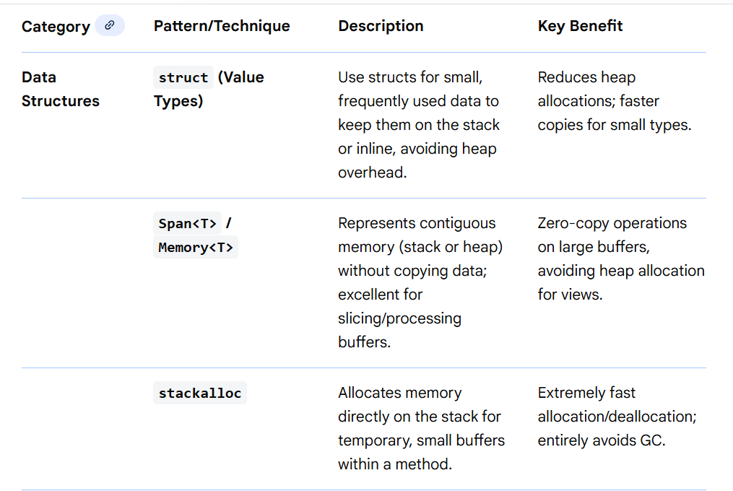
Allocation Free Patterns
Allocation-free patterns in C#/.NET focus on minimizing heap allocations using techniques like structs, Span<T>, stackalloc, ref parameters, avoiding LINQ closures/intermediate collections (.ToList(), .Select()), string formatting, and leveraging AsNoTracking() for data access, all crucial for high-performance code to reduce GC pressure and improve predictability, often involving measuring memory impact after changes.

Slide 116
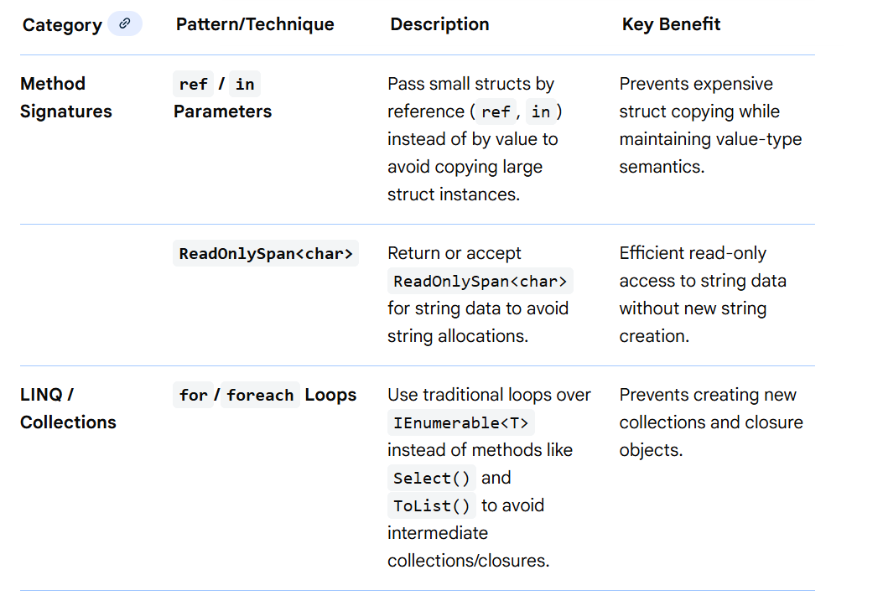
Allocation Free Patterns

Slide 117
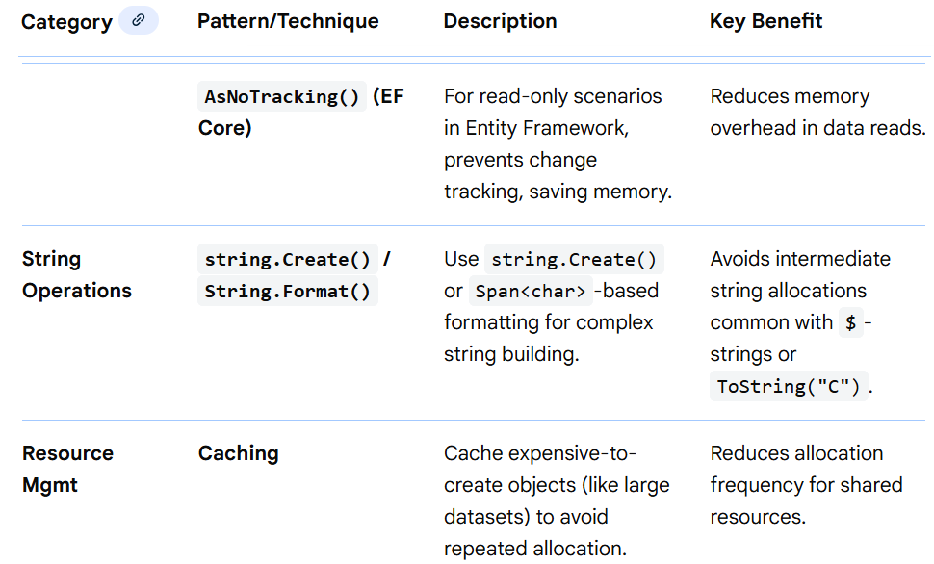
Allocation Free Patterns

Slide 118
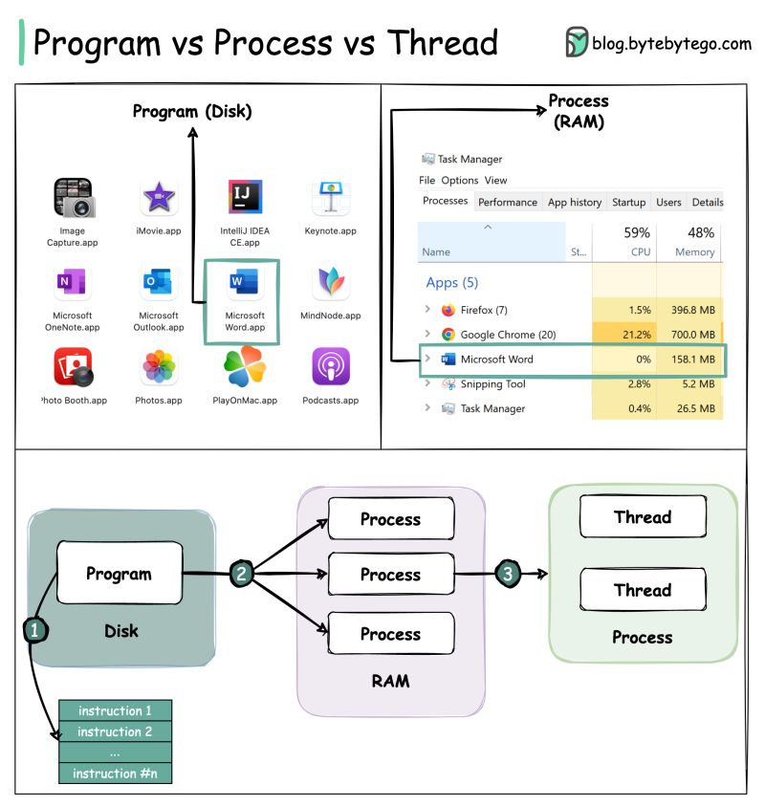
Concurrent Programming(/MultiThreading) in .NET(Core)
For Further Exploration –
Processes, Threads, AppDomains And Object Contexts | luke wickstead

Slide 119
Concurrent Programming(/MultiThreading) in .NET(Core)
 | When to Use | Comment(s)/Example(s)
Thread | When you need to control at the minutest level how these are managed(created, started, resumed, stopped etc.) | How to Pass Data Thread Function in Type-Safe Manner in C# How to Retrieve Data from a Thread Function in C# - Dot Net Tutorials
ThreadPool | Primarily used to reuse application threads and provide management of the worker threads. | Thread Pools - Win32 apps | Microsoft Learn (check/google/chaptGPT how data can be passed to [& back from] ThreadPool)
Task | Internally a Thread only but managed via the ThreadPool by default. | c# - What is the difference between task and thread? - Stack Overflow Task Class (System.Threading.Tasks) | Microsoft Learn (check/google/chatGPT how data can be passed to [& back from] Task)

Slide 120
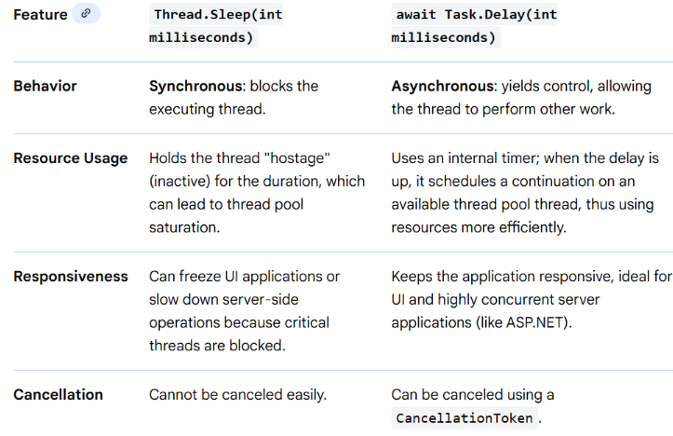
Concurrent Programming(/MultiThreading) in .NET(Core)
Thread.Sleep() vs Task.Delay()

Slide 121
Concurrent Programming(/MultiThreading) in .NET(Core)
Main Reason(s)/Advantages for MultiThreading –
1) Scalability using Worker Threads. Also, each thread can perform different/similar operation if needed.
Applications built using Thread Scalability –
a) Building High Performant Schedulers
b) Building High Performant servers in Client-Server model. Ultimately,
servers are continuously running schedulers listening for some network
protocol(s) based requests.
2) UI(/Client) Responsiveness(using async Threads)
3) Resource Sharing - but this can create problems also as depicted below
Shared Resource Concurrent Access Issues –
Unpredictable Values
Race Condition
Dead Lock

Slide 122
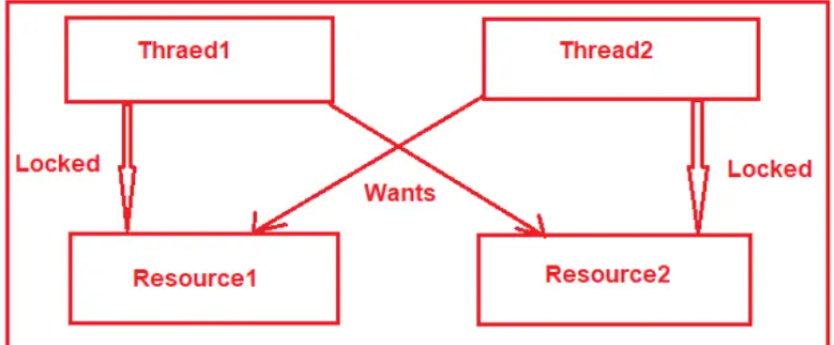
Concurrent Programming(/MultiThreading) in .NET(Core)
Race Condition –
A race condition happens when two or more threads want to update shared data at the same time.
What is a Race Condition? Vulnerability and Attack
Dead Lock –
Mainly happens when multiple threads are waiting for other threads to release some shared resource
EP112: What is a deadlock? - ByteByteGo Newsletter

Slide 123
Concurrent Programming(/MultiThreading) in .NET(Core)
Necessary Conditions for Dead Lock –
Mutual Exclusion: Resources involved must be unshareable between multiple threads.
Hold and Wait: Threads hold the resources they have allocated and wait for the resources they want.
No pre-emption: If the thread locks the resource, other threads cannot take the resource until the thread releases it.
Circular Wait: A circular chain must exist in which each thread waits for other threads to release resources.
Solving Shared Resource Concurrent Access Issues –
Using some critical section(some form of lock) wherein only some limited number of Thread(s)[typically 1] can enter at a time(& others will be queued up until their time comes to enter the critical section) & thus shared resource can’t be accessed concurrently by multiple threads at the same time & thus the issue gets resolved. This is a form of Synchronization.

Slide 124
Concurrent Programming(/MultiThreading) in .NET(Core)
Synchronization –
Synchronization is particularly important when threads access the same data. Its basically coordinating the actions of threads for a predictable outcome.
Basic Blocking Methods -
Sleep, Join, Task.Wait etc are simple blocking methods that wait for other thread(s) to finish or for a period of time to elapse.
Locking & Signaling constructs –
In .NET, thread synchronization is achieved primarily through Locking (ensuring mutual exclusion to shared resources) and Signaling (coordinating the order of execution between threads).
Locking: Prevents multiple threads from accessing a critical section of code or data simultaneously (e.g., lock, Mutex, Semaphore, ReaderWriterLockSlim).
Signaling: Allows one thread to pause until it receives a notification/signal from another thread, avoiding inefficient CPU-intensive polling (e.g., AutoResetEvent, ManualResetEvent, Monitor.Wait/Pulse)

Slide 125
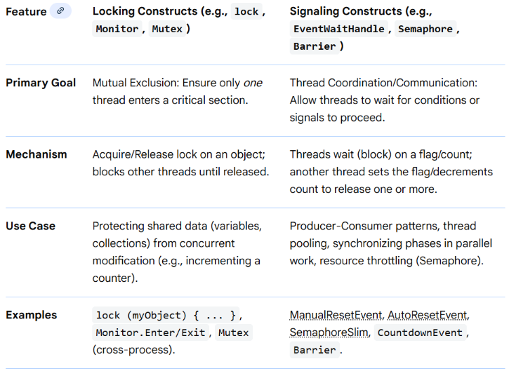
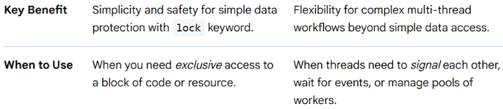
Concurrent Programming(/MultiThreading) in .NET(Core)
Synchronization –
Locking & Signaling constructs –

Slide 126
Concurrent Programming(/MultiThreading) in .NET(Core)
Synchronization –
Locking constructs –
Exclusive Locking Constructs
These constructs ensure that only one thread can execute a specific block of code or access a shared resource at a time.
lock Statement: The most common and simple way to achieve exclusive locking within a single process. It is syntactic sugar for the Monitor class methods and uses a try-finally block to ensure the lock is released even if an exception occurs. Check the difference between lock & Monitor at lock vs monitor in c#. Lock:- In C#, the lock keyword is used…
Usage: It requires a dedicated, private, reference-type object (e.g., private readonly object _lockObject = new object();) to lock on.
Lock Class (C# 13 / .NET 9+): A more performant and resource-efficient class introduced in C# 13/ .NET 9, providing a cleaner API for locking and unlocking shared resources than the traditional lock statement (which relies on Monitor).

Slide 127
Concurrent Programming(/MultiThreading) in .NET(Core)
Synchronization –
Locking constructs –
Exclusive Locking Constructs
Mutex Class: Similar to lock, but it can synchronize access to resources across multiple processes (system-wide synchronization), not just within a single application. It has higher overhead than lock or Lock.
SpinLock Struct: A lightweight alternative for scenarios where lock contention times are expected to be very short (microseconds). Instead of blocking a thread and incurring a context switch, it "spins" in a loop, repeatedly checking if the resource is free.
Non-Exclusive (Reader/Writer & Counted) Constructs
These constructs offer more flexible control over concurrency, allowing multiple threads to access a resource simultaneously under certain conditions.
Semaphore and SemaphoreSlim Classes: These limit the number of threads that can concurrently access a shared resource to a specified maximum number.

Slide 128
Concurrent Programming(/MultiThreading) in .NET(Core)
Synchronization –
Locking constructs –
Semaphore can be system-wide (cross-process).
SemaphoreSlim is a lightweight, faster alternative suitable for intra-process synchronization, often used with async/await operations.
Non-Exclusive (Reader/Writer & Counted) Constructs
ReaderWriterLockSlim Class: This allows multiple threads to have concurrent read access to a shared resource, but grants exclusive access to a single thread for writing. This is ideal for data structures that are read frequently but written to infrequently.
Key Considerations
Avoid Deadlocks: When using multiple locks, acquire them in a consistent, predefined order to prevent deadlocks.
Keep Critical Sections Brief: Minimize the amount of code within a locked section to reduce contention and improve performance.

Slide 129
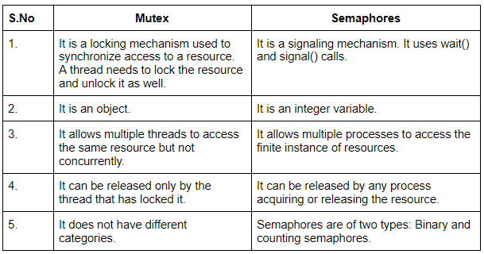
Concurrent Programming(/MultiThreading) in .NET(Core)
Synchronization –
Locking constructs –
Key Considerations
Lock on Dedicated Objects: Always lock on a dedicated private readonly object instance that isn't used for any other purpose and isn't publicly accessible (avoid lock(this), lock(typeof(MyType)), or lock("string")).
Exception Safety: Ensure that locks or semaphores are always released, typically by using a try...finally block (which the lock keyword handles automatically).
Mutex vs Semaphore -
Cross-Process (Named) Mutex Example(e.g. 2 apps trying to access the same file) –
.net - Synchronization between two processes in C#.? - Stack Overflow
Using C# Mutexes for interprocess synchronization

Slide 130
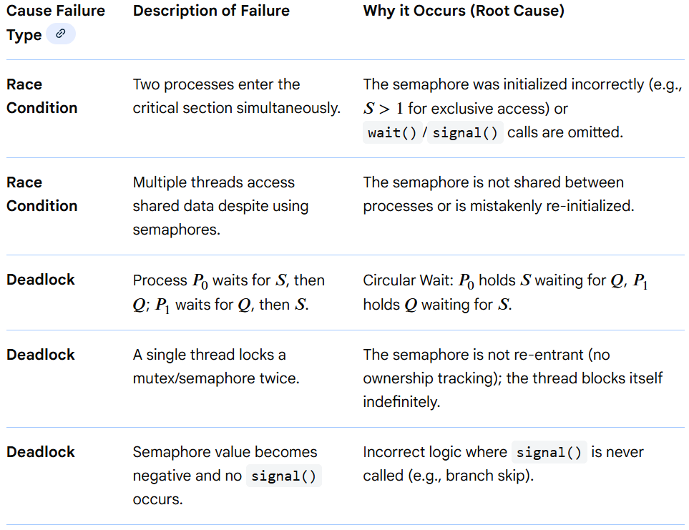
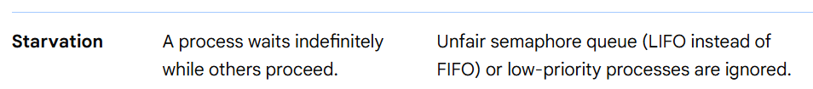
Concurrent Programming(/MultiThreading) in .NET(Core)
Synchronization –
Locking constructs –
Semaphore
Binary Semaphores can protect against Race condition and Dead Lock but Counting Semaphores with count > 1 cannot really protect against Race Consition and Deadlocks as mentioned below -

Slide 131
Concurrent Programming(/MultiThreading) in .NET(Core)
Synchronization –
Locking constructs –
Reader Writer Lock
A reader-writer (RW) lock should not be used always instead of a simple lock (lock/mutex). While RW locks allow multiple simultaneous readers, they are generally more complex, have higher overhead, and are slower than a simple, lightweight lock when there is low contention or a high frequency of writes.
The decision to use a reader-writer lock should be based on performance metrics confirming high read contention and low write frequency.
Why Reader-Writer Locks Should Not Be Used Everywhere
Higher Overhead: RW locks are more complex, often requiring atomic operations or even multiple internal mutexes to manage both readers and writers, which makes taking and releasing the lock slower.
Performance Penalty on Writes: If a resource is frequently updated (write-heavy), an RW lock will perform worse than a standard lock due to the overhead of managing the reader count.
Writer Starvation: In read-preferring RW locks, if there is a steady stream of readers, a writer may wait indefinitely, as new readers are allowed to enter even if a writer is waiting.
Complexity & Bugs: Implementing or using them incorrectly (e.g., failing to unlock in a finally block or incorrect upgrading/downgrading of locks) can lead to deadlocks or memory leaks.

Slide 132
Concurrent Programming(/MultiThreading) in .NET(Core)
Synchronization –
Locking constructs –
Reader Writer Lock
When to Use Each
Scenario Recommended Lock Reason
Read-Mostly Reader-Writer Lock Allows many threads to read simultaneously, reducing
bottleneck.
Write-Heavy Simple Lock (Mutex) Lower overhead than RW lock; quicker in high-write
scenarios.
Low Contention Simple Lock (Mutex) Uncontended mutexes are very fast and lightweight.
Short Critical Sections Simple Lock (Spinlock) Very fast for short tasks; RW lock adds unnecessary
complexity.
Summary Checklist
Can I avoid sharing data? If yes, do that (best performance).
Is it read-mostly (e.g., >95% reads)? If yes, consider ReaderWriterLockSlim (in .NET) or RwLock (in Rust).
Is it write-heavy or low-contention? Use a standard, simple lock (e.g., lock in C#, mutex in C++).
Note: In modern .NET development, ReaderWriterLockSlim is generally preferred over the older ReaderWriterLock

Slide 133
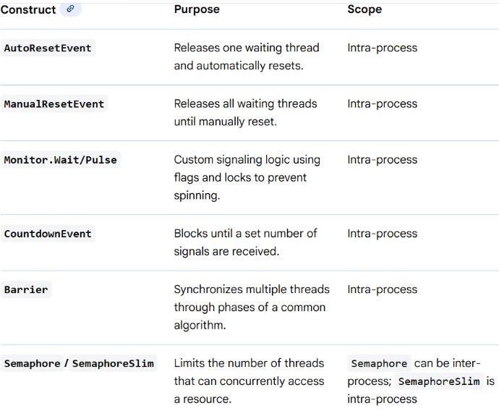
Concurrent Programming(/MultiThreading) in .NET(Core)
Synchronization –
Signaling Constructs - Signaling is when one thread waits until it receives notification from another. Event wait handles are the simplest of the signaling constructs and they are unrelated to C# events. Mainly needed for Thread(s) based Orchestration & most Orchestrations can be implemented using FSM(Finite State Machine) Techniques.

Slide 134
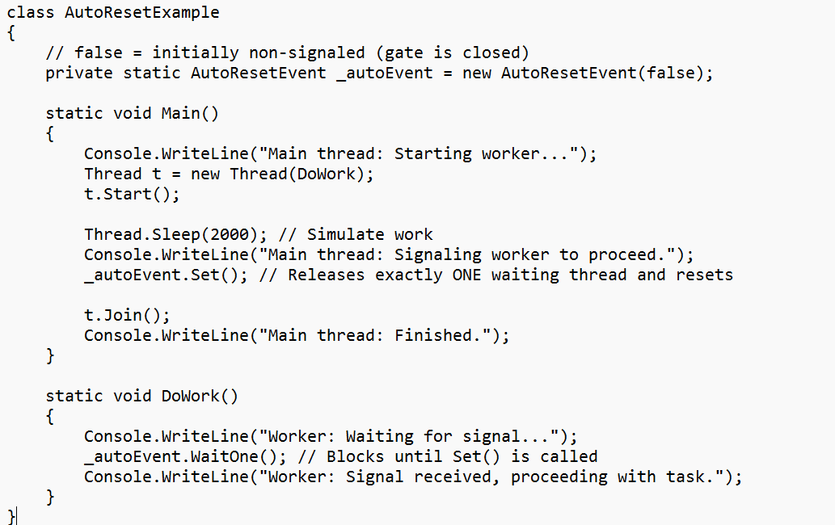
Concurrent Programming(/MultiThreading) in .NET(Core)
Synchronization –
Signaling Constructs
Manual and AutoResetEvent Code Examples
In .NET, AutoResetEvent and ManualResetEvent are synchronization primitives used for signaling between threads. The primary difference is how they handle the "gate" after a thread is released: an AutoResetEvent closes automatically after one thread passes, while a ManualResetEvent stays open until explicitly reset.
1. AutoResetEvent Code Sample
This event acts like a turnstile; it allows only one thread through and then immediately resets to a non-signaled state.

Slide 135
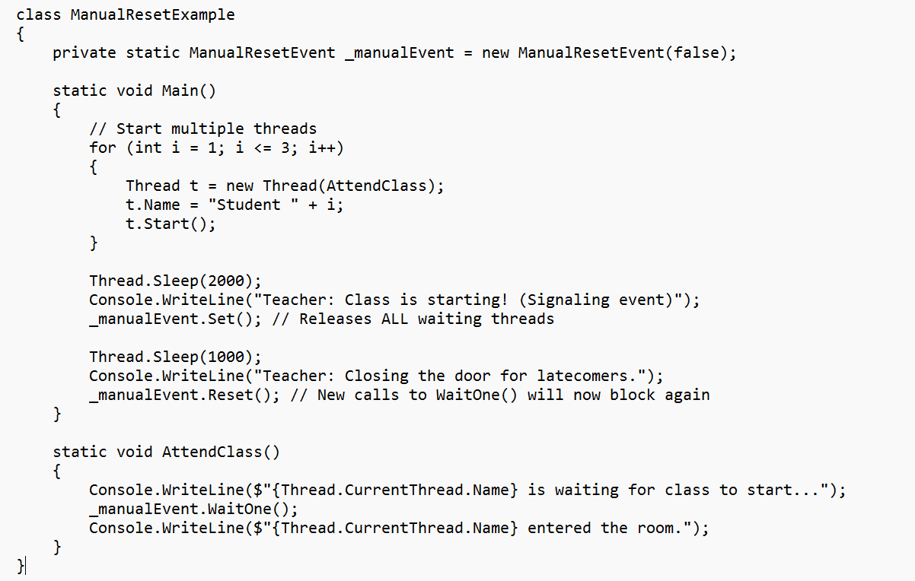
Concurrent Programming(/MultiThreading) in .NET(Core)
Synchronization –
Signaling Constructs
Manual and AutoResetEvent Code Examples
2. ManualResetEvent Code Sample
This event acts like an open door; once signaled, it stays open, allowing all waiting threads to pass until it is manually closed using Reset().

Slide 136
Concurrent Programming(/MultiThreading) in .NET(Core)
Synchronization –
Signaling Constructs
Manual and AutoResetEvent Code Examples
Some Salient points of the code
AutoResetEvent -
private static AutoResetEvent autoResetEvent = new AutoResetEvent(false);
autoResetEvent.Set();
// - Signal one thread at a time to proceed & so needs to be there in loop if multiple threads needs to be set.Code written in the main thread
autoResetEvent.WaitOne();
// Blocks until signal is received and automatically consumed.Code written in worker thread
ManualResetEvent -
_manualResetEvent.Set();
// Signal all waiting threads to proceed.Code written in main thread
_manualResetEvent.WaitOne();
// Block until the ManualResetEvent is in the signaled state.Code written in worker thread
_manualResetEvent.Reset();
- // Reset the event to block future threads - In Main thread

Slide 137
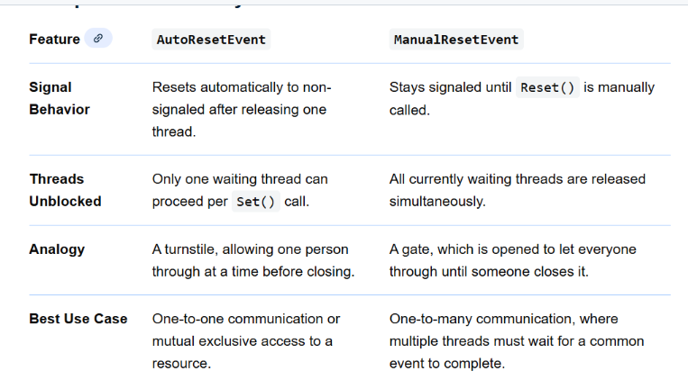
Concurrent Programming(/MultiThreading) in .NET(Core)
Synchronization –
Signaling Constructs
Manual and AutoResetEvent Code Examples
For high-performance scenarios where wait times are short, consider ManualResetEventSlim, which uses busy spinning to reduce overhead..AutoResetEventSlim can be implemented using SemaphoreSlim and busy spinning techniques for short wait times.Check AsyncManualResetEvent and AsyncAutoResetEvent for modern Task based asynchronous programming.

Slide 138
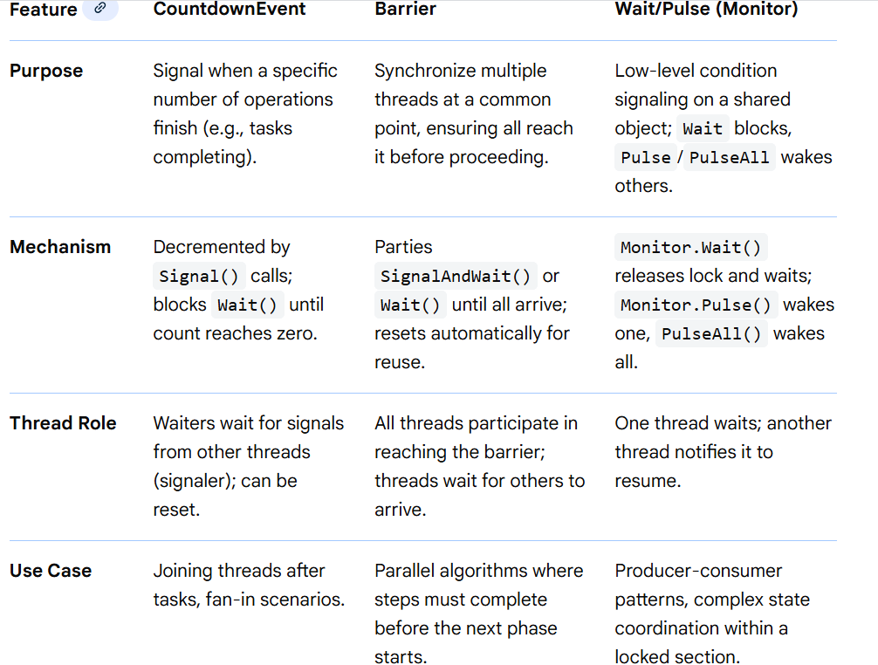
Concurrent Programming(/MultiThreading) in .NET(Core)
Synchronization –
Signaling Constructs
CountDownEvent vs Barrier vs Wait/Pulse

Slide 139
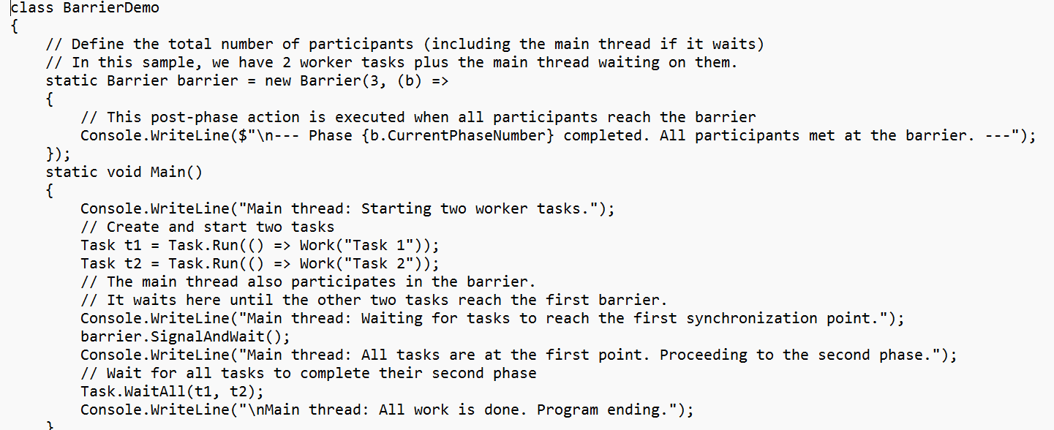
Concurrent Programming(/MultiThreading) in .NET(Core)
Synchronization –
Signaling Constructs
Barrier Code Sample
The C# Barrier class is a synchronization primitive used to coordinate multiple threads that cooperate in a multi-phase operation, ensuring all participants reach a certain point before any can proceed to the next phase.

Slide 140
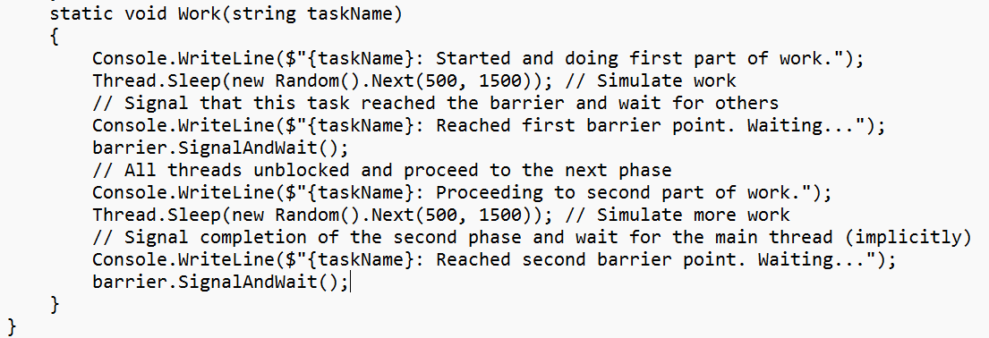
Concurrent Programming(/MultiThreading) in .NET(Core)
Synchronization –
Signaling Constructs
Barrier Code Sample

Slide 141
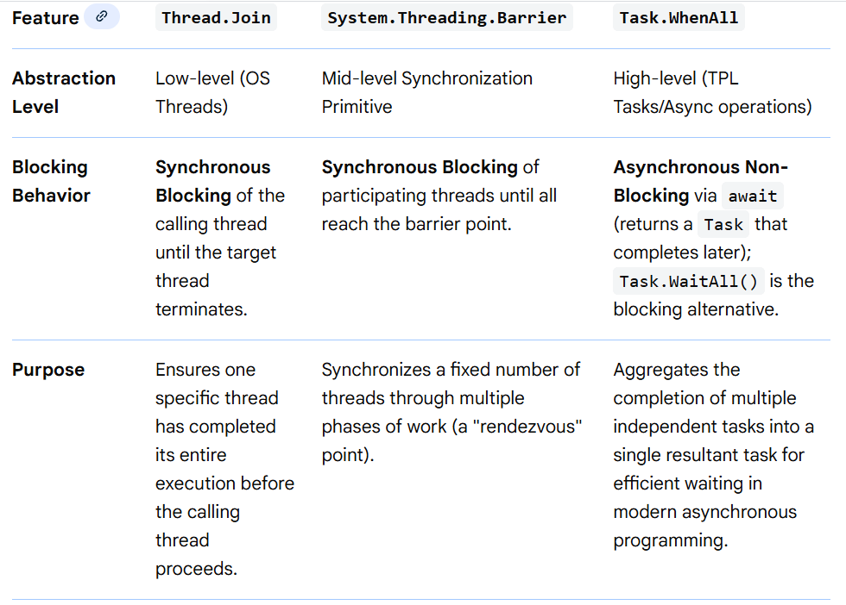
Concurrent Programming(/MultiThreading) in .NET(Core)
Synchronization –
Join vs Barrier vs Task.WhenAll

Slide 142
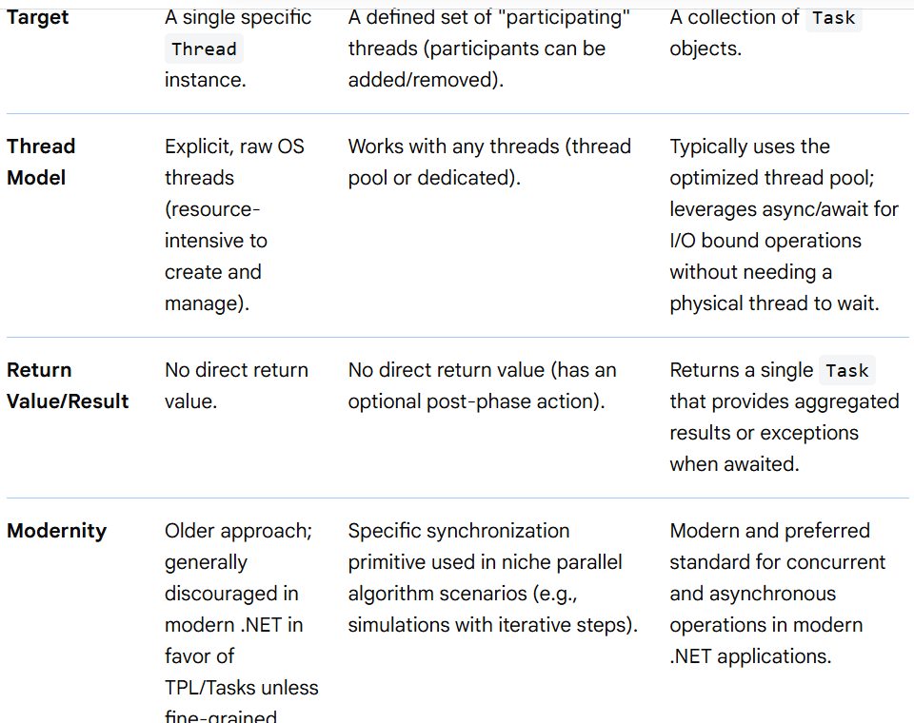
Concurrent Programming(/MultiThreading) in .NET(Core)
Synchronization –
Join vs Barrier vs Task.WhenAll

Slide 143
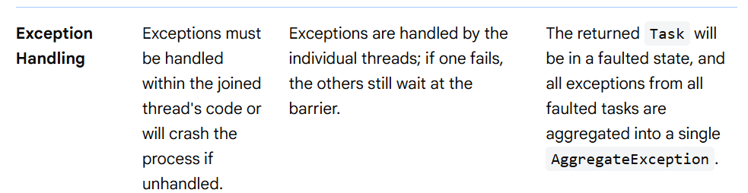
Concurrent Programming(/MultiThreading) in .NET(Core)
Synchronization –
Join vs Barrier vs Task.WhenAll
Summary of Use Cases
Use Thread.Join when you have an explicitly created Thread and the calling thread absolutely must stop and wait for that specific thread to terminate its entire operation before continuing.
Use a System.Threading.Barrier when you have a set of threads repeatedly working in parallel on phases of an algorithm (e.g., in a loop) and they all need to synchronize at a specific point ("barrier") before starting the next phase.
Use Task.WhenAll in modern asynchronous programming to efficiently manage multiple independent operations (both CPU-bound with Task.Run and I/O-bound with async/await) without blocking threads, allowing for responsive applications.

Slide 144
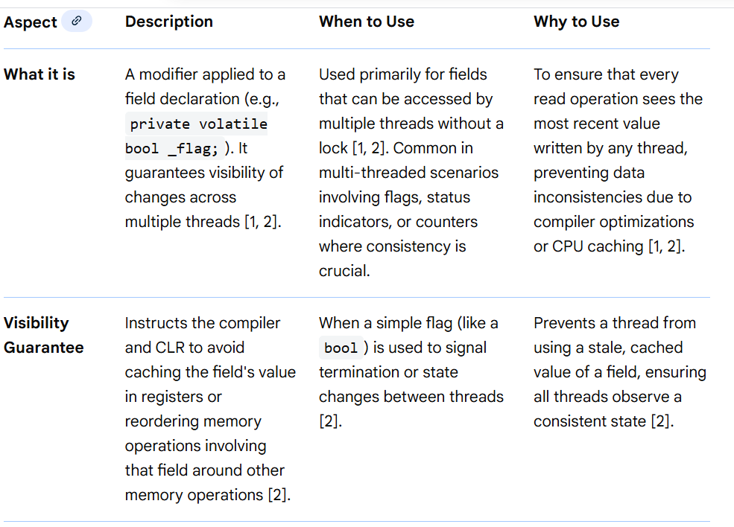
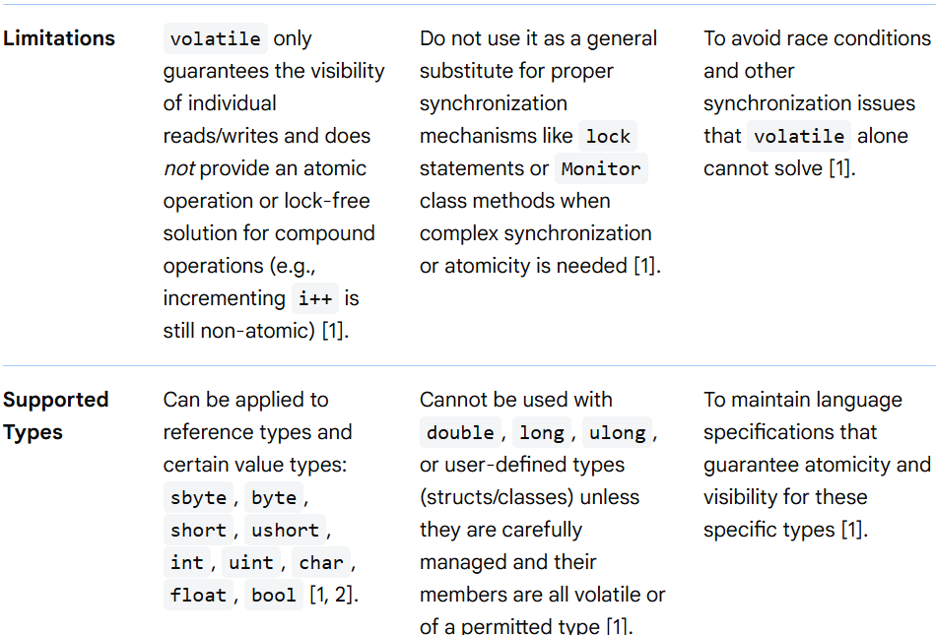
Concurrent Programming(/MultiThreading) in .NET(Core)
Synchronization –
Volatile

Slide 145
Concurrent Programming(/MultiThreading) in .NET(Core)
Synchronization –
Producer Consumer Constructs (BlockingCollection and Channels)
BlockingCollection (C# TPL) offers built-in bounded queues, thread-safe blocking for producer/consumer sync, simpler buffer management, and clear completion signals but lacks native persistence/batching/advanced monitoring; whereas Channels (like in Go/Kotlin) provide flexible async streams with more explicit backpressure, simpler synchronization (channels are often unbuffered or have direct signaling), fine-grained buffer control (buffered/unbuffered), require custom logic for persistence/batching, and offer rich monitoring via context/middleware, making Channels better for modern stream processing and BlockingCollection ideal for classic bounded-buffer producer-consumer tasks.
Channels(Important tasks to keep in mind)
✔️Creating channels: Channel.CreateUnbounded<T>(), Channel.CreateBounded<T>()
✔️ Writing/reading: WriteAsync, ReadAllAsync, TryWrite, WaitToReadAsync
✔️ Capacity control & backpressure strategies
✔️ Cancellation and lifetime management in long-running tasks
✔️ Integration in background services (e.g., background worker services)

Slide 146
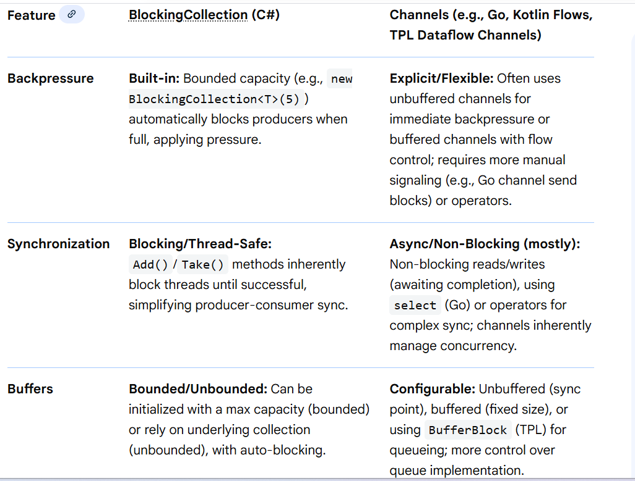
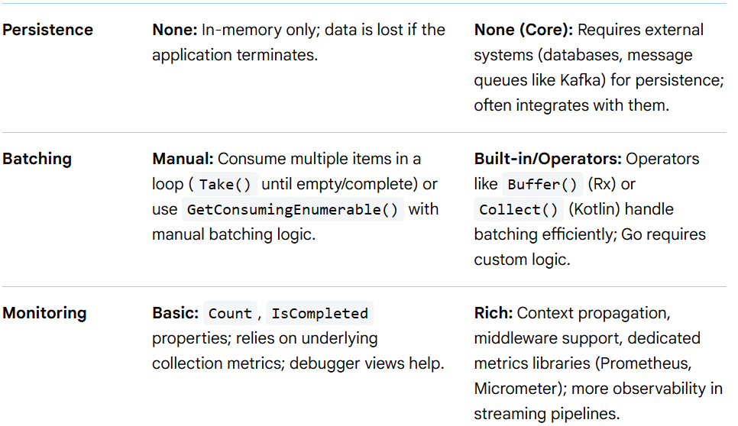
Concurrent Programming(/MultiThreading) in .NET(Core)
Synchronization –
Producer Consumer Constructs (BlockingCollection and Channels)

Slide 147
Concurrent Programming(/MultiThreading) in .NET(Core)
Synchronization –
Producer Consumer Constructs (BlockingCollection and Channels)
For Further Exploration
Backpressure Pattern- Design Principle
BlockingCollection vs. Channels in C#
BlockingCollection Overview - .NET | Microsoft Learn
Channels - .NET | Microsoft Learn
Csharp-Channels-Presentation
Building a .NET 9 Console App with Hangfire and Channels
Channels in .NET: Building High-Performance Pipelines | Turbo .NET

Slide 148

Concurrent Programming(/MultiThreading) in .NET(Core)
Synchronization –
Advanced NonBlocking Constructs(Atomic Operations Constructs) –
Atomic Operations – operations that cannot occur concurrently & should always occur in a sequence only

Slide 149
Concurrent Programming(/MultiThreading) in .NET(Core)
Synchronization –
Advanced NonBlocking Constructs(Atomic Operations Constructs) –
Atomic Operations Supported Types and Specifics
Types: Int32, Int64, Single (float), Double, IntPtr, and generic T (for Reference types).
Atomic Property: On 32-bit systems, 64-bit operations (Int64, Double) require Interlocked methods to guarantee atomicity, whereas 32-bit reads/writes are generally atomic, provided they are properly aligned.
Memory Fences: Interlocked operations often erect a memory barrier before and/or after the update, preventing compiler/CPU reordering.
CompareExchange: Forms the basis of lock-free data structures.
Alternatives and Advanced Patterns
Volatile.Read / Volatile.Write: Ensures the latest value is read from memory rather than a CPU cache, preventing read/write reordering, but not atomic for large types.
SpinWait: Used in conjunction with Interlocked to create high-performance spin-locks.
System.Threading.Channels / TPL Dataflow: Higher-level concurrency primitives that manage atomicity within pipelines.
For Further Exploration
What are atomic operations for newbies
Thread-Safe Counters and Flags Using Interlocked in .NET
Compare-and-swap - Wikipedia

Slide 150

Concurrent Programming(/MultiThreading) in .NET(Core)
Synchronization –
Other Techniques
Busy Waiting(/Spinning) –
When a thread blocks or unblocks, the operating system performs a context switch. This can be avoided using BusyWaiting. When a thread is in critical section, other threads simply spins(just loops) and keeps checking the break condition(via some flag) to enter in its critical section. This is called BUSY WAITING. Busy waiting wastes CPU cycles that some other process can use for doing any productive work. Mainly used for short span locks.
A sample Busy Waiting Logic(can be more complex for real world projects) -

Slide 151
Concurrent Programming(/MultiThreading) in .NET(Core)
Synchronization –
Other Techniques
Busy Waiting(/Spinning) –
Why Busy Waiting is Generally Avoided in C#
In most C# applications, especially ASP.NET Core or general-purpose desktop apps, busy waiting is an anti-pattern that leads to significant performance degradation:
**Wasted CPU Cycles:** A thread actively consumes CPU time while waiting for a condition, preventing other threads from running meaningful tasks.
**Thread Pool Starvation:** In environments like ASP.NET, busy-waiting can starve the thread pool, leading to degraded application responsiveness and potential deadlocks.
**Alternatives:** C# provides robust synchronization primitives that put threads to sleep (non-busy wait) until a signal is received, such as:
* `lock` (which uses `Monitor` internally)
* `SemaphoreSlim`
* `ManualResetEvent`/`AutoResetEvent`
* `BlockingCollection` for producer-consumer scenarios
Using these non-busy waiting mechanisms allows the operating system's scheduler to utilize the CPU efficiently by allocating time to threads that actually have work to do.

Slide 152
Concurrent Programming(/MultiThreading) in .NET(Core)
Synchronization –
Other Techniques
XSlim Locks where X can be Semaphore, ReaderWriterLock –
XSlim represents a lightweight, fast construct that can be used for waiting when wait times are expected to be very short.In general, uses Busy Waiting or a relevant variant to implement the “Slim” versions.
Async Awaiting inside C# Locks –
Async Waiting inside C# Locks. Infact, this technique is possible with most of the constructs deriving from System.Threading.WaitHandle.
Cancellation, Lazy Initialization &Thread Local Storage –
Threading in C# - Part 3 - Using Threads
How to use cancellation tokens in ASP.NET Core 7 | InfoWorld
For Web API, if the client is some Web UI or Non .NET 3rd party API, use a custom Middleware[or Filter] based on command(‘cancel’) pattern alongwith keeping track of the cancellation token per request(identifier passed by client) using some [distributed] cache.
Lock Splitting and Lock Stripping - Lock splitting vs lock striping

Slide 153


Concurrent Programming(/MultiThreading) in .NET(Core)
Thread Contention, Starvation & Safety

Slide 154
Concurrent Programming(/MultiThreading) in .NET(Core)
Thread Contention, Starvation & Safety
Detailed Breakdown
Contention (Lock Contentions): Occurs when a thread attempts to acquire a System.Threading.Monitor lock held by another thread, causing the requester to wait. This is normal but becomes a bottleneck when critical sections are too long or used too often.
Starvation: Occurs when the .NET ThreadPool has no available threads to process new work items, usually because existing threads are blocked (e.g., synchronous I/O). The system becomes unresponsive because it cannot spawn new threads quickly enough.
Safety: Ensures that data is not corrupted during simultaneous access. While necessary, over-synchronization leads to excessive contention. .NET generic collections are not thread-safe by default to maintain high performance for single-threaded scenarios.

Slide 155



Concurrent Programming(/MultiThreading) in .NET(Core)
.NET Lock Based vs Lock Free vs Wait Free Techniques

Slide 156
Concurrent Programming(/MultiThreading) in .NET(Core)
.NET Lock Based vs Lock Free vs Wait Free Techniques
Detailed Technique Characteristics
Lock-Based (Pessimistic):
Mechanism: Prevents concurrent access by forcing threads to wait until a resource is released.
Pros: Easiest to implement and verify; protects complex data structures efficiently when contention is low.
Cons: Subject to Priority Inversion and Deadlocks. Thread suspension causes expensive context switches to the kernel.
Lock-Free (Optimistic):
Mechanism: Uses atomic operations like Compare-And-Swap (CAS). If an update fails because another thread changed the data, the thread retries.
Pros: Avoids deadlocks; high throughput because threads don't go to sleep.
Cons: Individual threads can suffer from Starvation if they are perpetually unlucky during retries.
Wait-Free (Guaranteed):
Mechanism: Usually involves a "helping" mechanism where a fast thread identifies a stalled thread and completes its operation before finishing its own.
Pros: Essential for Real-Time Systems where every operation must meet a strict deadline.
Cons: Extremely difficult to design correctly; often carries slightly more overhead than lock-free due to the complexity of the "helping" logic.
For Further Exploration
Wait Free Algos
The Art of Multiprocessor Programming

Slide 157
Concurrent Programming(/MultiThreading) in .NET(Core)
Race Condition & Dead Lock Detection in .NET–
Detecting race conditions and deadlocks in C# involves a combination of design best practices, careful code review, and specialized tooling. Since these issues are non-deterministic and can be difficult to reproduce, a multi-faceted approach is key.
Detecting Race Conditions
A race condition occurs when the outcome of a program depends on the unpredictable timing or order of execution of multiple threads accessing shared resources.
Manual Detection and Prevention
Code Review: Carefully review code for shared variables accessed by multiple threads without proper synchronization. Look for scenarios where operations (like count++, which is not atomic) are broken into multiple steps (read, increment, write).
Design Practices:
Avoid Shared State: Design code to avoid sharing data between threads whenever possible.
Use Thread-Safe Collections: Utilize built-in concurrent collections like ConcurrentDictionary<TKey, TValue> or BlockingCollection<T> which manage synchronization internally.
Immutability: Use immutable objects, as their state cannot be changed after creation, eliminating the risk of concurrent modification issues.
Dynamic Analysis and Testing
Stress Testing: Run the application under heavy load with multiple threads to try and force the race condition to occur. This does not guarantee all race conditions will be found but can help expose suspected bugs.

Slide 158
Concurrent Programming(/MultiThreading) in .NET(Core)
Race Condition & Dead Lock Detection in .NET–
Design Practices:
Logging: Add extensive async logging to track which threads are accessing shared resources and when. Analyzing log files can help pinpoint unexpected execution orders.
Detecting Deadlocks
A deadlock occurs when two or more threads are stuck indefinitely, each waiting for a resource locked by the other.
Manual Detection and Prevention
Code Review: Look for nested locks, where one thread acquires a lock and then attempts to acquire another that a second thread might already hold.
Design Practices:
Consistent Lock Ordering: Always acquire multiple locks in the same, consistent global order across all threads. This prevents the circular wait condition necessary for a deadlock.
Avoid Long Operations Inside Locks: Keep locked sections of code minimal to reduce the chance of another thread needing the resource while the first is performing a long operation.
Use Timeouts: When acquiring a lock using classes like Monitor or Mutex, use a timeout value (e.g., Monitor.TryEnter(this, 500)). If the lock is not acquired within the specified time, it's a strong indication of a potential deadlock or starvation issue.

Slide 159
Concurrent Programming(/MultiThreading) in .NET(Core)
Race Condition & Dead Lock Detection in .NET–
Dynamic Analysis and Tooling
Memory Dumps and Debugging Tools:
Visual Studio: Use the Threads and Tasks windows during debugging to inspect what each thread is doing and which locks they are waiting on.
WinDbg: When an application hangs due to a deadlock, a memory dump can be analyzed using the WinDbg tool and the SOS/SOSEX extensions. The !dlk command (from SOSEX) can automatically detect deadlocked threads.
Performance Profilers: Profilers like dotTrace can capture performance snapshots and visualize long-running lock contentions, helping you identify threads that are stuck waiting.

Slide 160
Concurrent Programming(/MultiThreading) in .NET(Core)
For Further Exploration –
MultithreadingwithCSharpCookbook
Check the Number of threads available in ThreadPool at any time - Stack Overflow
Concurrency-in-csharp-cookbook
PowerThreading: Jeffrey Richter's Power Threading Library
Web Servers Succinctly
Web server implementations in ASP.NET Core | Microsoft Learn
Compendium of Community Knowledge on Game Design and Development
FConcBook: Source code for "Concurrency in .NET" book Manning publisher
Multithreading Principles and Patterns
Multithreading and Patterns - DEV Community
Multithreading-Patterns-Data-Structures
Common patterns for poorly-behaved multithreaded apps - Visual Studio (Windows)
Part B (ADVANCE) Multithreading Design Patterns ( pthreads ) | Udemy
Embedded C Programming Design Patterns
Design-Patterns-For-Embedded-system-in-c
Seven Concurrency Models in Seven Weeks: When Threads Unravel by Paul Butcher
List of concurrency models - Stack Overflow

Slide 161


Concurrent Programming(/MultiThreading) vs Multi Core Parallel Programming

Slide 162
Multi Core Parallel Programming in .NET(Core)
Assigning a Thread to a specific core –
c# - How can I set processor affinity to a thread or a Task in .NET? - Stack Overflow
MultiCore_Locking_constructs– Threading in C# - Part 5 - Parallel Programming
Some usual Parallel constructs –
Parallel.Invoke – equivalent to Task.WhenAll but in this case threads are optimally distributed across multiple cores.. For Speculative Execution, there is no Parallel equivalent but you need to use Task.WhenAny but for this if you want to use multiple cores optimally, you will have to build some wrapper over Task.WhenAny using the above 2 links/resources(Processor Affinity based Thread [& SpinWait]). For Sequential API calls better to use Task.ContinueWith for better readability.
Parallel.For
Parallel.ForEach
Parallel Constructs can be used to fire calls to multiple APIs or DB Tables or any external resource for single or multiple(Bulk/Batch) items in each API or DB or some other external call.
Threading in C# - Part 5 - Parallel Programming
Plinq –
AsParallel is applicable only on IEnumerable and not IQueryable.
Threading in C# - Part 5 - Parallel Programming

Slide 163
Multi Core Parallel Programming in .NET(Core)
ConcurrentCollections –
Threading in C# - Part 5 - Parallel Programming
Immutable Collections vs Concurrent Collections –
c# - When immutable collections are preferable than concurrent - Stack Overflow
For Further Exploration(a bit advanced)–
Hands-On-Parallel-Programming-with-C-8-and-.NET-Core-3
Parallel-Programming-and-Concurrency-with-C-sharp-10-and-.NET-6
c# - How do I spawn threads on different CPU cores? - Stack Overflow
c# - Can you force Parallel.Invoke to use multiple threads? - Stack Overflow
c# - How to set maximum concurrent threads using Task - Stack Overflow
Limiting concurrency for faster and more responsive apps - Developer Support
c# - Limited concurrency TaskScheduler that can interleave tasks to be explicitly ordered - Stack Overflow
A Tour of ParallelExtensionsExtras - .NET Parallel Programming
Parallel-Extensions-Extras
For Further Reading (Parallel Programming) - .NET | Microsoft Learn
Parallel-Patterns
Patterns for Parallel Programming[Book]
Build Your Own RealTime OS (RTOS) From Ground Up™ on ARM 1 | Udemy
Build Your Own RealTime OS (RTOS) From Ground Up™ on ARM 2 | Udemy
"DIY RTOS Made Easy: Mastering Microcontrollers " | Udemy

Slide 164
User Space, Kernel Space & Systems Programming
╔══════════════════════════════════════════════════════════════════╗
║ USER SPACE ║
║ ║
║ ┌────────────────────────────────────────────────────────────┐ ║
║ │ Applications ║
║ │ ║
║ │ • Browsers (Chrome, Firefox) ║
║ │ • ML / AI code (Python, TensorFlow, PyTorch) ║
║ │ • Editors (VS Code) ║
║ │ • Business applications ║
║ │ ║
║ │ Characteristics: ║
║ │ - No direct hardware access ║
║ │ - Runs with low privilege ║
║ │ - Crashes affect only this process ║
║ └────────────────────────────────────────────────────────────┘ ║
║ ║
║ ║
║ ║
║ ║

Slide 165
User Space, Kernel Space & Systems Programming
║ ┌────────────────────────────────────────────────────────────┐ ║
║ │ SYSTEMS PROGRAMMING (User-Space Part) ║
║ │ ║
║ │ • Shells (bash, zsh) ║
║ │ • Compilers (gcc, clang) ║
║ │ • Runtimes (JVM, Python interpreter) ║
║ │ • Databases (storage engines) ║
║ │ • Web servers (nginx) ║
║ │ • Container runtimes (Docker, containerd) ║
║ │ ║
║ │ Characteristics: ║
║ │ - Written in C / C++ / Rust ║
║ │ - Performance-critical ║
║ │ - Uses system calls ║
║ │ - OS-aware, but not privileged ║
║ └────────────────────────────────────────────────────────────┘ ║
║ ║
╠══════════════════════ SYSTEM CALL BOUNDARY ══════════════════════╣
║ (Controlled & secure entry into kernel space) ║
║ ║
║ Examples: read(), write(), fork(), exec(), mmap(), ioctl() ║

Slide 166
User Space, Kernel Space & Systems Programming
║ ║
╠══════════════════════════════════════════════════════════════════╣
║ KERNEL SPACE ║
║ ║
║ ┌────────────────────────────────────────────────────────────┐ ║
║ │ SYSTEMS PROGRAMMING (Kernel Part = Kernel Programming) │ ║
║ │ ║
║ │ • Process Scheduler ║
║ │ • Virtual Memory Manager ║
║ │ • File Systems (ext4, xfs) ║
║ │ • Device Drivers ║
║ │ • Interrupt Handlers ║
║ │ • Network Stack ║
║ │ ║
║ │ Characteristics: ║
║ │ - Runs in Ring 0 (highest privilege) ║
║ │ - Direct hardware access ║
║ │ - Bugs can crash entire OS ║
║ │ - Written mostly in C / Rust ║
║ └────────────────────────────────────────────────────────────┘ ║

Slide 167
User Space, Kernel Space & Systems Programming
║ ║
╠══════════════════════════════════════════════════════════════════╣
║ HARDWARE ║
║ ║
║ • CPU (registers, modes, interrupts)
║ • RAM ║
║ • Disk / SSD ║
║ • Network cards ║
║ • GPUs ║
║ ║
╚══════════════════════════════════════════════════════════════════╝

Slide 168
User Space, Kernel Space & Systems Programming
Why Separate User and Kernel Space Needed?
First: what problem are we really solving?
An operating system has to do two very different jobs:
Let programs run freely and fast (editors, browsers, ML code, etc.)
Protect the system and other programs from mistakes or abuse
Those two goals conflict if you put everything in one place.
Why only Kernel Space is a bad idea 🚫
Imagine everything runs with full hardware power.
What goes wrong?
A bug in one app can:
overwrite memory of another app
crash the entire OS
No isolation → no security
Every typo in user code = potential system panic
Historical example
Early systems (and even MS-DOS) effectively worked this way.
They were:
fast ✅
simple ✅
fragile and insecure ❌
So kernel-only systems fail at stability and safety.

Slide 169
User Space, Kernel Space & Systems Programming
Why Separate User and Kernel Space Needed?
Why only User Space is also impossible 🚫
Now flip the idea: what if everything runs as a normal program?
What breaks?
User-space programs:
cannot directly access hardware
cannot schedule CPU
cannot manage memory or interrupts
Why?
Because CPUs themselves enforce privilege levels (rings).
So:
No kernel → no disk access
No kernel → no process scheduling
No kernel → no memory protection
A pure user-space OS cannot control hardware.
The key insight 🔑 (this is the heart of it)
User space exists to protect the system from programs.
Kernel space exists to protect the system for programs.
They are complementary, not redundant.

Slide 170
User Space, Kernel Space & Systems Programming
Why Separate User and Kernel Space Needed?
Clean mental model 🧠
Think of it like this:
Layer Role
User Space Freedom, flexibility, experimentation
Kernel Space Authority, safety, arbitration
Or even simpler:
User space = “I want to do X”
Kernel space = “You may do X safely”
Why the boundary is worth the overhead
Yes, system calls add overhead.
But the trade-off buys us:
✔ Process isolation
✔ Memory protection
✔ Security boundaries
✔ Fault containment
✔ Multi-user safety
A crashing Python script should not reboot your machine—and thanks to this split, it doesn’t.

Slide 171
User Space, Kernel Space & Systems Programming
Why Separate User and Kernel Space Needed?
Real-world analogy 🏛️
Kernel space = government + law enforcement
User space = citizens
Could citizens run the country directly? Chaos.
Could government do everything for citizens? No innovation.
You need both, with clear rules.
Modern twist: “Is the boundary fixed?”
Not exactly.
Microkernels → push more into user space
Monolithic kernels → keep more in kernel space
Containers → virtualize user space
eBPF → controlled kernel execution
Different designs, same fundamental separation.
One-line takeaway
Without user space: unsafe.
Without kernel space: impossible.
With both: stable, secure, scalable systems.

Slide 172

User Space, Kernel Space & Systems Programming
Why Switching From User Space to Kernel Space & vice versa Needed

Slide 173

User Space, Kernel Space & Systems Programming
Why Switching From User Space to Kernel Space & vice versa Needed
Summary of Differences
User Space: Restricted mode (Ring 3), limited resources, user application code.
Kernel Space: Privileged mode (Ring 0), full access to hardware and memory, core OS code.
Switch Overhead: Switching is expensive; high frequency can reduce performance, which is why techniques like batching or eBPF are used.

Slide 174

User Space, Kernel Space & Systems Programming
Kernel Types

Slide 175

User Space, Kernel Space & Systems Programming
Kernel Types
For Further Exploration
Kernel in Operating System
Operating System Architecture
Comparison of operating system kernels - Wikipedia

Slide 176

User Space, Kernel Space & Systems Programming
When and Why Custom Kernel Programming is required?
Custom kernel programming involves modifying, configuring, or writing code for the core of an operating system (most commonly the Linux kernel) to tailor it to specific hardware or performance requirements. Unlike standard, pre-compiled kernels, a custom kernel is stripped of unnecessary components and optimized for a particular workload.

Slide 177


User Space, Kernel Space & Systems Programming
When and Why Custom Kernel Programming is required?

Slide 178

User Space, Kernel Space & Systems Programming
When and Why Custom Kernel Programming is required?
Why programming Languages like C, C++ & Rust are more suitable for Systems Programming?
Languages like C, C++, and Rust are well-suited for systems programming due to their design principles that emphasize low-level control over system resources, manual memory management, performance, and a direct interface with hardware and the operating system.
Here are the key attributes that distinguish them:
Manual Memory Management: These languages give programmers explicit control over memory allocation and deallocation (e.g., using malloc/free in C, new/delete in C++, and the ownership/borrowing system in Rust). This precision is vital for systems programming, where efficiency and predictable memory usage are paramount, avoiding the overhead of automatic garbage collection often found in languages like C# or Java.

Slide 179
User Space, Kernel Space & Systems Programming
Why programming Languages like C, C++ & Rust are more suitable for Systems Programming?
Close-to-Hardware Access: They provide mechanisms to interact directly with hardware. Features like pointers in C/C++ allow manipulation of specific memory addresses, which is essential for device drivers and operating system kernels.
Predictable Performance: The lack of a runtime environment or virtual machine means the code executes "bare metal" with minimal abstraction layers. This results in highly efficient and predictable performance crucial for tasks where speed and real-time constraints matter.
Minimal Runtime: They have very small or no built-in runtime libraries compared to languages like C# or Java. The compiled code is highly self-contained, which is vital for building core system components like bootloaders or embedded systems where resources are severely limited.
Statically Typed: All three are statically typed, meaning type checks happen at compile-time. This helps catch errors early and allows the compiler to generate more optimized machine code, further enhancing performance and reliability.
Direct Interoperability (FFI): They offer robust support for Foreign Function Interfaces (FFI), making it easy to link with code written in other languages, particularly assembly language, which is often necessary for highly optimized or hardware-specific operations.
Rust, specifically, builds on these principles while introducing a novel ownership system to ensure memory safety at compile time without requiring manual tracking of allocations, thereby preventing common bugs like null pointer dereferences, data races, and buffer overflows that can plague C and C++ development.

Slide 180

User Space, Kernel Space & Systems Programming
Programming Languages for Systems Programming Comparison

Slide 181

User Space, Kernel Space & Systems Programming
Programming Languages for Systems Programming Comparison

Slide 182
User Space, Kernel Space & Systems Programming
Programming Languages for Systems Programming Comparison
Summary
C offers maximum control and simplicity, ideal for environments where resources are extremely constrained, but demands significant programmer discipline to avoid errors.
C++ builds on C with powerful abstractions like OOP and generics, making it suitable for large, complex projects. However, it retains the potential for memory-related bugs if modern safety features like smart pointers are not used correctly and consistently.
Rust is a modern systems language designed to provide C/C++ performance with guaranteed memory and thread safety at compile time, via its unique ownership model. This makes it a strong choice for new projects prioritizing reliability and secure concurrency, although it has a steeper initial learning curve.
For Further Exploration(on Systems Programming)
Pointers in C & C++
Free C Programming Book
Free C++ Programming Book
The Definitive C Book Guide and List - Stack Overflow
The Definitive C Book Guide and List - Stack Overflow
Awesome C
Awesome CPP
Awesome Modern C++
Awesome Rust
Build Your Own X

Slide 183
User Space, Kernel Space & Systems Programming
For Further Exploration(in General)
User space and kernel space – Wikipedia
Kernel vs User Space - NamasteDev Blogs
Linux fundamentals: user space, kernel space, and the syscalls API surface
What Are Rings in Operating Systems? | Baeldung on Computer Science
Systems-Programming-with-C-Sharp-and-.NET
Operating Systems: Three Easy Pieces
The little book about OS development
Baking Pi – Operating Systems Development
Computer Science from the Bottom Up
Practical Operating Systems: A Hands-On Approach with Python
Developing a Computer Operating System from… [PDF/iPad/Kindle]
THE MINIX BOOK: OPERATING SYSTEMS
Modern Operating Systems
Linux Internals and Kernel Programming alongwith Drivers Resources
Linux System Programming
Understanding the Linux Kernel
Linux From Scratch!
How Linux Works
Windows Internals and Kernel Programming alongwith Drivers Resources
System Software by Leland L. Beck | Open Library
SYSTEMS PROGRAMMING
Hacker's Delight - Wikipedia

Slide 184
Stream Programming
Why/When do you need Stream(s) –
Say you want to transfer a large file array/list/object from one server to another but your intermediate server(which will get the data from source & process it & then transfer & store to destination) has RAM(/memory) limitations & the large array/list/file/object needs to be processed & so only option left is to then divide the large array/list/file/object into chunks & then it can be a stream of chunks which is in general easier to be processed. The chunk in general is in the form of byte(s) & can be a single byte or a block of byte(s)(although chunks can be some text[character or string], XML, JSON etc as well).Streaming is a real good technique to solve such problems.
Also, sometimes Streaming improves the overall performance of a system.

Slide 185

Stream Programming
.NET Streaming Architecture
N.B. – Although the arrows (direction) above might give the impression that the data is always moving from Stream Adapters to Decorator Streams to Backing Stores but that’s in the case of writing data from RAM (using some class inheriting from StreamWriter class or the StreamWriter class itself which again inherits from Stream class). For reading data into the RAM, it’s the other way around.(using some class inheriting from StreamReader class or the SreamReader class itself which again inherits from Stream class).

Slide 186
Stream Programming
.NET Streaming Architecture contd…
High Level Stream(s) Type/Group | Description
Backing Store Stream(s) | Hardwired to a particular type of Backing Store. Provides raw data. Itself a Stream.
Decorator Stream(s) | Feed off another stream & transform the data in some way (compression or encryption or Buffering). Chain of decorators also possible. Itself a Stream.
Adapter Stream(s) | Both Backing store & Decorator stream deal exclusively in bytes. Although that's flexible & efficient but an app often works at higher levels like formatted bytes or text(character or string) or XML or JSON etc. Adapters bridge this gap by wrapping a stream in a class with specialized methods types to a particular format. Itself is not a Stream.
N.B. – To compose a chain, you simply pass one object into another’s constructor.

Slide 187

Stream Programming
Backing Store Stream(s)
For Further Exploration(Seek & Peek) -
c# - Stream.Seek(0, SeekOrigin.Begin) or Position = 0 - Stack Overflow
StreamReader.Peek Method (System.IO) | Microsoft Learn

Slide 188

Stream Programming
Decorator Stream(s)
For Further Exploration –
Anonymous Pipes Made Easy- CodeProject

Slide 189

Stream Programming
Stream Adapter(s)

Slide 190

Stream Programming
File(/Directory) Operations
For Further Exploration –
Reading large text files with streams in C# - Stack Overflow
System.IO Namespace | Microsoft Learn
Environment.SpecialFolder Enum (System) | Microsoft Learn

Slide 191
Stream Programming
Zero Copy IO
In .NET, zero-copy I/O is primarily achieved by using memory-mapped files for direct memory access and inter-process communication, or leveraging OS-specific zero-copy mechanisms (like sendfile) via high-performance networking libraries.
Using Memory-Mapped Files for Inter-Process Zero-Copy
Memory-mapped files provide a form of zero-copy by mapping a file (or a region of system memory not backed by a physical file) directly into the virtual address space of multiple processes. This allows processes to read and write to the same physical memory location without data ever needing to be copied between the kernel and user space.
Achieving "Zero-Copy" with sendfile (Networking Context)
For scenarios involving high-throughput data transfer (e.g., serving static files), true zero-copy on a system level often leverages OS-specific system calls like sendfile (Linux) or TransmitFile (Windows). These calls instruct the kernel to copy data directly from a file descriptor to a socket descriptor, bypassing the application's user space buffer entirely.
.NET does not expose a direct, cross-platform API for sendfile, but high-performance libraries or native interop can be used to access this functionality for specific use cases (e.g., in a web server context).

Slide 192
Stream Programming
Zero Copy IO
Summary
For inter-process communication in .NET where true zero-copy is the goal, memory-mapped files are the most effective built-in mechanism. They allow direct manipulation of shared memory pages, eliminating copies between user and kernel space. Standard pipes, while suitable for general IPC, involve data movement that is not considered true zero-copy in the technical sense.
For Further Exploration
Zero-Copy IO: Building Lightning-Fast Applications Across Languages
Memory-Mapped Files - .NET | Microsoft Learn

Slide 193
Stream Programming
Low Level Concepts
1. What Stream Actually Is (Conceptual Model)
Stream is a sequential byte transport abstraction.
Not:
files ❌
network ❌
memory ❌
But:
“A readable/writable sequence of bytes with optional seeking”
Core guarantees
Bytes arrive in order
Reads may return less than requested
Position may exist (not guaranteed)
Lifetime is explicit (Dispose)
2. Stream Capabilities Matrix
Every stream advertises its capabilities:
bool CanRead
bool CanWrite
bool CanSeek

Slide 194
Stream Programming
Low Level Concepts
2. Stream Capabilities Matrix
IMPORTANT INSIGHT
Never assume seekability
Many bugs come from:
stream.Position = 0; // ❌ crashes on NetworkStream
Capability-based logic (pattern)
if (stream.CanSeek)
{
long len = stream.Length;
}
3. Core API Surface (What REALLY Matters)
Abstract methods (the real contract)
Read(byte[] buffer, int offset, int count)
Write(byte[] buffer, int offset, int count)
Seek(long offset, SeekOrigin origin)
SetLength(long value)
Flush()
Async variants
ReadAsync(...)
WriteAsync(...)
FlushAsync(...)

Slide 195
Stream Programming
Low Level Concepts
3. Core API Surface (What REALLY Matters)
Modern additions
Read(Span<byte>)
ReadAsync(Memory<byte>)
CopyToAsync
🔥 Span/Memory are the real performance unlock
4. Read Semantics (MOST COMMON BUG SOURCE)
Rule #1
Read does NOT guarantee filling the buffer
int bytesRead = stream.Read(buf, 0, buf.Length);
// bytesRead can be 1 … buf.Length
Correct pattern
int total = 0;
while (total < count)
{
int read = stream.Read(buf, total, count - total);
if (read == 0) break; // EOF
total += read;
}

Slide 196
Stream Programming
Low Level Concepts
4. Read Semantics (MOST COMMON BUG SOURCE)
Rule #1
Read does NOT guarantee filling the buffer
Async equivalent
while ((read = await stream.ReadAsync(mem)) > 0)
5. EOF Detection (Subtle but Critical)
EOF is signaled by:
Read(...) == 0
Not by exception ❌
Not by Length ❌
Network streams
0 means remote closed gracefully
Exception means error / reset
6. Write Semantics (Less Risky, Still Tricky)
Write ≠ Persist
Write → writes to buffer
Flush → pushes downstream
OS may still cache

Slide 197
Stream Programming
Low Level Concepts
6. Write Semantics (Less Risky, Still Tricky)
Flush() realities
Stream Flush behavior
FileStream Pushes to OS buffers
NetworkStream Usually no-op
BufferedStream Critical
CryptoStream Mandatory
⚠️ CryptoStream without FlushFinalBlock = corrupted data
7. Seeking, Position & Length (Lies You Can Trust… or Not)
Position
Meaningful only if CanSeek == true
Changes with reads/writes
Not atomic
Length
Snapshot, not stable
Invalid for network streams
Common bug
if (stream.Position == stream.Length) // ❌ race-prone

Slide 198
Stream Programming
Low Level Concepts
8. Stream Lifetime & Ownership (THE Silent Killer)
Rule
Who creates the stream owns disposing it
Wrapper streams
using var gzip = new GZipStream(file, CompressionMode.Compress, leaveOpen: true);
Without leaveOpen, outer stream gets closed unexpectedly.
Disposal chain
CryptoStream
↳ BufferedStream
↳ NetworkStream
Disposing top → closes all (unless overridden)
9. Key Stream Implementations (Know Their Behavior)
FileStream
OS-backed
Async uses IOCP
Has internal buffering
FileOptions.SequentialScan improves perf

Slide 199
Stream Programming
Low Level Concepts
9. Key Stream Implementations (Know Their Behavior)
MemoryStream
RAM-backed
Fast
ToArray() copies ❌
TryGetBuffer() avoids copy ✅
NetworkStream
Non-seekable
Partial reads common
Flush is meaningless
BufferedStream
Adds buffering to any stream
Reduces syscall overhead
Dangerous double-buffering with FileStream
CryptoStream
Transform stream
Read/Write direction matters
Must finalize block
Compression Streams
Forward-only

Slide 200
Stream Programming
Low Level Concepts
9. Key Stream Implementations (Know Their Behavior)
No seeking
Flush ≠ finish
10. Copy Patterns (DO THIS, NOT THAT)
BAD
stream.Read(buffer);
GOOD
await source.CopyToAsync(dest, bufferSize);
Tuned buffer sizes
Disk → 64KB
Network → 16–32KB
Memory → irrelevant
11. Buffer Management (Perf-Critical)
Array allocations kill throughput
Use ArrayPool<byte>
byte[] buf = ArrayPool<byte>.Shared.Rent(64 * 1024);
try { ... }
finally { ArrayPool<byte>.Shared.Return(buf); }

Slide 201
Stream Programming
Low Level Concepts
11. Buffer Management (Perf-Critical)
Use Span<T> for sync paths
Span<byte> span = stackalloc byte[256];
stream.Read(span);
12. Async vs Sync (Deep Truth)
Async streams
Do not mean background thread
Use kernel async I/O (File, Socket)
Avoid thread pool starvation
Mixing sync + async
❌ Can cause deadlocks
❌ Destroys scalability
Rule:
Once async, always async
13. Thread Safety (Streams Are NOT Safe)
No internal locking
Concurrent reads corrupt state
Wrap with your own synchronization

Slide 202
Stream Programming
Low Level Concepts
14. High-Performance Patterns
Zero-copy pipelines
System.IO.Pipelines
ASP.NET Core uses this internally
Avoids Stream abstractions overhead
RecyclableMemoryStream
Microsoft.IO.RecyclableMemoryStream
Prevents LOH fragmentation
15. Exception Semantics
Scenario Exception
EOF No exception
Closed stream ObjectDisposedException
Network reset IOException
Timeout IOException
Never use exceptions for flow control.
16. Common Gotchas (Real Production Bugs)
❌ Assuming full buffer read
❌ Forgetting FlushFinalBlock
❌ Disposing inner stream accidentally
❌ Blocking async with .Result

Slide 203
Stream Programming
Low Level Concepts
16. Common Gotchas (Real Production Bugs)
❌ Using Length on network streams
❌ Double buffering (BufferedStream + FileStream)
❌ Allocating new buffers per request
17. Design Patterns Using Streams
Decorator pattern
BufferedStream
CryptoStream
CompressionStream
Adapter pattern
Stream ↔ PipeReader
Stream ↔ HTTP content
Producer–Consumer
Stream as boundary
Backpressure via async reads
18. When NOT to Use Stream
Use case Better alternative
High-frequency messaging Pipelines
Binary protocols Span + Socket
Structured data gRPC / Protobuf

Slide 204
Stream Programming
Low Level Concepts
18. When NOT to Use Stream
Use case Better alternative
In-memory transformations Span APIs
19. Deep Insight (The “Aha” Moment)
Streams are not data structures.
They are flow control primitives.
Once you think in:
backpressure
partial reads
ownership
buffering layers
For Further Exploration
Working with Files and Streams in .NET (Updated for .NET 8)
What is a MemoryStream and how to use MemoryStrea... | Syncfusion® FAQ
Stream Class (System.IO) | Microsoft Learn
File and Stream I/O - .NET | Microsoft Learn
StreamReader Class (System.IO) | Microsoft Learn
StreamWriter Class (System.IO) | Microsoft Learn

Slide 205

Network Programming
OSI Model

Slide 206
Network Programming
OSI Model Low Level Concepts
🌐 OSI Model Overview
The OSI model divides network communication into seven layers, each with distinct responsibilities. The idea is to modularize networking functions, so implementation, troubleshooting, and standardization become easier.
Here’s a layered breakdown:
7. Application
6. Presentation
5. Session
4. Transport
3. Network
2. Data Link
1. Physical
Each layer adds its own logic, services, and data structures.

Slide 207
Network Programming
OSI Model Low Level Concepts
📌 Layer 7 — Application Layer
🔎 Layer-by-Layer Functionalities + Implementation Logic
📌 Layer 7 — Application Layer
Primary Purpose
Provides networking services directly to user applications. It is where users interact with the network.
Key Functionalities
Function Description
End-user services Enables email, web browsing, remote login, file transfer
Application protocols HTTP, FTP, SMTP, DNS, POP3, IMAP, SNMP
Data representation settings Negotiates formats between systems
Resource sharing and device redirection File and printer sharing, remote drives
Implementation Logic
Service Invocation Logic: Apps (e.g., browsers) initiate sessions using application protocols.
Protocol Handlers: Each application implements a protocol stack—e.g., HTTP parser in browsers.
API Access: Uses system network APIs (e.g., sockets in OS) to send/receive data.
Request/Response: Implements request headers, status codes, commands (e.g., HTTP GET/POST).
Authentication and access: Handles encryption credentials, session tokens.
Example: In HTTP, a client constructs a request, resolves domain via DNS (Layer 7), and issues GET/POST commands. The server responds with status codes and payload.

Slide 208
Network Programming
OSI Model Low Level Concepts
📌 Layer 6 — Presentation Layer
Primary Purpose
Formats and translates application data into a standard representation for network syntax.
Key Functionalities
Function Description
Data translation Syncs different data formats between machines
Encryption/Decryption SSL/TLS, data confidentiality
Compression/Decompression Reduces data size (ZIP, JPEG, MPEG)
Character encoding ASCII, Unicode conversions
Implementation Logic
Format negotiation: Systems negotiate supported formats (e.g., TLS version, cipher suites).
Serialization/Deserialization: Converts application objects to network byte sequences.
Encryption modules: Uses crypto libraries (e.g., OpenSSL) to process TLS handshakes, certificates.
Data compaction: Applies compression algorithms (gzip) before sending.
With TLS, the presentation layer wraps data into secure frames and negotiates encryption parameters before passing to lower layers.

Slide 209
Network Programming
OSI Model Low Level Concepts
📌 Layer 5 — Session Layer
Primary Purpose
Manages dialogue control and synchronization between applications.
Key Functionalities
Function Description
Session establishment Create/maintain sessions
Dialog control Full duplex / half-duplex negotiation
Synchronization points Checkpoints in long transfers
Recovery services Resume after interruptions
Implementation Logic
Session creation handshake: Negotiates session parameters.
Token management: Controls who transmits in half-duplex systems.
Ack/Nak logic: Optional synchronizing acknowledgments.
Checkpoint markers: Inserts checkpoints to resume long transfers.
Example: In remote procedure call systems (RPC), sessions ensure both ends are synchronized, and if a connection drops, they can resume from the last checkpoint.

Slide 210
Network Programming
OSI Model Low Level Concepts
📌 Layer 4 — Transport Layer
Primary Purpose
Provides reliable or best-effort delivery of data, manages end-to-end delivery, flow control, error control, and segmentation.
Key Functionalities
Function Description
Segmentation / reassembly Splits stream into smaller units
End-to-end connection Establish, maintain, teardown connections
Reliability ACKs, timeouts, retransmissions
Flow control Sliding window, congestion avoidance
Port addressing Multiplexing between apps
Implementation Logic
Transport protocols are implemented inside OS kernels or networking libraries & kernel space needs to be used for the same.
TCP (Transmission Control Protocol) — Reliable
Three-way handshake: SYN → SYN-ACK → ACK
Sequencing: Labels segments with sequence numbers
ACK/NACK: Acknowledges received data
Retransmission timers: Retransmits lost segments

Slide 211
Network Programming
OSI Model Low Level Concepts
📌 Layer 4 — Transport Layer
Implementation Logic
Flow control: Uses sliding windows to regulate sender speed
Congestion control: Uses algorithms like Reno, CUBIC
UDP (User Datagram Protocol) — Unreliable
Sends datagrams without handshake or reordering.
No error recovery; simple checksum only.
📌 Layer 3 — Network Layer
Primary Purpose
Handles routing, addressing, and forwarding packets across multiple networks.
Key Functionalities
Function Description
Logical addressing IP addressing
Routing Best path determination
Packet forwarding Move packets from source to destination
Fragmentation Break large packets to fit MTU
Error handling TTL limits loops, ICMP errors

Slide 212
Network Programming
OSI Model Low Level Concepts
📌 Layer 3 — Network Layer
Implementation Logic
Network layer is implemented inside routers and OS IP stacks.
IPv4 / IPv6
Addressing: Logical IP addresses
Header processing: TTL, version, header checksum
Fragmentation logic: Follows MTU limits
Routing protocols: OSPF, BGP, RIP on routers
Forwarding Logic
Receive packet
Lookup destination in routing table
Choose interface
Update TTL
Forward to Data Link
📌 Layer 2 — Data Link Layer
Primary Purpose
Prepares network layer packets into frames and manages node-to-node physical transfer.

Slide 213
Network Programming
OSI Model Low Level Concepts
📌 Layer 2 — Data Link Layer
Key Functionalities
Function Description
Framing Packet → frame
MAC addressing Unique hardware addresses
Error detection/correction CRC checks
Flow control Controls link traffic
Access control Who can transmit when?
Link aggregation Combines multiple links
Implementation Logic
Data link layer runs in NIC drivers and switch firmware.
Sub-Layers
📍 LLC (Logical Link Control)
Multiplexes protocols
Frame delimiting
📍 MAC (Media Access Control)
Controls physical media access
Implements CSMA/CD or CSMA/CA

Slide 214
Network Programming
OSI Model Low Level Concepts
📌 Layer 2 — Data Link Layer
Implementation Logic
Switching Logic
MAC tables: Learns addresses
Frame forwarding: Based on MAC lookup
Loop prevention: STP (Spanning Tree Protocol)
📌 Layer 1 — Physical Layer
Primary Purpose
Transmits raw bits over a physical medium.
Key Functionalities
Function Description
Bit transmission Electrical/optical/radio signals
Physical topology Bus, star, ring etc.
Encoding/decoding NRZ, Manchester
Modulation Converts digital to analog
Clock synchronization Aligns sender/receiver timing
Cable/connector standards RJ-45, fiber optics, coax

Slide 215
Network Programming
OSI Model Low Level Concepts
📌 Layer 1 — Physical Layer
Implementation Logic
Hardware-level implementations in transceivers, PHY chips.
Examples
Ethernet PHY: Converts digital frames to electrical pulses
Fiber optics: Laser modulation
Wireless: RF modulation (OFDM, QAM)
🧠 Summary Table (Quick View)
Layer Primary Role Key Protocols Implementation
7 App UI Networking HTTP, FTP, SMTP App software
6 Pres Data format TLS, JPEG Crypto/codec engines
5 Sess Dialog sync NetBIOS, RPC Session managers
4 Trans End-to-end TCP, UDP Kernel network stack
3 Net Routing/Address IP, ICMP Routers, IP stack
2 Data Link Node-to-node Ethernet, ARP NICs, switches
1 Phys Bit transmission IEEE 802.3, Wi-Fi Cables, radios

Slide 216
Network Programming
OSI Model Low Level Concepts
🧩 Implementation Logic Flow (End-to-End)
Application creates data.
Presentation encodes → encrypts/compresses if needed.
Session ensures dialogue control.
Transport breaks into segments/streams.
Network adds IP addresses + routing logic.
Data Link frames with MAC addresses.
Physical sends bits over wires/air.
On the receiving side, each layer reverses this process.
🛠️ How OSI Concepts Map to Real Protocol Stacks
OSI Layer Internet Suite Equivalent
7,6,5 App/Pres/Sess Application Layer (HTTP, SMTP, etc.)
4 Transport TCP / UDP
3 Network IP
2 Data Link Ethernet, Wi-Fi
1 Physical Cabling, RF, optics

Slide 217
Network Programming
OSI Model Low Level Concepts
🚀 Implementation Examples
HTTP Request Sending
Browser builds request (App)
TLS wraps it (Pres)
Session established (Session)
TCP segments it (Transport)
IP routes it (Network)
Ethernet frames (Data Link)
NIC transmits bits (Physical)
📌 Additional Concepts
Encapsulation
Each layer wraps data from above into a header/trailer suited to its purpose.
Decapsulation
Receiving systems remove headers/trailers in reverse order.
Errors & Controls
Checksums/CRCs detect corruption
Timeouts & Retransmissions ensure delivery
ACK/NACKs confirm reception

Slide 218

Network Programming
.NET Network Architecture

Slide 219

Network Programming
.NET Networking Architecture Mapping to OSI Layers
The .NET networking architecture operates as part of the broader operating system's network stack (primarily the Windows or Linux kernel's TCP/IP implementation) and does not have a direct, one-to-one mapping for all seven OSI layers within its own framework. Instead, .NET provides APIs that interact with the upper layers while relying on the underlying OS for the lower ones.

Slide 220
Network Programming
.NET Networking Architecture Mapping to OSI Layers
Key points:
Layers 1-4: The core functions of the physical, data link, network, and transport layers are primarily managed by the host operating system's network drivers and kernel-level TCP/IP stack.
.NET Interaction: .NET provides managed code interfaces, such as the System.Net.Sockets namespace, to interact with the transport layer and above.
Layers 5-7: The session, presentation, and application layers are where .NET provides robust, feature-rich APIs for developers to build applications and manage data exchange, security (like SSL/TLS), and specific application protocols (like HTTP and FTP)

Slide 221
Network Programming
Custom Network Protocol Design & Implementation
🧠 Big Picture: What “Implementing a Protocol” Really Means
A protocol is essentially:
A contract + state machine + message formats + timing rules
Every protocol implementation has:
Specification (what messages exist, how they look)
State machine (what happens next)
Encoding/decoding logic
Error handling
Interoperability rules
Performance constraints
OSI layer only changes where the code runs and what guarantees you must provide.
🧱 Universal Protocol Design Workflow (All OSI Layers)
These steps are mandatory regardless of layer.
1️⃣ Define the Problem & Scope
Ask very precisely:
Question Why it matters
What problem does this protocol solve? Avoid protocol bloat
Who are the peers? Client–server? Peer-to-peer?
Reliable or best-effort? Impacts retransmission logic
Latency vs throughput? Buffering strategy

Slide 222
Network Programming
Custom Network Protocol Design & Implementation
1️⃣ Define the Problem & Scope
Ask very precisely:
Question Why it matters
Human-readable or binary? Debug vs performance
Backward compatibility? Versioning strategy
📌 Example:
“I need a low-latency, binary, request-response protocol between microservices inside a datacenter.”
2️⃣ Choose the OSI Layer (Critical Decision)
Layer Typical Reason
L7 Application New app behavior (REST, RPC, streaming)
L6 Presentation Encryption, compression, serialization
L5 Session Stateful dialogs, resumability
L4 Transport Reliability, congestion, multiplexing
L3 Network Routing, addressing logic
L2 Data Link Custom framing, switching, MAC control
L1 Physical Custom signaling / hardware
👉 Rule of thumb:
Build at the highest possible layer unless you have a very strong reason not to.

Slide 223
Network Programming
Custom Network Protocol Design & Implementation
3️⃣ Define Protocol Semantics (The “Contract”)
a) Define Roles
Client / Server
Publisher / Subscriber
Peer-to-peer
b) Define Operations
Examples:
CONNECT
PUBLISH
ACK
HEARTBEAT
CLOSE
c) Define Guarantees
Guarantee Optional?
Ordering Yes
Exactly-once delivery Hard
At-least-once Common
Idempotency Recommended

Slide 224
Network Programming
Custom Network Protocol Design & Implementation
4️⃣ Design Message Structure (Wire Format)
This is the most important step.
a) Choose Encoding
Encoding Use When
Binary (TLV, Protobuf) Performance-critical
JSON Debuggability
Fixed-length headers Fast parsing
Variable-length fields Flexibility
b) Message Layout (Example)
| Magic | Version | MsgType | Length | Payload | CRC |
c) Versioning Strategy
Major.Minor
Feature flags
Backward-compatible fields
📌 Golden Rule:
Always include length and version fields.

Slide 225
Network Programming
Custom Network Protocol Design & Implementation
5️⃣ Define State Machines (Explicitly!)
Every protocol must have a formal state machine.
Example (Client Side)
INIT → CONNECTING → ESTABLISHED → CLOSING → CLOSED
Define:
Valid transitions
Timeout behavior
Error transitions
Retry rules
📌 If you don’t draw the state machine, bugs will draw it for you later.
6️⃣ Error Handling & Recovery Rules
You must define:
Invalid message behavior
Timeouts
Partial reads/writes
Retransmission logic
Backpressure handling
Example:
If ACK not received in 200ms → retransmit
After 3 retries → close connection

Slide 226
Network Programming
Custom Network Protocol Design & Implementation
7️⃣ Security Model (Even for Internal Protocols)
Define:
Authentication
Authorization
Encryption
Replay protection
Even a “private” protocol gets abused eventually.
8️⃣ Performance & Resource Constraints
Area Design Impact
Memory Buffer pooling
CPU Parsing cost
Latency Nagle vs no-delay
Concurrency Lock-free queues
9️⃣ Interoperability & Testing Strategy
Fuzz testing
Golden packet captures
Version skew tests
Chaos testing (packet loss, reordering)

Slide 227
Network Programming
Custom Network Protocol Design & Implementation
🧩 Implementation Differences by OSI Layer
Now let’s get concrete per layer.
🔷 L7 – Application Layer Protocol
Examples
HTTP, gRPC, Redis protocol, MQTT
Where Code Runs
User-space application
Uses OS sockets
Implementation Steps
Open socket (TCP/UDP)
Implement parser (stream-based)
Implement request dispatcher
Implement response serializer
Implement timeout & retry logic
Core Challenges
Partial reads
Head-of-line blocking
Version compatibility
📌 Example:
A custom RPC protocol over TCP with binary framing.

Slide 228
Network Programming
Custom Network Protocol Design & Implementation
🧩 Implementation Differences by OSI Layer
🔷 L6 – Presentation Layer Protocol
Examples
TLS, compression layers, serialization formats
Where Code Runs
Libraries or middleware
Implementation Steps
Wrap application data
Apply transform (encrypt/compress)
Negotiate parameters
Pass transformed bytes downward
Core Challenges
Streaming vs block transforms
Key management
CPU overhead

Slide 229
Network Programming
Custom Network Protocol Design & Implementation
🧩 Implementation Differences by OSI Layer
🔷 L5 – Session Layer Protocol
Examples
NetBIOS sessions, RPC sessions
Where Code Runs
Middleware / frameworks
Implementation Steps
Session creation handshake
Session ID assignment
Heartbeat logic
Resume / reconnect support
Core Challenges
Session leaks
Recovery consistency
🔷 L4 – Transport Layer Protocol (Hard)
Examples
TCP, QUIC, SCTP
Where Code Runs
Kernel space or user-space stacks (DPDK)

Slide 230
Network Programming
Custom Network Protocol Design & Implementation
🔷 L4 – Transport Layer Protocol (Hard)
Implementation Steps
Connection establishment logic
Sequencing & ACK logic
Flow control (windows)
Congestion control
Retransmission timers
Core Challenges
Packet loss
Reordering
Fairness
📌 This is very hard to get right.
🔷 L3 – Network Layer Protocol
Examples
IP, ICMP, routing protocols
Where Code Runs
Routers / kernel networking stack

Slide 231
Network Programming
Custom Network Protocol Design & Implementation
🔷 L3 – Network Layer Protocol
Implementation Steps
Addressing scheme
Routing table management
Forwarding logic
Fragmentation rules
Core Challenges
Scalability
Loop prevention
Convergence
🔷 L2 – Data Link Layer Protocol
Examples
Ethernet, ARP, VLAN
Where Code Runs
NIC firmware
Switch ASICs
Kernel drivers

Slide 232
Network Programming
Custom Network Protocol Design & Implementation
Implementation Steps
Frame structure
MAC addressing
Error detection (CRC)
Medium access control
Core Challenges
Collision handling
Broadcast storms
🔷 L1 – Physical Layer Protocol
Examples
Ethernet PHY, Wi-Fi modulation
Where Code Runs
Hardware / FPGA / ASIC
Implementation Steps
Bit encoding
Signal modulation
Clock synchronization
Noise handling

Slide 233
Network Programming
Custom Network Protocol Design & Implementation
🔷 L1 – Physical Layer Protocol
Core Challenges
Physics 😄
Signal integrity
🧪 Example: Implementing a Simple Custom L7 Protocol (Concrete)
Message Format
| 1B Version | 1B Type | 2B Length | Payload |
Flow
Client connects
Sends HELLO
Server replies OK
Client sends DATA
Server ACKs
Implementation Logic
Read header (blocking until full)
Validate version
Dispatch by type
Process payload
Send response

Slide 234
Network Programming
Custom Network Protocol Design & Implementation
🧠 Practical Advice (Hard-Won Wisdom)
✔ Start at L7 unless impossible
✔ Always design versioning early
✔ Write spec before code
✔ Assume packet loss and reordering
✔ Measure before optimizing
✔ Capture packets early (Wireshark is gold)
Why Custom Network Protocol Design & Implementation may be needed?
1️⃣ Domain-specific semantics
Generic protocols (HTTP, TCP, MQTT) don’t always model what your system really means.
You may need command–response, event streaming, state sync, or real-time control
Example: robotics commands, medical device telemetry, financial order matching
➡️ Custom protocols encode meaning, not just bytes.
2️⃣ Performance & latency constraints
Standard protocols add overhead:
HTTP headers, JSON parsing, TLS handshakes
Retransmissions and buffering in TCP

Slide 235
Network Programming
Why Custom Network Protocol Design & Implementation may be needed?
2️⃣ Performance & latency constraints
Custom protocols allow:
Binary encoding
Fixed-size frames
Zero-copy parsing
Predictable latency
📉 This is critical for real-time, low-latency, or high-throughput systems.
3️⃣ Resource-constrained environments
In IoT, embedded, or edge systems:
Limited CPU, RAM, battery
Intermittent connectivity
Custom protocols can:
Minimize packet size
Reduce retransmissions
Avoid heavyweight stacks
Example: sensor nodes sending only delta updates.
4️⃣ Special reliability or ordering guarantees
TCP gives strict ordering & reliability—sometimes too much.
DP gives none—sometimes too little.

Slide 236
Network Programming
Why Custom Network Protocol Design & Implementation may be needed?
4️⃣ Special reliability or ordering guarantees
Custom protocols can implement:
Partial reliability
Application-level acknowledgements
Priority-based delivery
Custom congestion control
Used heavily in media streaming and gaming.
5️⃣ Security & compliance requirements
Sometimes you need:
Custom authentication
Domain-specific encryption
Regulatory isolation (healthcare, defense)
Custom protocol ≠ insecure
It means security aligned to your threat model.
6️⃣ Interoperability with legacy or proprietary systems
Many industries run on:
Legacy hardware
Vendor-locked systems
Custom protocols act as bridges between old and new systems.
📍 Where are custom protocols actually used?

Slide 237
Network Programming
Why Custom Network Protocol Design & Implementation may be needed?
6️⃣ Interoperability with legacy or proprietary systems
🌐 Distributed systems & microservices
Internal service-to-service communication
Lower latency than REST
Strong contracts
Examples:
gRPC (custom over HTTP/2)
Database replication protocols
📡 IoT & Edge Computing
Smart meters
Wearables
Industrial sensors
Why?
Bandwidth is expensive
Power is limited
Devices are simple
🎮 Online games & real-time collaboration
Multiplayer games
Live whiteboards
Video conferencing

Slide 238
Network Programming
Why Custom Network Protocol Design & Implementation may be needed?
6️⃣ Interoperability with legacy or proprietary systems
🎮 Online games & real-time collaboration
Needs:
Fast state updates
Loss tolerance
Prioritization (position > chat)
🏥 Healthcare & Medical systems
Imaging devices
Patient monitoring
Hospital equipment integration
Why custom?
Deterministic delivery
Compliance
Device heterogeneity
🚗 Automotive & Industrial systems
CAN, FlexRay, EtherCAT
Factory automation
Robotics
Hard real-time + safety = custom protocol design.

Slide 239
Network Programming
Why Custom Network Protocol Design & Implementation may be needed?
6️⃣ Interoperability with legacy or proprietary systems
💰 Financial & trading systems
Stock exchanges
HFT platforms
Microseconds matter.
Custom binary protocols dominate.
🚀 Cloud infrastructure & storage systems
Distributed file systems
Consensus systems
Cluster coordination
Examples:
Raft message protocols
Database internode communication
When not to design a custom protocol?
Don’t reinvent the wheel if:
HTTP/gRPC/MQTT already fits
You don’t need tight performance control
You want easier tooling and debugging
Rule of thumb: Start with standard protocols & then go custom only when constraints force you.

Slide 240
Network Programming
For Further Exploration –
TCP vs UDP | LinkedIn
Reliable User Datagram Protocol – Wikipedia
Sockets - What do you use when you need reliable UDP? - Stack Overflow
Head First Networking[Book]
Computer-Networking-Top-Down-Approach-notes
Hands-On-Network-Programming-with-CSharp-and-.NET-Core
Network programming in .NET - .NET | Microsoft Learn
Web Protocols and Practice: Http/1.1, Networking Protocols, Caching, and Traffic Measurement
Systems Approach Based Networking Books
High Performance Browser Networking (O'Reilly)
What Is Checksum? Guide to Learn Checksum | Simplilearn
Debugging - Wireshark vs Firebug vs Fiddler - pros and cons?

Slide 241
ADO.NET
🚀 What ADO.NET Is (and What It Isn’t)
ADO.NET is Microsoft’s data access framework in .NET for working with relational data (e.g., SQL Server, Oracle, MySQL) and other data sources through providers.
Key Principles
Disconnected and Connected models
Provider-based architecture (each database has its own provider)
Strong typing and XML support
Performance and scalability focus
It’s not an ORM like Entity Framework — it’s lower-level, giving you explicit control over SQL, connections, commands, and data movement.
📌 Core Architecture & Components
Providers (DbProviderModel)
Each database system offers its own ADO.NET provider.
Database Provider Namespace
SQL Server System.Data.SqlClient or Microsoft.Data.SqlClient
Oracle Oracle.ManagedDataAccess.Client
MySQL MySql.Data.MySqlClient
SQLite Microsoft.Data.Sqlite
OLE DB System.Data.OleDb
ODBC System.Data.Odbc
👉 A provider implements the same base abstractions (DbConnection, DbCommand, DbDataReader, etc.) so you can write provider-agnostic code with factories.

Slide 242
ADO.NET
📌 Core Architecture & Components
🧠 Connection Model
Connection (DbConnection)
A connection is the gateway to the database.
using var conn = new SqlConnection(connectionString);
conn.Open();
// use the connection
Key Concepts
Connection String — controls server, database, auth, timeout, pooling.
Pooling — automatic reuse of physical connections; enabled by default.
Gotchas
Opening/closing frequently without pooling benefits performance.
Wrong connection string => runtime errors.
Connection should be disposed/closed ASAP using using.
⚡ Command Execution
Command (DbCommand)
Represents a SQL statement or stored procedure.
Key properties:
CommandText
CommandType (Text vs StoredProcedure)

Slide 243
ADO.NET
📌 Core Architecture & Components
🧠 Connection Model
Parameters
Sync vs Async
await cmd.ExecuteNonQueryAsync();
var reader = await cmd.ExecuteReaderAsync();
Use async in UI/API apps to avoid blocking threads.
CommandTimeout
Defaults vary — set explicitly if queries might take long.
📊 Data Retrieval Patterns
1. DataReader (Connected, Forward-Only)
Best for fast, read-only, streaming access.
using var reader = await cmd.ExecuteReaderAsync();
while (await reader.ReadAsync())
Console.WriteLine(reader["Column"]);
Pros
Very low memory.
Fast.
Cons
Must keep connection open.
Forward-only.
Gotcha
Never call blocking calls inside a reader on async methods.

Slide 244
ADO.NET
📌 Core Architecture & Components
🧠 Connection Model
📊 Data Retrieval Patterns
2. DataAdapter + DataSet/DataTable (Disconnected)
Fetch all data, then work offline.
var adapter = new SqlDataAdapter(cmd);
var table = new DataTable();
adapter.Fill(table);
Use Cases
Bulk fetch, offline editing.
Binding to UI grids.
Gotchas
Memory heavy for large tables.
Requires careful concurrency handling.
3. DataTable
Tabular, in-memory data store.
Feature Support
Schema Yes
Relations Yes
Filtering Yes
Sorting Yes

Slide 245
ADO.NET
📌 Core Architecture & Components
🌀 Transactions
using var tx = conn.BeginTransaction();
cmd.Transaction = tx;
try {
// multiple commands
tx.Commit();
} catch {
tx.Rollback();
}
Points
Ensures data consistency.
Use appropriate isolation level (ReadCommitted, Serializable, etc.)
Isolation Gotchas
Higher isolation => more blocking/locking => lower concurrency.
🪶 Parameters (Strong Typing, SQL Injection Protection)
cmd.CommandText = "SELECT * FROM Users WHERE Id = @id";
cmd.Parameters.AddWithValue("@id", userId);
Best Practice
Always use parameters instead of string concatenation.
Explicitly set DbType for better performance.

Slide 246
ADO.NET
📌 Core Architecture & Components
📦 Bulk Operations
SqlBulkCopy
High-speed bulk insertion.
using var bulk = new SqlBulkCopy(conn);
bulk.DestinationTableName = "MyTable";
bulk.WriteToServer(dataTable);
Great for
Loading millions of rows.
ETL, data migration.
🔁 Provider-Agnostic Coding
Use DbProviderFactory:
var factory = DbProviderFactories.GetFactory(providerName);
using var conn = factory.CreateConnection();
Benefits
Switch DBs without rewriting data code.
Useful for frameworks/tools.
📉 Stored Procedures vs Inline SQL
Approach Pros Cons
Inline SQL Simple Harder to manage, security risk
Stored Procedures Secure, precompiled Deployment complexity
Rule of Thumb
Use stored procedures for critical data logic, inline for simple ad-hoc queries in apps.

Slide 247
ADO.NET
💡 Design Patterns in ADO.NET
🔹 Repository Pattern
Abstracts data access behind interface.
interface IUserRepo { Task<User> Get(int id); }
🔹 Unit of Work
Groups multiple operations per transaction.
🔹 Factory Pattern
Creates provider objects (DbProviderFactory).
🔹 Data Mapper
Maps DataReader/DataTable to domain objects manually or via helpers.
🛠 Advanced Techniques
🔹 MARS — Multiple Active Result Sets
SQL Server feature that allows multiple DataReaders per connection.
Enable: MultipleActiveResultSets=True in connection string.
🔹 Streaming Large Data
Use CommandBehavior.SequentialAccess to stream BLOBs.
🔹 Batching
cmd.CommandText += "; SELECT SCOPE_IDENTITY();";
🔹 Cancel Long Running Queries
cmd.Cancel();

Slide 248
ADO.NET
🧪 Testing & Mocks
ADO.NET is concrete and tight to DB — abstract with interfaces for testing:
IDbConnection, IDbCommand
Use fakes/mocks in unit tests.
🚫 Common Gotchas
❌ Forgetting to Dispose
Leads to connection leaks.
Always use using or try/finally.
❌ Blocking Async
Mixing sync and async on the same connection/reader can deadlock.
❌ Implicit Conversions
Retrieving wrong type causing invalid cast — use GetXXX() strongly.
❌ Unbounded Data Loads
Loading whole table into DataSet → memory explosion.
📈 Performance Insights
Factor Impact
Connection Pooling Massive positive
Prepared Statements Faster repeated execution
DataReader vs DataSet Reader is leaner
Parameterized Queries Prevent recompiles & injection
Async IO Better scalability

Slide 249
ADO.NET
📈 Performance Insights
Tune With
Min Pool Size, Max Pool Size
CommandTimeout per command
✍ Modern Practices
Even with EF/Core being popular, ADO.NET remains relevant where:
✔ Ultra-fast queries required
✔ Minimal abstraction overhead
✔ High concurrency systems
You can also combine ADO.NET with Dapper, Micro-ORM that sits on top of ADO.NET for fast mapping.
🧠 Cheat Sheet — Common Methods
Task Method
Open connection Open() / OpenAsync()
Execute non-query ExecuteNonQuery()
Read rows ExecuteReader()
Get single value ExecuteScalar()
Fill table SqlDataAdapter.Fill()
Begin transaction BeginTransaction()

Slide 250
ADO.NET
📚 Summary — Mental Model
Connection
↳ Manage life cycle (open/close)
Command
↳ Define SQL/SP + parameters
Execution
Reader (fast forward)
Scalar (one value)
NonQuery (insert/update/delete)
Disconnection Support
↳ DataAdapter, DataTable
Transactions for critical consistency
Provider Factory for DB-agnostic code
e
For Further Exploration
Learn Complete ADO.NET (C#) - Free Tutorial Examples
TutorialsPoint ADO.NET Tutorials
SQL Server for C# Developers Succinctly® | Free Ebook | Syncfusion®
SQL Server and ADO.NET | Microsoft Learn
ADO.NET 3.5 Cookbook, 2nd Edition [Book]
Programming Microsoft® ADO.NET 2.0 Applications: Advanced Topics [Book]

Slide 251
Dapper Micro ORM
📌 1) What Dapper Actually Is
Dapper is a micro-ORM for .NET — a lightweight toolkit that maps raw SQL query results to your C# objects with very little overhead. It sits between:
ADO.NET raw SQL (fully manual)
Full ORMs like EF Core (heavy abstraction & change tracking)
It gives you the simplicity of object mapping without hiding SQL, and it usually adds only ~5–15% overhead over raw ADO.NET performance.
Core philosophy:
“You write the SQL; we do the object mapping fast.”
🧠 2) Core Concepts in Dapper
✅ a) Mapping Query Results to Objects
Dapper extends IDbConnection with API methods like:
Query<T>() → for list of objects
QuerySingle<T>() / QuerySingleOrDefault<T>()
Execute() → for inserts/updates/deletes
Async versions like QueryAsync<T>(), ExecuteAsync()
Example:
using var conn = new SqlConnection(connString);
var users = conn.Query<User>("SELECT * FROM Users WHERE IsActive = @active", new { active = true });
Here Dapper maps each result row to a User object.
🧩 b) Parameter Binding (Prevent SQL Injection)
Dapper automatically parameterizes SQL, preventing injection and allowing safer queries:

Slide 252
Dapper Micro ORM
🧠 2) Core Concepts in Dapper
🧩 b) Parameter Binding (Prevent SQL Injection)
var product = conn.QuerySingle<Product>(
"SELECT * FROM Products WHERE Id = @Id", new { Id = id });
No string concatenation — Dapper handles it securely.
🔗 c) Multi-Mapping & Complex Queries
Often your query involves JOINs. Dapper supports:
Multi-mapping: Map results into multiple linked objects (e.g., Order + Customer)
Multi result sets: Read multiple SELECT results in one roundtrip using a GridReader
This lets you reconstruct relationships without multiple database hits.
⚙️ d) Async & Streaming Support
Everything you can do synchronously has a Task-based async equivalent, including:
QueryAsync<T>()
QueryUnbufferedAsync<T>() → streams results instead of buffering
Streaming is great for large datasets when you don’t want all results in memory.
🚀 3) Performance Anatomy
Dapper is fast because:
It uses hand-crafted SQL, so there’s no expression tree translation.
It caches mapping delegates, minimizing reflection overhead.
It performs low memory allocation compared to heavy ORMs.
Benchmarks generally show Dapper close to raw ADO.NET performance, and typically faster than full ORMs like Entity Framework Core, especially for read operations.

Slide 253
Dapper Micro ORM
🧩 4) Practical Techniques & API Patterns
✅ a) Reuse Connections Wisely
Do not hold a connection open forever. Instead:
Open connection just before use
Close immediately after
Use connection pooling (handled by ADO.NET)
Example best pattern:
await using var conn = new SqlConnection(connString);
await conn.OpenAsync();
This keeps your app scalable.
✅ b) Centralize SQL
Inline SQL everywhere quickly becomes hard to manage. Instead:
Store SQL in constants or embedded files
Use repository or query service patterns
That makes maintenance and testing easier.
✅ c) Use Parameter Objects
Instead of anonymous objects:
Use a typed DTO for parameters
Improves readability & tooling support
Example:
var parameters = new { MinPrice = 100, MaxPrice = 500 };
var products = conn.Query<Product>("SELECT * FROM Products WHERE Price BETWEEN @MinPrice AND @MaxPrice", parameters);

Slide 254
Dapper Micro ORM
🧩 4) Practical Techniques & API Patterns
✅ d) Multi-Mapping for Joins
For a join across tables, specify split point:
var sql = @"SELECT o.*, c.* FROM Orders o
JOIN Customers c ON o.CustomerId = c.Id";
var list = conn.Query<Order, Customer, Order>(
sql,
(o, c) => { o.Customer = c; return o; },
splitOn: "CustomerId");
This maps parent + child correctly.
✅ e) Handling Stored Procedures
Stored procedures are just another SQL command to Dapper:
conn.Query<Product>(
"GetProductsByCategory",
new { CategoryId = id },
commandType: CommandType.StoredProcedure);
Dapper handles input/output parameters easily too.
🧠 5) Patterns for Architectures
🧱 a) Repository & Unit of Work
Even though Dapper is simple, layering can help:
Repository encapsulates data access for one entity
Unit of Work handles transactional scope
This separation helps testing and scaling.

Slide 255
Dapper Micro ORM
🧠 5) Patterns for Architectures
🤝 b) Combine with Other Tools
Because Dapper doesn’t manage migrations:
Use EF Core or DbUp for schema migrations
Continue using Dapper for performance-critical queries
This hybrid approach gives both productivity and control.
🐂 Bulk Operations
Dapper itself has no native bulk insert. For massive inserts:
Use SqlBulkCopy
Or use libraries like Dapper Plus for extensions
⚠️ 6) Gotchas, Anti-Patterns & Common Pitfalls
❌ a) SQL Duplication
Copying identical SQL across layers:
Increases maintenance cost
Encourages drift when schema evolves
Solution: centralize SQL templates.
❌ b) N+1 Query Pattern
Retrieving a list and then querying inside a loop:
foreach (var user in users)
user.Orders = conn.Query<Order>(...);
This causes multiple database roundtrips and is a classic performance issue.
Use a single join with multi-mapping or IN (@ids) pattern instead.

Slide 256
Dapper Micro ORM
⚠️ 6) Gotchas, Anti-Patterns & Common Pitfalls
❌ c) Hard-coded SQL Strings
Directly building SQL via string concatenation is messy and unsafe.
Use parameterized queries or SQL builders (SqlKata, etc.).
⚠️ d) Schema Changes Break Mapping
Since Dapper doesn’t generate SQL for you, a change in schema (like renamed columns) silently breaks mapping at runtime.
Use CI tests to validate queries regularly.
📈 7) Best Practices Cheatsheet
✔ Write simple, explicit SQL
✔ Use strongly typed parameters
✔ Prefer async to scale under load
✔ Centralize SQL text
✔ Watch out for N+1 patterns
✔ Profile database performance (e.g., MiniProfiler)
✔ Cache static query results when helpful
✔ Separate data access from business logic
✔ Use proper transactions only where needed

Slide 257
Dapper Micro ORM
🧭 8) When to Use Dapper (Decision Points)
Situation Good Fit? Why
High Performance Reads ✔ Minimal overhead
Complex SQL you control ✔ Full control over plans
Simple CRUD only ✔ (with extensions) Very light
Domain object graphs & lazy loads ❌ Better use full ORM
Automatic migrations ❌ External tool required
📦 Summary — Why Dapper Matters
Dapper isn’t a “full ORM” — it’s a focused micro-ORM that balances performance, control, and simplicity. It fits best in:
Microservices
Performance-critical endpoints
Systems where SQL expertise exists
Codebases that benefit from explicit queries
It does one thing very well: execute your SQL and map results to objects quickly and safely.

Slide 258
Dapper Micro ORM
For Further Exploration
Dapper Tutorial
Welcome To Learn Dapper ORM - A Dapper Tutorial for C# and .NET Core
Basics of Dapper - JetBrains Guide
A Practical Guide to Dapper - Simple Talk
Dapper in C#: High-Performance Data Access for .NET Developers
Dapper Samples
Dapper Plus - The Ultimate Way to Save Multiple Rows in Dapper
Dapper.SqlBuilder
Awesome Dapper

Slide 259

JIT & AoT Compilation
In .NET, Just-in-Time (JIT) compilation converts Intermediate Language (IL) to machine code at runtime, while Ahead-of-Time (AOT) compilation converts IL to native machine code at build time. AOT applications generally offer faster startup and smaller footprints, while JIT provides dynamic optimization and faster development cycles.

Slide 260

JIT & AoT Compilation

Slide 261

Cold Start Optimisation Techniques

Slide 262

Cold Start Optimisation Techniques

Slide 263

Cold Start Optimisation Techniques

Slide 264


Cost Optimization in HTLL Systems

Slide 265

Cost Optimization in HTLL Systems

Slide 266

Cost Optimization in HTLL Systems

Slide 267

Cost Optimization in HTLL Systems

Slide 268

Cost Optimization in HTLL Systems

Slide 269
Cost Optimization in HTLL Systems
Summary of Key Performance Indicators (KPIs) for Success
To ensure that these techniques do not harm performance, monitor:
Cost per Unit/Transaction: Total cost divided by output.
System Latency/Response Time: Ensuring speed is maintained.
Infrastructure Utilization: Aiming for 60-80% rather than 100% (overloaded) or <20% (idle).
Error Rates: Ensuring that cutting costs does not increase bugs/failures

Slide 270
Mechanical Sympathy
Mechanical sympathy in C# means coding with deep awareness of hardware (CPU caches, memory, cores) and OS behavior to minimize latency, focusing on data locality, reducing GC pressure, optimizing locking (e.g., ReaderWriterLockSlim), avoiding false sharing (cache line padding), using value types (structs) for small data, and employing lock-free/wait-free algorithms, leading to high-performance, low-overhead code for demanding scenarios. Key techniques involve structs over classes, Span/Memory, ref locals/returns, explicit memory management (stackalloc), and understanding memory barriers for concurrency.
🧠 Why Mechanical Sympathy Matters
Modern hardware is extremely fast, but performance depends heavily on:
CPU pipelines, branch prediction
Cache hierarchy (L1/L2/L3), cache line size
NUMA, memory bandwidth & latency
Data locality & alignment
Contention, locking, context switches
Network & disk characteristics
Code that ignores the hardware often performs much slower than necessary.
This is critical in:
High-frequency trading
Messaging systems (Kafka / Aeron / Chronicle queues)
Game engines
Embedded & mobile systems
Real-time & time-series processing
Resource-constrained systems

Slide 271
Mechanical Sympathy
For low-latency & high-throughput systems, the enemies are:
Cache misses
Branch mispredictions
Context switches
Lock contention
GC pauses
Kernel transitions
NUMA penalties
Memory allocations
False sharing
Your goal is predictability over raw power.
1. Core Principles (Non-Negotiable)
1.1 Prefer Predictable Latency Over Average Latency
p99/p999 matters more than mean
Avoid anything with unbounded pauses (GC, locks, page faults)
1.2 Avoid Contention, Don’t “Optimize” It
Locks scale poorly
Replace contention with:
Partitioning
Single-writer principle
Message passing

Slide 272
Mechanical Sympathy
Core Principles (Non-Negotiable)
1.3 Data > Algorithms
Cache-friendly data beats clever algorithms
Memory layout matters more than Big-O at scale
1.4 Keep Hot Paths Simple
No virtual calls
No allocations
No exceptions
No logging
No LINQ
No reflection
2. Hardware-Level Sympathy (CPU, Cache, NUMA)
2.1 CPU Caches (L1/L2/L3)
Techniques
Structure of Arrays (SoA) instead of Array of Structures (AoS)
Keep hot data contiguous
Reduce pointer chasing
// BAD: cache-unfriendly
class Order { public int Id; public double Price; }
// GOOD: SoA
int[] orderIds;
double[] prices;

Slide 273
Mechanical Sympathy
Core Principles (Non-Negotiable)
2. Hardware-Level Sympathy (CPU, Cache, NUMA)
2.2 Cache Line Awareness (False Sharing)
Problem
Two threads modify different variables that live on the same cache line → cache line ping-pong.
Techniques
Padding
StructLayout
CacheLineSize = 64 bytes
[StructLayout(LayoutKind.Explicit, Size = 128)]
struct PaddedCounter
{
[FieldOffset(64)]
public long Value;
}
.NET tools
System.Runtime.CompilerServices.Unsafe
StructLayout

Slide 274
Mechanical Sympathy
Core Principles (Non-Negotiable)
2. Hardware-Level Sympathy (CPU, Cache, NUMA)
2.3 NUMA Awareness
Problems
Cross-NUMA memory access is slower
Thread hopping across nodes kills latency
Techniques
Pin threads to cores (advanced)
Keep data local to thread
Use partitioned queues
.NET does not expose NUMA APIs directly, but Windows/Linux OS scheduling still matters.
3. OS & Threading Sympathy
3.1 Thread Affinity & Thread Pools
Avoid
Excessive Task.Run
ThreadPool starvation
Prefer
Long-running dedicated threads for hot paths
BackgroundService + Channels
Explicit threading for critical paths
new Thread(ProcessLoop) { IsBackground = true }.Start();

Slide 275
Mechanical Sympathy
Core Principles (Non-Negotiable)
3. OS & Threading Sympathy
3.2 Context Switch Avoidance
Techniques
Busy-spin briefly before parking
Avoid lock convoying
Avoid blocking calls
SpinWait sw = new();
while (!TryAcquire())
{
sw.SpinOnce();
}
4. CLR & JIT Mechanical Sympathy
4.1 JIT Warm-Up
Problems
Cold start latency
Tiered compilation
Techniques
Pre-JIT hot paths
Disable tiered compilation (if latency-critical)
DOTNET_TieredCompilation=0

Slide 276
Mechanical Sympathy
Core Principles (Non-Negotiable)
4. CLR & JIT Mechanical Sympathy
4.2 Avoid Virtual Dispatch
// BAD
interface IHandler { void Handle(); }
// GOOD
sealed class Handler { public void Handle() {} }
Use:
sealed
static
Generic specialization
4.3 Avoid Exceptions in Hot Paths
Exceptions are slow
Use return codes or result structs
bool TryParseFast(ReadOnlySpan<char> s, out int value);
5. Memory Management & GC Sympathy (Critical)
5.1 Allocation Is the Enemy
Avoid
Per-request allocations
Boxing
Captured lambdas
LINQ

Slide 277
Mechanical Sympathy
Core Principles (Non-Negotiable)
5. Memory Management & GC Sympathy (Critical)
5.1 Allocation Is the Enemy
Prefer
Object pooling
struct
Span<T> / Memory<T>
5.2 Object Pools
ObjectPool<T>
ArrayPool<byte>.Shared
MemoryPool<byte>.Shared
var buffer = ArrayPool<byte>.Shared.Rent(1024);
// use
ArrayPool<byte>.Shared.Return(buffer);
5.3 Stack Allocation (stackalloc)
Span<byte> buffer = stackalloc byte[256];
Best for:
Temporary buffers
Parsing
Serialization

Slide 278
Mechanical Sympathy
Core Principles (Non-Negotiable)
5. Memory Management & GC Sympathy (Critical)
5.4 GC Modes
Server GC
DOTNET_gcServer=1
SustainedLowLatency
GCSettings.LatencyMode = GCLatencyMode.SustainedLowLatency;
⚠️ Use only when you understand heap pressure trade-offs.
6. Concurrency Models (Mechanical Sympathy Friendly)
6.1 Single-Writer Principle (Gold Standard)
One thread owns the data → zero locks
Patterns
Event loops
Actor model
Disruptor-style rings
6.2 Message Passing over Shared Memory
Use
System.Threading.Channels
Bounded channels for backpressure
var channel = Channel.CreateBounded<Event>(1024);

Slide 279
Mechanical Sympathy
Core Principles (Non-Negotiable)
6. Concurrency Models (Mechanical Sympathy Friendly)
6.3 Lock-Free & Wait-Free (Advanced)
Tools
Interlocked
Volatile
SpinWait
Interlocked.CompareExchange(ref state, 1, 0);
⚠️ Lock-free ≠ faster if contention is high.
6.4 Avoid Async in Hot Paths
Async:
Allocates state machines
Adds continuations
Hurts predictability
Use:
Synchronous pipelines
Async only at boundaries (I/O)
7. I/O & Networking Sympathy
7.1 Zero-Copy Techniques
Span<T>
Memory<T>
PipeReader / PipeWriter
ReadOnlySequence<byte> buffer = result.Buffer;

Slide 280
Mechanical Sympathy
Core Principles (Non-Negotiable)
7. I/O & Networking Sympathy
7.2 Batching
Batch everything:
Network sends
Disk writes
Database calls
if (batch.Count >= 64) Flush();
7.3 Avoid Syscalls
Use async I/O
Reduce flushes
Use buffering
8. Data Structures for Throughput
8.1 Prefer Arrays Over Lists
T[] buffer;
8.2 Ring Buffers
Fixed size
No resizing
Predictable
index = (index + 1) & (size - 1);
(power-of-two sizes)

Slide 281
Mechanical Sympathy
Core Principles (Non-Negotiable)
8. Data Structures for Throughput
8.3 Avoid Dictionaries in Hot Paths
If unavoidable:
Pre-size
Use CollectionsMarshal.GetValueRefOrAddDefault
9. Architectural Patterns (Mechanical Sympathy Friendly)
9.1 Event-Driven Architecture
Append-only logs
Sequential writes
Replayable
9.2 Sharding by Key
UserId % N → partition
Each partition:
Single thread
Own data
9.3 CQRS + Event Sourcing
Write path optimized for append
Read models optimized for cache

Slide 282
Mechanical Sympathy
Core Principles (Non-Negotiable)
10. Backpressure & Load Control
Techniques
Bounded queues
Drop strategies
Adaptive batching
Channel.CreateBounded(
new BoundedChannelOptions(1024)
{
FullMode = BoundedChannelFullMode.DropOldest
});
11. Observability Without Killing Performance
11.1 Metrics > Logs
Counters
Histograms
11.2 Sampling Logs
if ((++count & 1023) == 0) Log();
11.3 Benchmarking
Use
BenchmarkDotNet
EventCounters
PerfView

Slide 283
Mechanical Sympathy
Core Principles (Non-Negotiable)
11. Observability Without Killing Performance
11.3 Benchmarking
Measure:
Allocation rate
GC pauses
Cache misses (via ETW)
12. Checklist (Mental Model)
If latency matters, ask:
Did I allocate?
Did I block?
Did I lock?
Did I cross threads?
Did I hit the kernel?
Did I miss the cache?
Did I trigger GC?
If yes → redesign.

Slide 284
Mechanical Sympathy
Core Techniques and Patterns Summary
CPU Cache Awareness (Locality of Reference)
Understand the Memory Model : CPU reordering, Compiler reordering, Need for memory barriers (fences)
For high-speed systems, correctness + performance require precise ordering.
Data Locality: Keep related data close in memory (e.g., arrays of structs struct MyData { int A; int B; }[] vs. array of classes MyData[]) to leverage CPU cache lines. Use contiguous arrays, not linked lists
Use Structs-of-Arrays (SoA) instead of Arrays-of-Structs (AoS).Ensure alignment
Padding/False Sharing: Never let two threads write to variables on the same cache line.
Use cache line padding. Use padding fields (e.g., long[] _padding = new long[7];) or align data to prevent unrelated variables on the same cache line from interfering, improving multi-core performance.
Avoid Cache Line Thrashing: Structure data to stay within cache lines; access patterns matter. Keep hot paths small, pack frequently accessed data together, avoid "pointer chasing"
Memory Management & GC
Reduce Allocations: Minimize new calls to reduce Garbage Collection (GC) pauses, especially in hot paths (e.g., use structs, stackalloc, Span<T>).
Use: object pools, stack allocation, arena allocators
struct vs. class: Use small value types (struct) for data that fits in a cache line; use class for larger reference types.
Span<T> & Memory<T>: Efficiently work with contiguous memory (arrays, strings, unmanaged memory) without copying data.
stackalloc: Allocate small arrays directly on the stack for zero-cost allocation.ref locals & returns: Avoid copying data when passing references to methods.
Avoid: GC pauses, malloc/free churn, Page faults

Slide 285
Mechanical Sympathy
Core Techniques and Patterns Summary
Concurrency & Locking
Minimize Lock Contention: Reduce time spent holding locks. Prefer lock-free or wait-free algorithms. Use single-writer principles. Use ring buffers (like Aeron, Disruptor). Atomic operations > mutexes for hot paths.
ReaderWriterLockSlim: Allow multiple readers but only one writer.
Lock-Free/Wait-Free Structures: Use Interlocked operations or custom lock-free data structures (like Disruptor-style queues) for high-throughput scenarios.
volatile: Use with caution; ensures visibility but doesn't guarantee atomicity for complex operations.
Batch and Amortize
The CPU is efficient at doing repetitive work in batches. A single syscall for 32 messages is far cheaper than 32 syscalls.
Examples:Process 32 messages at a time, SIMD operations, Network batching (NAPI, sendmmsg/recvmmsg), DB batch inserts.
Hardware Architecture Awareness
Branch Prediction: Write simple code with predictable branches; avoid complex if/else in tight loops. Use predictable patterns, minimize conditionals in hot loops, use bit operations or lookup tables when appropriate.
Vectorization (SIMD): Use System.Numerics or Vector<T> for parallel operations on data.
Memory Barriers: Understand MemoryBarrier() for explicit memory ordering when needed (rarely needed with modern C# features).

Slide 286
Mechanical Sympathy
Core Techniques and Patterns Summary
Code Simplicity & Compilers
Small Methods: Compilers optimize simple, small methods better than large, complex ones.
Clear Separation: Good OO design aids performance by making code easier to optimize.
Profile, Don’t Guess
Use tools:perf, Intel Vtune, Flamegraphs, Hardware counters, CPU pipeline stall analysis,
C# Specifics for Mechanical Sympathy
System.Runtime.CompilerServices.Unsafe: For low-level, unsafe operations (use with extreme care).
System.Buffers (Span/Memory): For efficient, allocation-free slicing and manipulation.
System.Threading.Channels: High-performance, async-friendly alternatives to traditional queues.
System.Runtime.InteropServices: For interop with unmanaged code (e.g., Marshal.AllocHGlobal).
By applying these, you write code that respects the underlying hardware, leading to significant performance gains in latency-sensitive applications.
For Further Exploration
Resource Constrained Programming
Resource Constrained Programming vs Mechanical Sympathy
Mechanical Sympathy Resources

Slide 287
Some Niche Low Level Tips for HTLL Systems
Some Low Level Performance Tips for HFT(High Frequency Trading) Systems as an example
Hot Path Optimizations
Why hot paths matter
Optimizing cold code gives you nothing much.
Optimizing hot paths gives you:
Lower latency (p50/p99)
Higher throughput
Better cache locality
Less GC pressure
In HTLT systems, hot path optimization is the whole game.
Rules of hot path optimization
1. Measure first
CPU profiler (PerfView, dotnet-trace, VTune)
Allocation profiler
Flame graphs
2. Reduce work
Fewer branches
Fewer function calls
Precompute outside the hot path
3. Avoid allocations
struct over class (carefully)

Slide 288
Some Niche Low Level Tips for HTLL Systems
Some Low Level Performance Tips for HFT(High Frequency Trading) Systems as an example
Hot Path Optimizations
Rules of hot path optimization
3. Avoid allocations
Span<T>, Memory<T>
Object pooling
No LINQ, no closures
4. Cache-friendly
Tight loops
Sequential memory access
Avoid pointer chasing
5. Predictable execution
Avoid locks (use lock-free / sharded)
Avoid exceptions
Avoid virtual dispatch
Hot path vs Cold path
Hot Path Cold Path
Runs millions of times Runs rarely
Optimized aggressively Readability > performance
Low-level, ugly code allowed Clean, expressive code
No logging Logging OK

Slide 289
Some Niche Low Level Tips for HTLL Systems
Some Low Level Performance Tips for HFT(High Frequency Trading) Systems as an example
Hot Path Optimizations
Golden rule:
Write clean code everywhere — except the hot path.
In .NET specifically
Hot path techniques include:
Tiered JIT awareness
Devirtualization
Aggressive inlining
MethodImplOptions.AggressiveInlining
Avoiding async state machines
Using ValueTask carefully
Pinning down allocations

Slide 290
Some Niche Low Level Tips for HTLL Systems
Some Low Level Performance Tips for HFT(High Frequency Trading) Systems as an example
Runtime & CLR Configuration
✅ Use
.NET 8+ (LTS)
Why:
Tiered PGO
Faster GC
Better Span / intrinsics
Improved ThreadPool heuristics
🔧 CLR Settings (critical)
{
"runtimeOptions": {
"configProperties": {
"System.GC.Server": true,
"System.GC.Concurrent": true,
"System.GC.RetainVM": true,
"System.Threading.ThreadPool.MinThreads": 64
}
}
}

Slide 291
Some Niche Low Level Tips for HTLL Systems
Some Low Level Performance Tips for HFT(High Frequency Trading) Systems as an example
Runtime & CLR Configuration
🔧 CLR Settings (critical)
Rationale
Server GC → dedicated GC threads per core
RetainVM → prevents heap shrink = stable memory layout
Pre-warming ThreadPool avoids first-burst latency spikes
Memory & GC Discipline (The Heart of HFT)
Golden Rule
Allocation = latency bomb
🚫 Avoid at all costs
new in hot paths
LINQ
string manipulation
object boxing
Exceptions as control flow
Use various Allocation Free Patterns in .NET

Slide 292
Some Niche Low Level Tips for HTLL Systems
Some Low Level Performance Tips for HFT(High Frequency Trading) Systems as an example
CPU, Threading & Concurrency
❌ Avoid locks in hot paths
lock
Monitor
Mutex
SemaphoreSlim
✅ Prefer
Single-writer principle
Disruptor-style ring buffers
Networking & IO
Socket best practices
socket.NoDelay = true;
socket.ReceiveBufferSize = 1 << 20;
Why:
Disable Nagle
Avoid kernel backpressure
Kernel bypass (advanced)
DPDK
Solarflare Onload

Slide 293
Some Niche Low Level Tips for HTLL Systems
Some Low Level Performance Tips for HFT(High Frequency Trading) Systems as an example
Networking & IO
Kernel bypass (advanced)
Mellanox VMA
Why:
Avoid kernel context switches
Deterministic latency
(.NET is often just the strategy layer, native libs handle NIC.)
Data Structures & Algorithms
❌ Avoid
Dictionary<TKey, TValue>
ConcurrentDictionary
List<T> resizing
Tree-based structures
✅ Prefer
Use case Structure
Time series Circular buffer
Queues Ring buffer
Lookup Flat arrays

Slide 294
Some Niche Low Level Tips for HTLL Systems
Some Low Level Performance Tips for HFT(High Frequency Trading) Systems as an example
Data Structures & Algorithms
Example: Ring buffer
index = (index + 1) & mask;
Why:
No modulo
Branch-free
Cache aligned
Serialization & Messaging
❌ Avoid
JSON
XML
Protobuf (too slow for HFT)
✅ Use
Fixed-width binary
Unsafe structs
Memory-mapped layouts
[StructLayout(LayoutKind.Sequential, Pack = 1)]
struct Order

Slide 295
Some Niche Low Level Tips for HTLL Systems
Some Low Level Performance Tips for HFT(High Frequency Trading) Systems as an example
Serialization & Messaging
Why:
Zero-copy encode/decode
Predictable size
NIC friendly
Error Handling, Logging & Observability
🚫 Never throw exceptions in hot paths
Instead:
if (!TryParse(...))
{
errorCounter++;
return;
}
Logging strategy
Path Strategy
Hot path Counters only
Warm path Ring-buffer logs
Cold path Structured logs

Slide 296
Some Niche Low Level Tips for HTLL Systems
Some Low Level Performance Tips for HFT(High Frequency Trading) Systems as an example
Error Handling, Logging & Observability
Logging strategy
Why:
I/O = death
Even async logging causes stalls
Anti-Patterns That Kill HFT Systems
❌ LINQ in hot path
❌ async/await everywhere
❌ Dependency Injection in inner loops
❌ Reflection
❌ Dynamic typing
❌ Unbounded queues
❌ “Clean Architecture” abstractions in strategy core
In HFT, clarity beats abstraction.
Final Mental Model
HFT .NET code is closer to embedded systems than web apps.
Deterministic
Allocation-free
Cache-aware
Boring by design

Slide 297
HTLL Systems Performance in Depth
For Further Exploration
High-Performance-Programming-in-C-Sharp-and-.NET
C# at Speed
High Performance Coding with .NET Core and C#
Systems Performance 2nd Edition Book
The Art of Computer Systems Performance Analysis
The High-Frequency Trading Developer’s Guide: Six Key Components for Low Latency and Scalability | HackerNoon
Is Parallel Programming Hard, And, If So, What Can You Do About It?
Optimising .NET for High-Frequency Trading: Microseconds Matter
6 Rules for Ultra-Low Latency Data Access at Massive Scale in C#
Awesome-Dot-Net-Performance
PerformanceTuningHandbookShare.pdf
Awesome-Low-Latency
Free Masterclass on Low-Latency Programming & High Frequency Trading
Stephen Toub - MSFT, Author at .NET Blog
David Fowler, Author at .NET Blog

Slide 298
Thank You

